Slide 1
Process Specifications and
Structured Decisions

Slide 2
Learning Objectives
Purpose of process specifications
Difference between structured and
semi-structured decisions
Use
  structured English,
  decision tables, and
  decision trees
to analyze, describe, and document structured decisions

Slide 3

Overview
determine the users’ objectives
+ organization’s objectives
determine
human information requirements of a decision analysis strategy
should follow top-down approach
to broad objectives of entire organization
Notes:
The systems analyst must understand
the principles of organizations and have a working knowledge of data-gathering techniques. The
top-down approach is critical because all human decisions in the organization should be related,
at least indirectly, to the broad objectives of the entire organization.
Từ yêu cầu về mục tiêu của người dùng của doanh nghiệp, mới đi đến được việc xác định yêu cầu về chiến lược phân tích quyết định về yêu cầu thông tin của tổ chức đó.

Slide 4
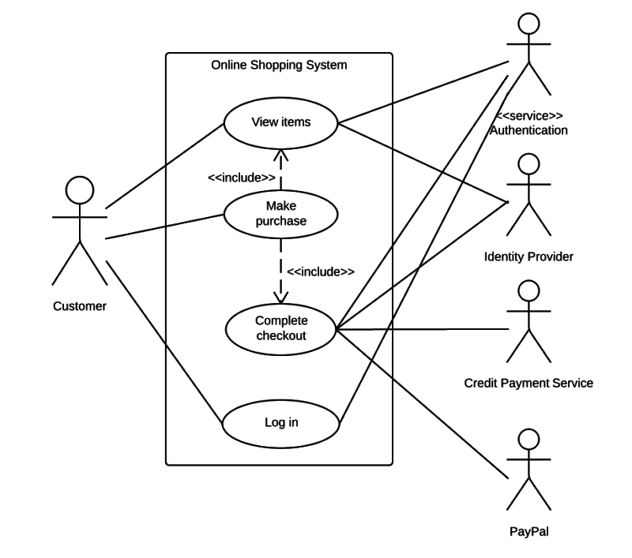
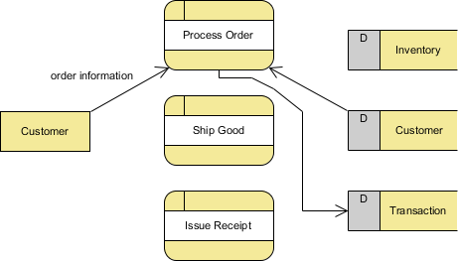
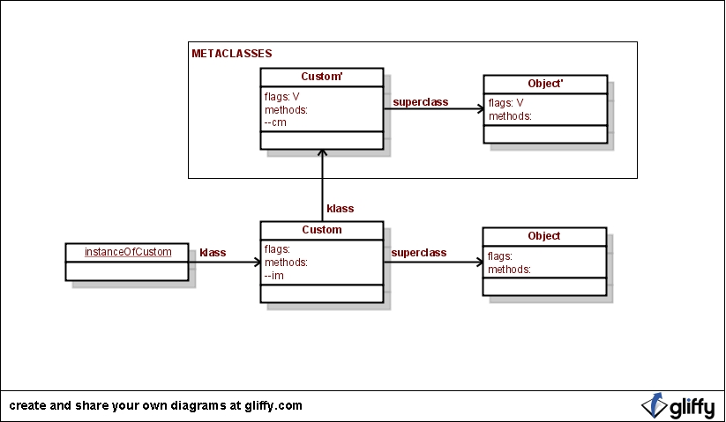
What for?
Overview (cont.)
Data flow diagram
Process specifications
- minispec
Class method (OOP)
Use case
create
Notes:
Vì mỗi phần đặc tả sẽ là một mảnh ghép nhỏ trong toàn bộ đặc tả quy trình của dự án
Được tạo ra để

Slide 5
What for?
Overview (cont.)
Reduce process ambiguity
Obtain a precise description of what is accomplished
Validate the system design
Notes:
Vì mỗi phần đặc tả sẽ là một mảnh ghép nhỏ trong toàn bộ đặc tả quy trình của dự án
Được tạo ra để

Slide 6
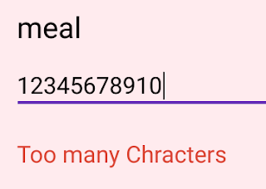
What don’t require specifications?
Overview (cont.)
Physical input / output
Read / write ( ~ get / set in Class Diagram)
Simple data validation
Process using written code
~ libraries
(are either purchased / free)
Notes:
Vì mỗi phần đặc tả sẽ là một mảnh ghép nhỏ trong toàn bộ đặc tả quy trình của dự án
Được tạo ra để

Slide 7
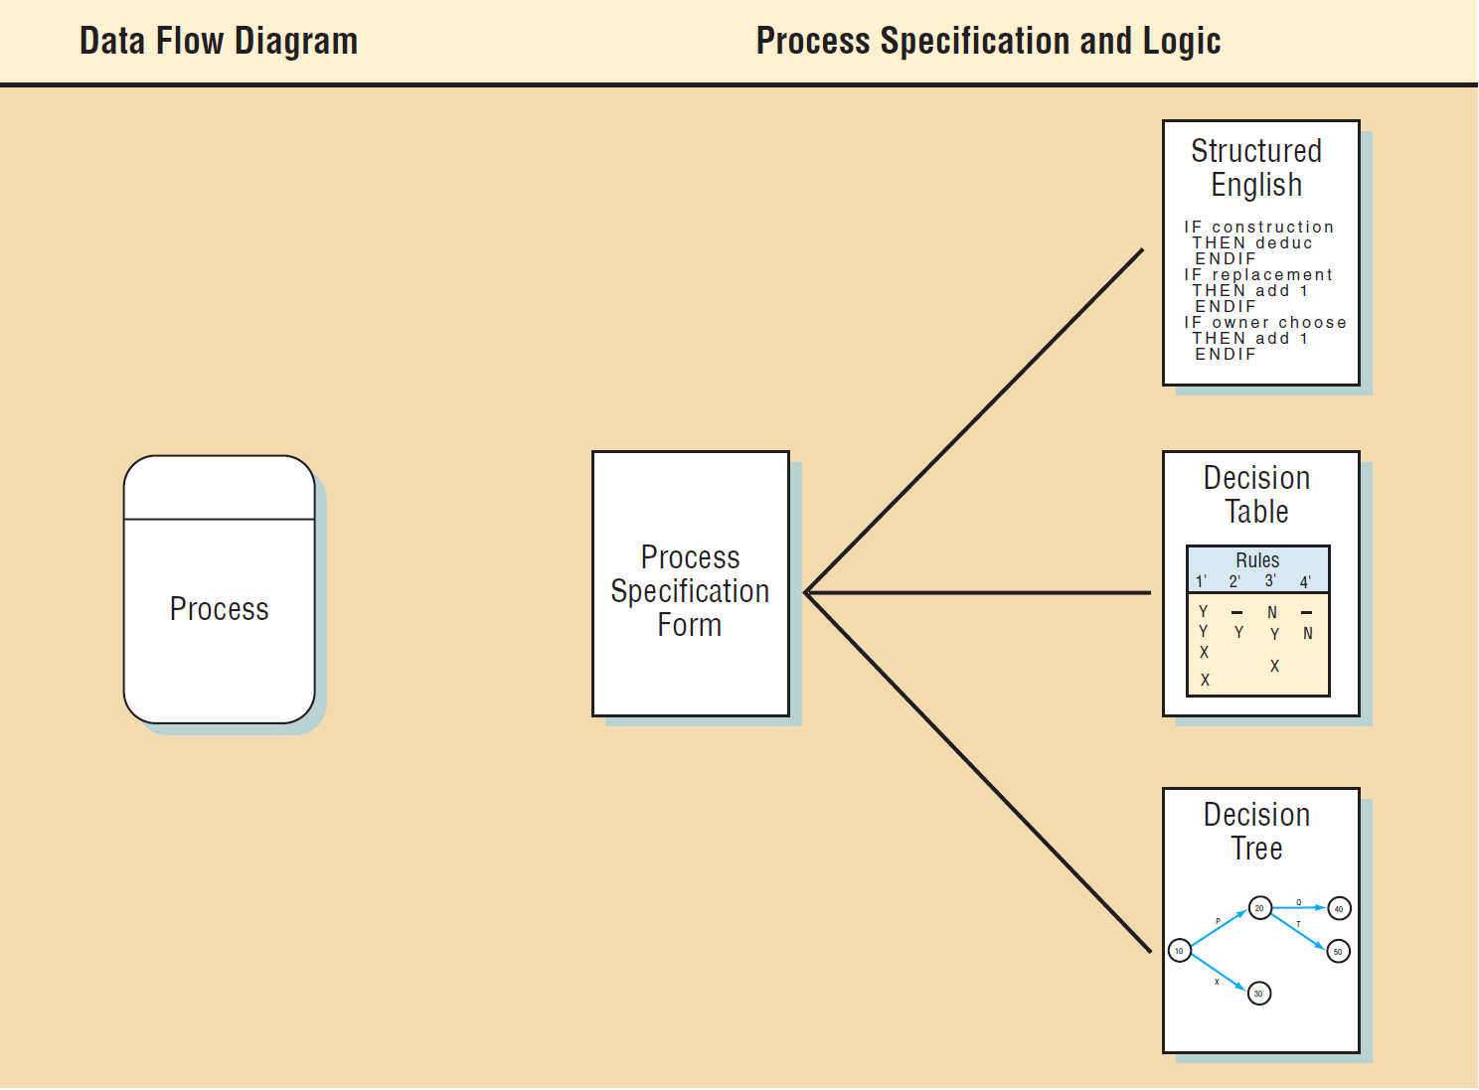
Process Specifications Format
Process specifcations link a process to a data ﬂow diagram,
and hence a data dictionary

Slide 8
Process Specifications Format (cont)
Includes:
The process number
The process name
Description of what the process accomplishes
A list of input data flow
Output data flows
Type of process
Uses prewritten code
Process logic description
Logic method reference
List any unresolved issues

Slide 9
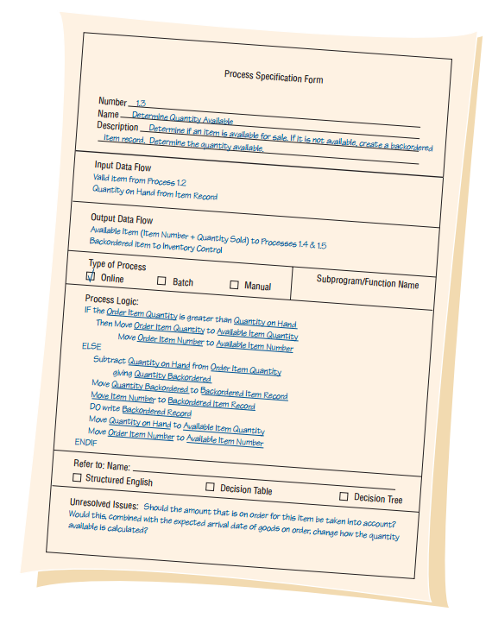
Process Specifications Format (cont)
Includes:
The process number
The process name
Description of what the process accomplishes
A list of input data flow
Output data flows
Type of process
Uses prewritten code
Process logic description
Logic method reference
List any unresolved issues

Slide 10
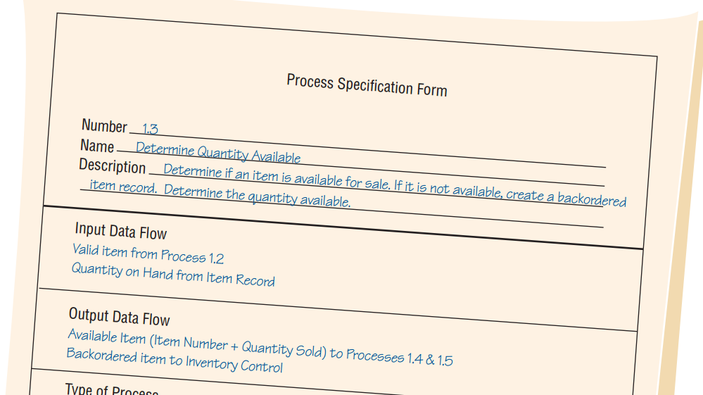
Process Specifications Format (cont)
Number: match process ID on data flow diagram
Name: the same with name of process symbol
Description: brief description of accomplishing
Input/Output:
- Using name found in data flow diagram
- Name match with words in data dictionary

Slide 11
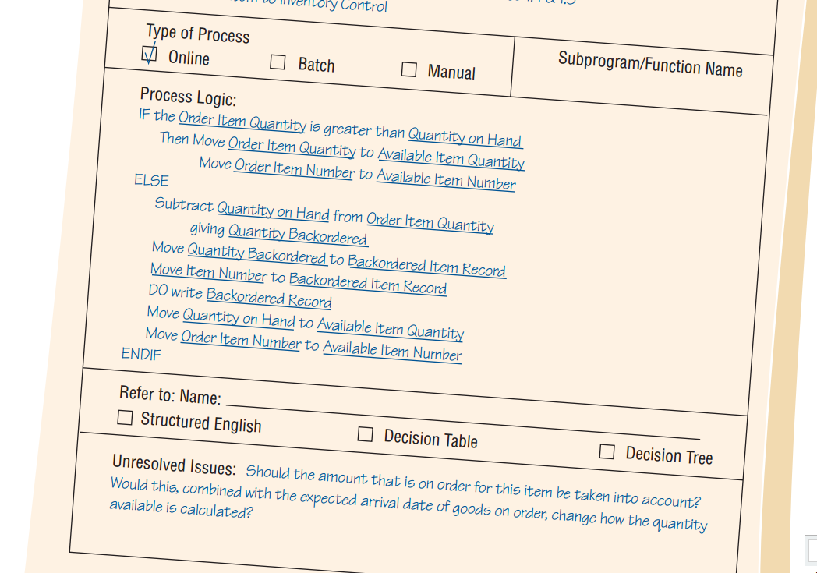
Process Specifications Format (cont)
Type: Online should have screen design; Manual should have step-by-step
Subprogram: <if process uses prewritten code>
Process Logic: business rules in everyday language, not computer language pseudo-code
Refer to:
<if not enough room for process logic>
Unresolved Issues: Issues of above contents. These for next interview with user/expert in team for clearance.

Slide 12
Writing Specifications
Structured English
Decision Table
Decision Tree

Slide 13
Writing Specifications
Structured English
Decision Table
Decision Tree

Slide 14
WRITING: Structured English
When?
process logic involves formulas or iteration, or
when structured decisions are not complex

Slide 15
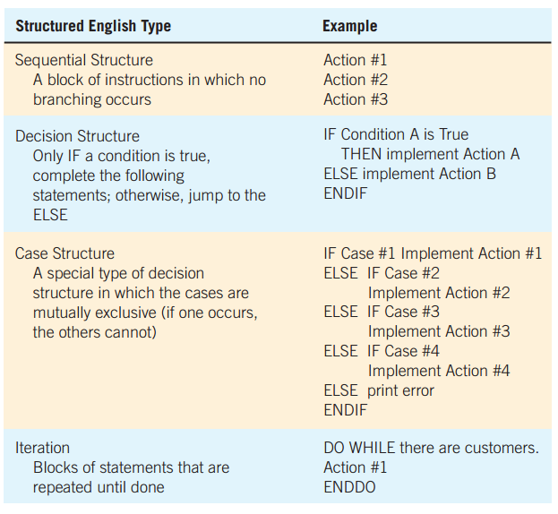
WRITING: Structured English
When?
process logic involves formulas or iteration, or
when structured decisions are not complex

Slide 16
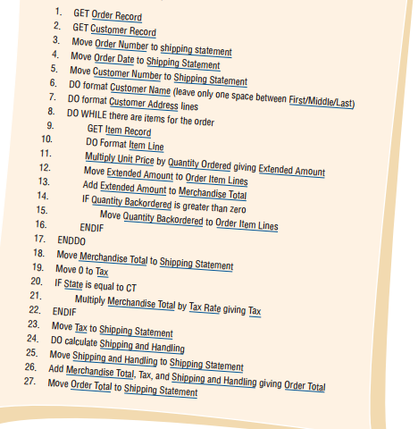
WRITING: Structured English
Example 1
1. Divide into 4 type of logic
2. CAPITALIZE keywords
3. Indent blocks clearly
4. Underline words in data dictionary
5. Clarify logic process, specially in AND and OR
(avoid doing in coding stage)

Slide 17
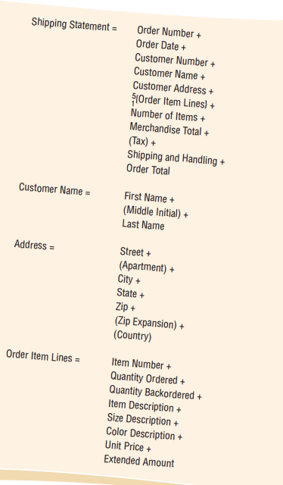
WRITING: Structured English
Example 1

Slide 18
WRITING: Structured English
Example 2
We process all our claims in this manner. First, we determine whether the claimant has ever sent in a claim before; if not, we set up a new record. The claim totals for the year are then updated. Next, we determine if a claimant has policy A or policy B, which differ in deductibles and copayments (the percentage of the claim claimants pay themselves). For both policies, we check to see if the deductible has been met ($100 for policy A and $50 for policy B). If the deductible has not been met, we apply the claim to the deductible. Another step adjusts for the copayment; we subtract the percentage the claimant pays (40 percent for policy A and 60 percent for policy B) from the claim. Then we issue a check if there is money coming to the claimant, print a summary of the transaction, and update our accounts. We do this until all claims for that day are processed.

Slide 19
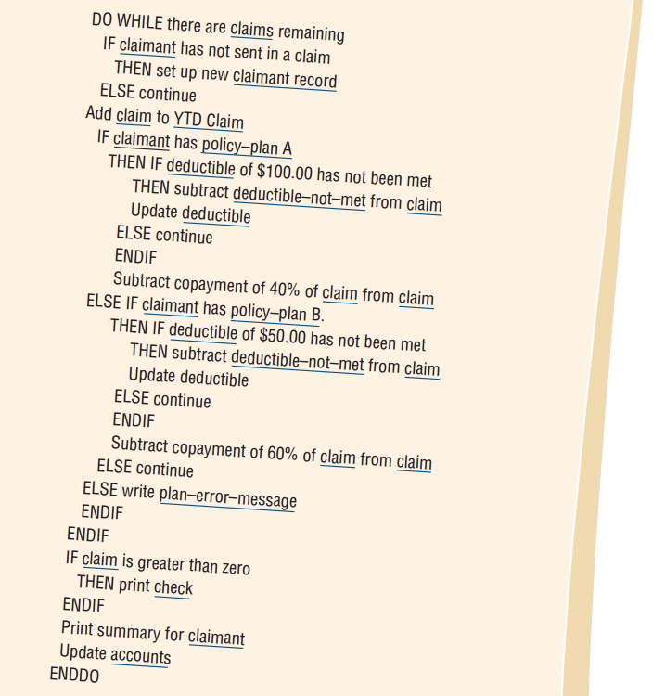
WRITING: Structured English
Example 2

Slide 20
EXERCISE 1
Write Structured English
Clyde’s narrative of the reimbursement policies
“Our reimbursement policies depend on the situation. You see, first we determine if it is a local trip. If it is, we only pay mileage of 18.5 cents a mile. If the trip was a one-day trip, we pay mileage and then check the times of departure and return. To be reimbursed for breakfast, you must leave by 7:00 a.m., lunch by 11:00 a.m., and have dinner by 5:00 p.m. To receive reimbursement for breakfast, you must return later than 10:00 a.m., lunch later than 2:00 p.m., and have dinner by 7:00 p.m. On a trip lasting more than one day, we allow hotel, taxi, and airfare, as well as meal allowances. The same times apply for meal expenses.”

Slide 21
Writing Specifications
Structured English
Decision Table
Decision Tree

Slide 22
WRITING: Decision Table
When?
Action depends on set of state of pre-defined of rules.
These number of state is small (2 – 3), easy to manage

Slide 23
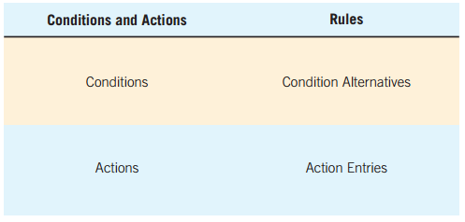
WRITING: Decision Table
How?

Slide 24
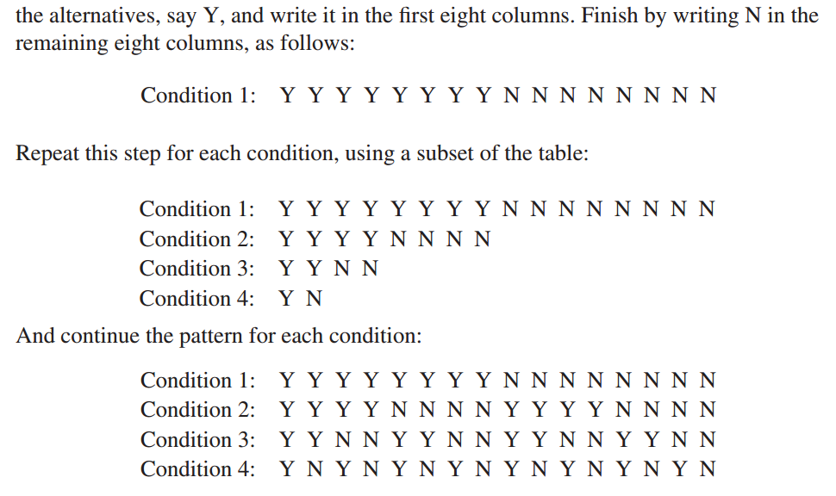
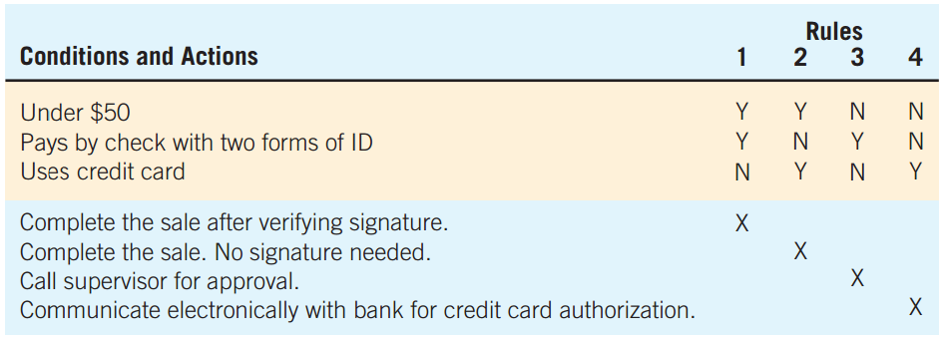
WRITING: Decision Table
How?
Notes:
Lưu ý khi bắt đầu điền ô II, nên bắt đầu theo kiểu

Slide 25
WRITING: Decision Table
Example
The managers realize that certain loyal customers order from every catalog and that some people on the mailing list never order. These ordering patterns are easy to observe, but deciding which catalogs to send customers who order only from selected catalogs is more diffcult.
Once these decisions are made, a decision table is constructed for three conditions (C1: customer ordered from Fall catalog;
C2: customer ordered from Christmas catalog; and
C3: customer ordered from specialty catalog), each having two alternatives (Y or N).
Three actions can be taken (A1: send out this year’s Christmas catalog; A2: send out the new specialty catalog; and A3: send out both catalogs).
Notes:
Lưu ý khi bắt đầu điền ô II, nên bắt đầu theo kiểu

Slide 26
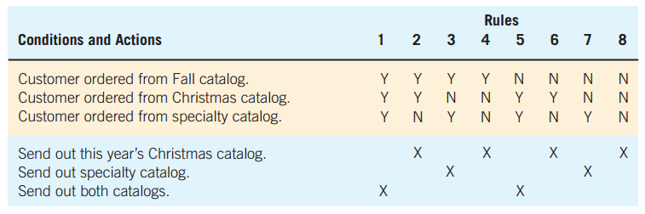
WRITING: Decision Table
Example
Notes:
Lưu ý khi bắt đầu điền ô II, nên bắt đầu theo kiểu

Slide 27
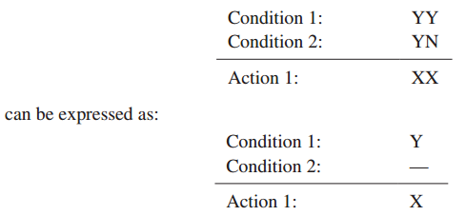
WRITING: Decision Table
Example
Notes:
Lưu ý khi bắt đầu điền ô II, nên bắt đầu theo kiểu

Slide 28
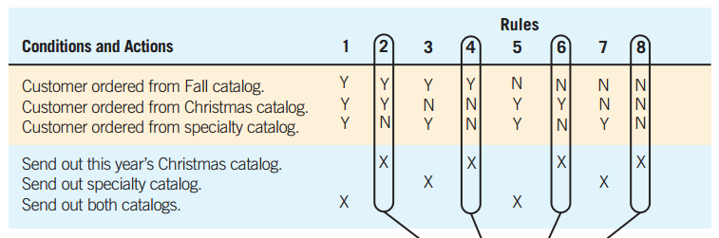
WRITING: Decision Table
Example
Notes:
Lưu ý khi bắt đầu điền ô II, nên bắt đầu theo kiểu

Slide 29
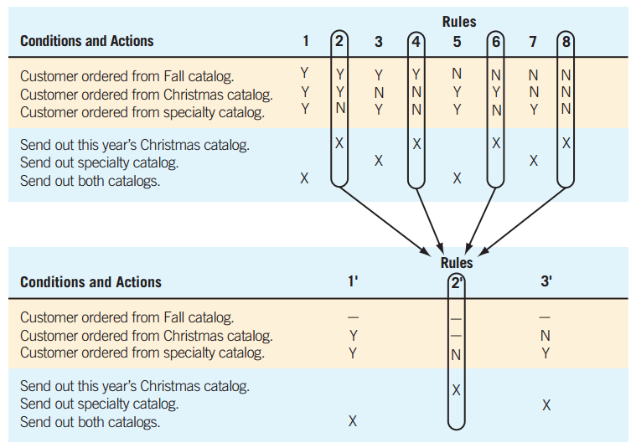
WRITING: Decision Table
Example
Checking for Redundancy

Slide 30
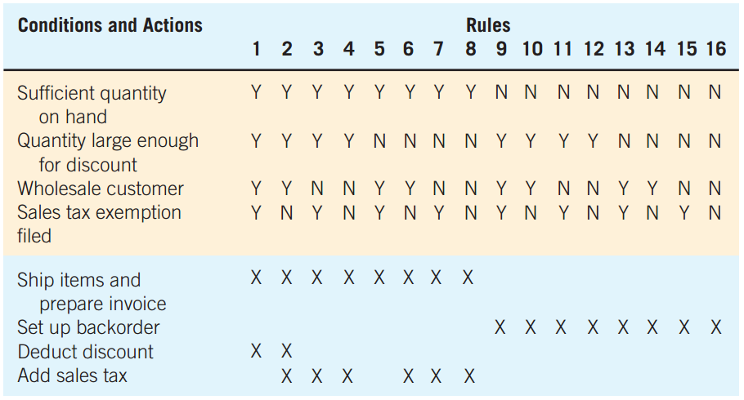
EXERCISE 2
Reduce Decision table below
to the minimum numbers of rules

Slide 31
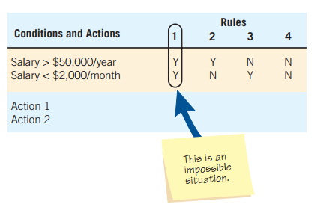
WRITING: Decision Table
When complex branching occurs in a structured decision process:
Then?

Slide 32
Writing Specifications
Structured English
Decision Table
Decision Tree

Slide 33
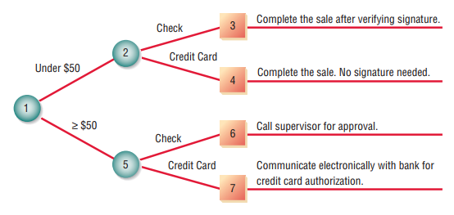
WRITING: Decision Tree
Useful to keep a string of decisions in a particular sequence
Building from left to right
Unlike the decision tree used in management science
Notes:
Although the decision tree derives its name from natural trees, decision trees are most often drawn on their side, with the root of the tree on the left side of the paper; from there, the tree branches out to the right. This orientation allows the analyst to write on the branches to describe conditions and actions
the analyst’s tree does not contain probabilities and outcomes. In systems analysis, trees are used mainly for identifying and organizing conditions and actions in a completely structured decision process.

Slide 34


WRITING: Decision Tree
Drawing Decision Trees
: indicate an action: THEN
: represent a condition: IF
Identify all conditions and actions and their order and timing
Building from left to right, list all possible alternatives
Notes:
When decision tables were discussed in an earlier section, a point-of-sale example was used to determine the purchase approval actions for a department store. Conditions included the amount of the sale (under $50) and whether the customer paid by check or credit card. The four actions possible were to:
complete the sale after verifying the signature;
complete the sale with no signature needed;
call the supervisor for approval;
or communicate electronically with the bank for credit card authorization
How
1. Identify all conditions and actions and their order and timing (if they are critical).
2. Begin building the tree from left to right, making sure you list all possible alternatives before moving to the right.
Cây đơn giản này là đối xứng, và bốn hành động ở cuối là duy nhất. Cây không cần phải đối xứng. Hầu hết các cây quyết định có điều kiện có một số lượng chi nhánh khác nhau.
Ngoài ra, các hành động giống nhau có thể xuất hiện nhiều lần.

Slide 35
WRITING: Decision Tree
Advantages
The order of checking conditions and executing actions is immediately noticeable
Conditions and actions of decision trees are found on some branches but not on others
Compared with decision tables, decision trees are more readily understood by others in an organization
Notes:
First, it takes advantage of the sequential structure of decision tree branches
Second, in contrast, with decision tables, conditions and actions are all part of the same table. Conditions and actions that are critical are connected directly to other conditions and actions, whereas conditions that do not matter are absent. In other words, the tree does not have to be symmetrical.
Thứ hai, điều kiện và hành động của cây quyết định được tìm thấy ở một số nhánh nhưng không có ở những nơi khác; ngược lại, với các bảng quyết định, điều kiện và hành động đều là một phần của cùng một bảng. Các điều kiện và hành động quan trọng được kết nối trực tiếp với các điều kiện và hành động khác, trong khi các điều kiện không quan trọng là vắng mặt. Nói cách khác, cây không cần phải đối xứng.
Third, consequently, they are more appropriate as a communication tool: Do đó, chúng thích hợp hơn như một công cụ truyền thông.

Slide 36
EXERCISE 3
Develop a decision tree for Exercise 2

Slide 37
Choosing a Structured Decision Analysis
Way to choose one of the three techniques:
1. Use structured English when
a. There are many repetitious actions,
OR
b. Communication to end users is important.
2. Use decision tables when
a. Complex combinations of conditions, actions, and rules are found,
OR
b. You require a method that effectively avoids impossible situations,
redundancies, and contradictions.
3. Use decision trees when
a. The sequence of conditions and actions is critical,
OR
b. When not every condition is relevant to every action (the branches are different).
Notes:
We have examined the three techniques for analysis of structured decisions: structured English, decision tables, and decision trees. Although they need not be used exclusively, it is customary
to choose one analysis technique for a decision rather than employing all three. The following guidelines provide you with a way to choose one of the three techniques for a particular case:

Slide 38
SUMMARY
Specifications
Process specifications
Decision Analysis
  Structured English: Logic is expressed in sequential structures, decision structures, case structures, or iterations
  Decision tables: Four quadrants are used to:
      Describe the conditions
      Identify possible decision alternatives,
      Indicate which actions should be performed,
      Describe the actions
  Decision trees: Consists of nodes and branches

Slide 39
SUMMARY
Decision Analysis Advantages
Structured English is useful when many actions are repeated and when communicating with others is important
Decision tables provide complete analysis of complex situations while limiting the need for change attributable to impossible situations, redundancies, or contradictions
Decision trees are important when proper sequencing of conditions and actions is critical and when each condition is not relevant to each action

