Slide 1

HUMAN COMPUTER INTERFACE
From Systems Analysis and Design, 7e
Kendall & Kendall

Slide 2
Understanding HCI
Dialog design
Feedback
Queries
Usability
User interfaces
Abstract
HUMAN
COMPUTER
INTERFACE

Slide 3
0. abstract
⇦
Design and use of computer technology, focused on the interfaces between people (users) and computers

Slide 4
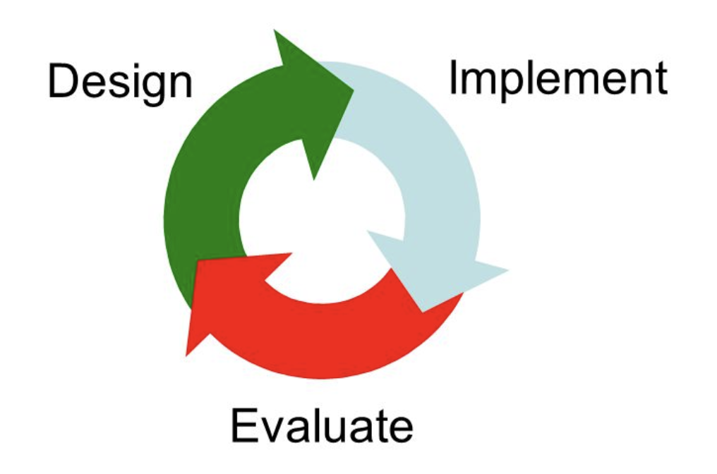
⇦

Slide 5
⇦
Prototyping
People and Computers
The areas of HCL
The evolution of HCL
HCI and UI/UX
How to do?

Slide 6
0.1. PROTOTYPING
⇦
What are prototypes prototyping?
Feel: What might it look like?
Implementation: What might it work like?
Role: What might the experience be like?

Slide 7
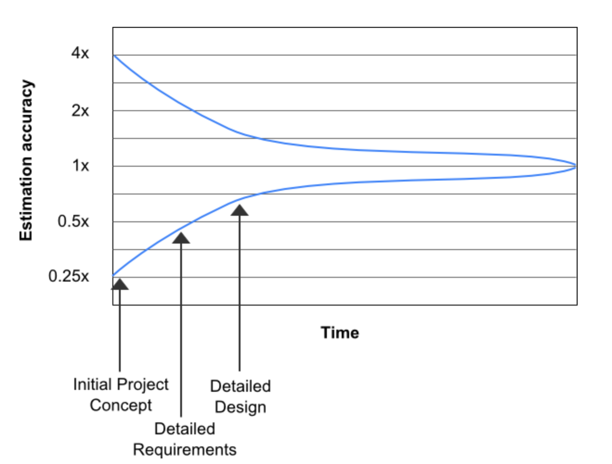
⇦
The cone of uncertainty shows the best case accuracy of estimates made at different times in the projects life

Slide 8
0.1. PROTOTYPING
⇦
Researchers in the field of HCI both observe the ways in which humans interact with computers and design technologies that let humans interact with computers in novel ways

Slide 9
0.2. PEOPLE AND COMPUTERS
⇦
What is people (human)?
- (hard to concisely say - human factors of computers (system) - psychology, behaviors)
What is computers?
- (computing - computer software and hardware mechanisms to support human–computer interaction)

Slide 10
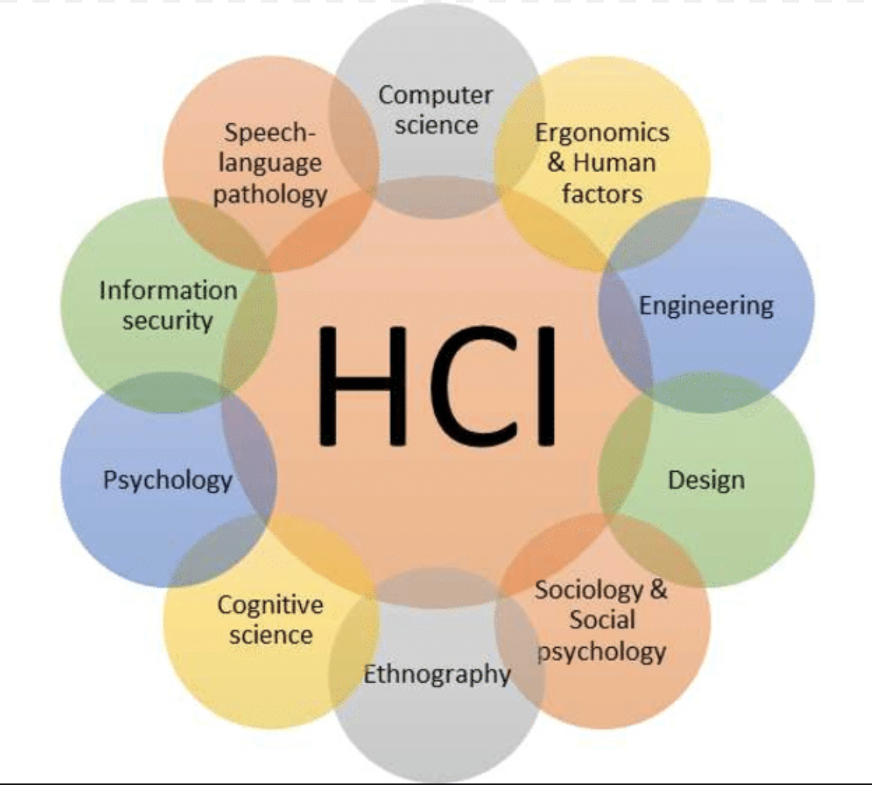
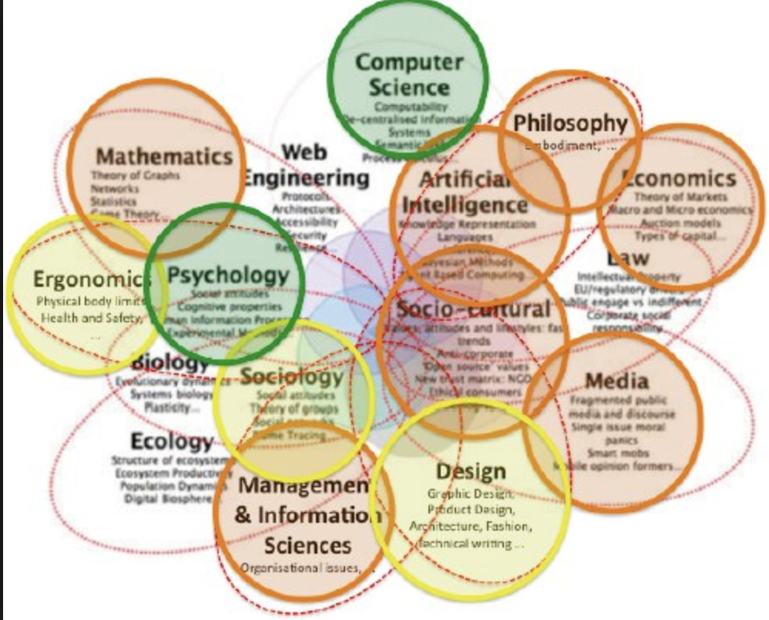
0.3. The areas of hci
⇦

Slide 11
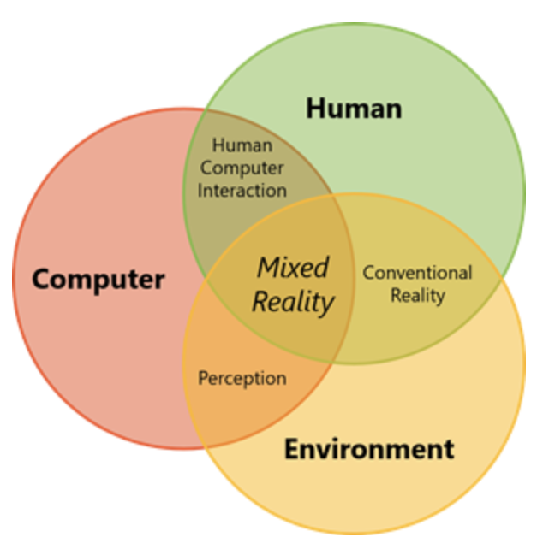
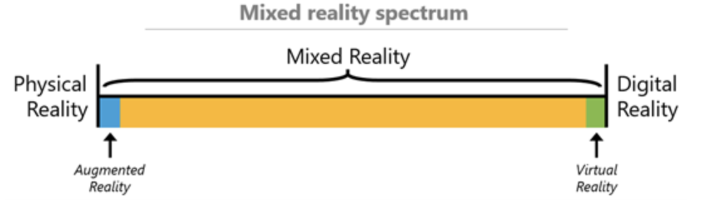

0.4. THE EVOLUTION OF HCI
⇦

Slide 12
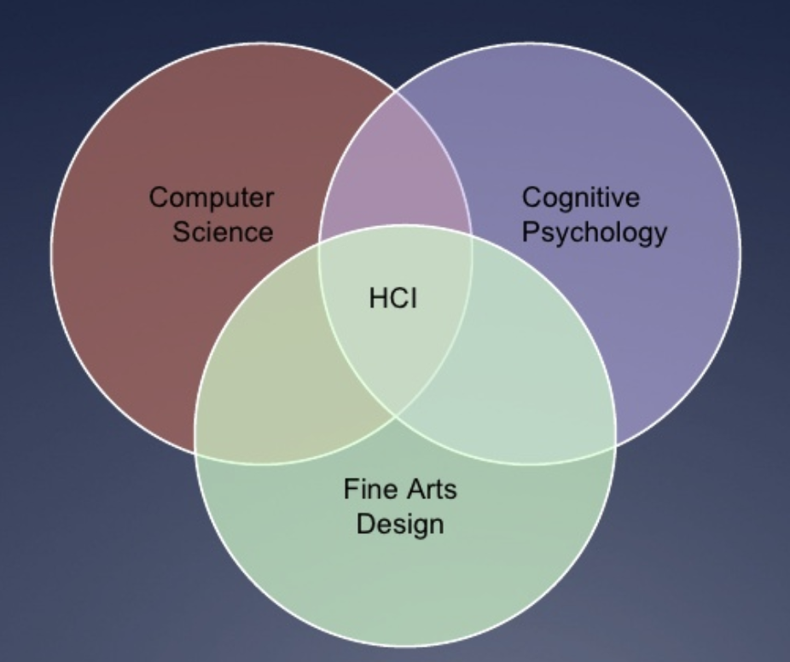
⇦
The simplest map of HCI

Slide 13
0.5. HCI AND UI/UX (USER INTERFACE,
USER EXPERIENCE)
⇦
If you have HCI on your resume you're most likely a user researcher.
who studies users motivations, barriers and circumstances to better understand how to solve their problems.
Their output generally takes the form of a report
with some findings.

Slide 14
0.5. HCI AND UI/UX (USER INTERFACE,
USER EXPERIENCE)
⇦
If you have UX on your resume you're more likely closer to a interface designer than a researcher.
They tend to take inputs from researchers, product managers, analysts, and the market to functionally solve the problems.
Their output can vary from wireframes to fully functioning visual prototypes.
> Segmentation (visual designer, UI designer and
interaction designer)

Slide 15
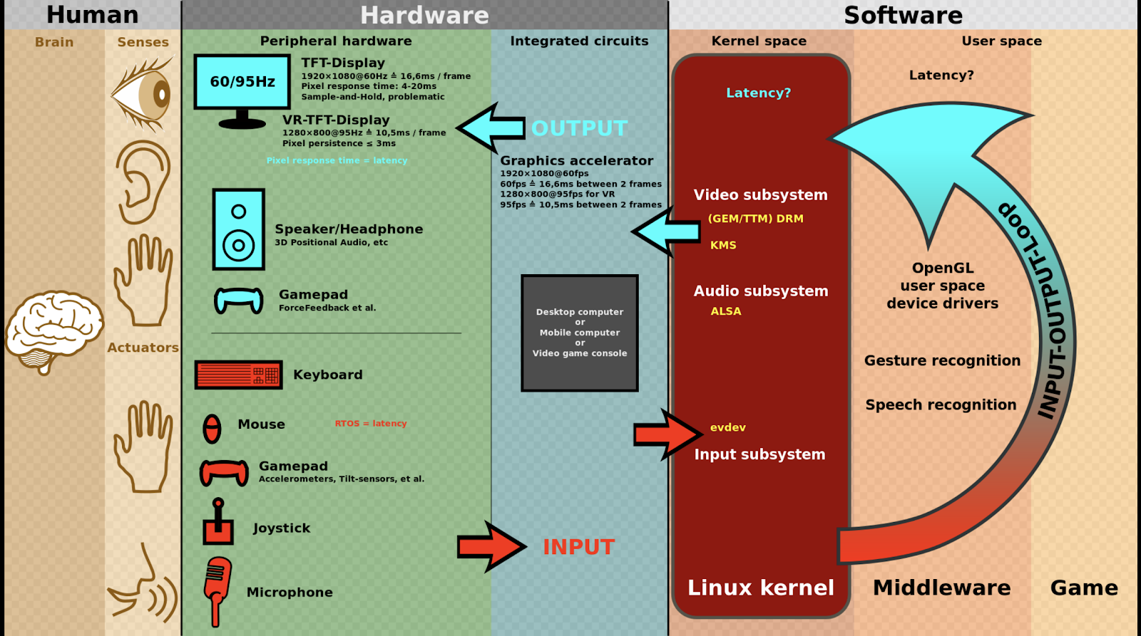
0.6. How to do?
⇦
Researchers in the field of HCI both observe the ways in which humans interact with computers and design technologies that let humans interact with computers in novel ways
The user interacts directly with hardware for the human input and output such as displays, e.g. through a graphical user interface. The user interacts with the computer over this software interface using the given input and output (I/O) hardware.
Software and hardware must be matched, so that the processing of the user input is fast enough, the latency of the computer output is not disruptive to the workflow.

Slide 16
1. UNDERSTANDING HCI
⇦
Knowledge about the interplay among users, tasks, task contexts, IT, and the environments in which the systems are used comprises the basis of human-computer interaction.
How fits affects performance and well-being
TAM (Technology Appearance Model)

Slide 17
1.1. how fits affects performance and well-being
⇦
Task
Performance
Well-being
Fit

Slide 18
1.1.2. Task
⇦
Complex tasks that require human, system, and task interaction are supported by ecommerce and Web systems, ERP systems, and wireless systems inside and outside of the organization
Can be structured and routine or ill-defined and without apparent structure

Slide 19
1.1.3. Performance
⇦
A combination of the efficiency involved in performing a task and the quality of the work that is produced by the task

Slide 20
1.1.4. Well-Being
⇦
Concern for a human’s overall comfort, safety, and health
Psychological attitudes are also important

Slide 21
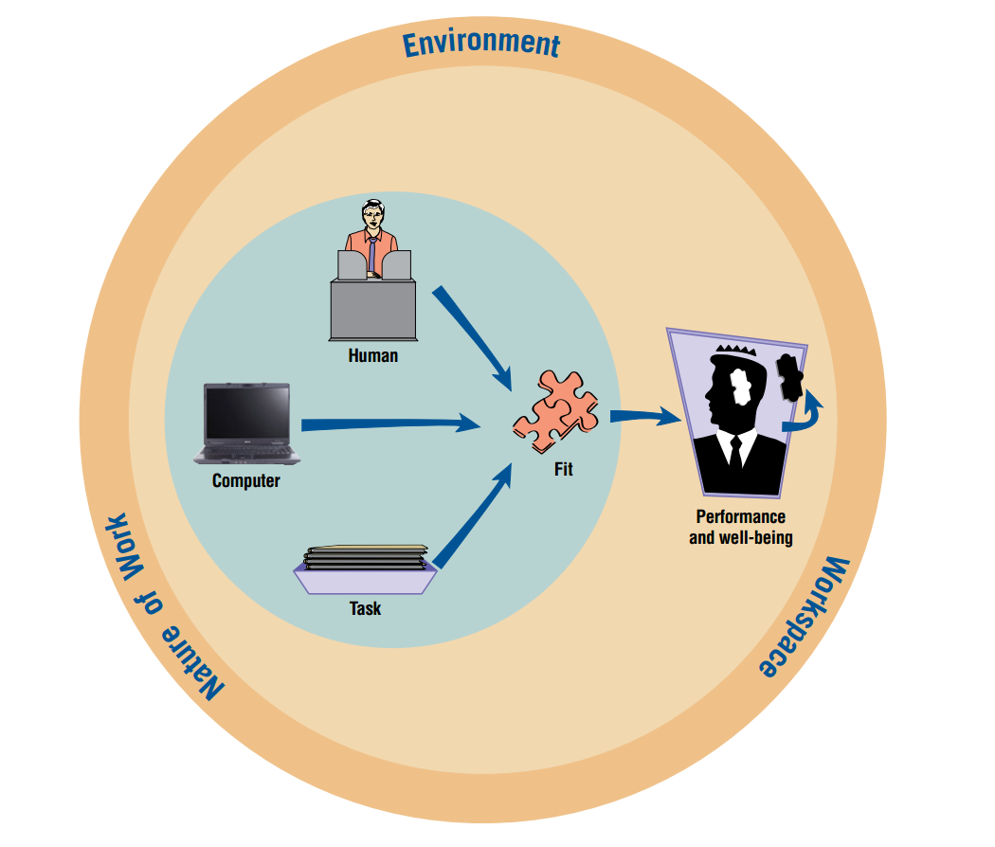
1.1.1 FIT
⇦
The “fit” between the HCI elements of the human, the computer, and the task needs to be performed leads to performance and well-being

Slide 22
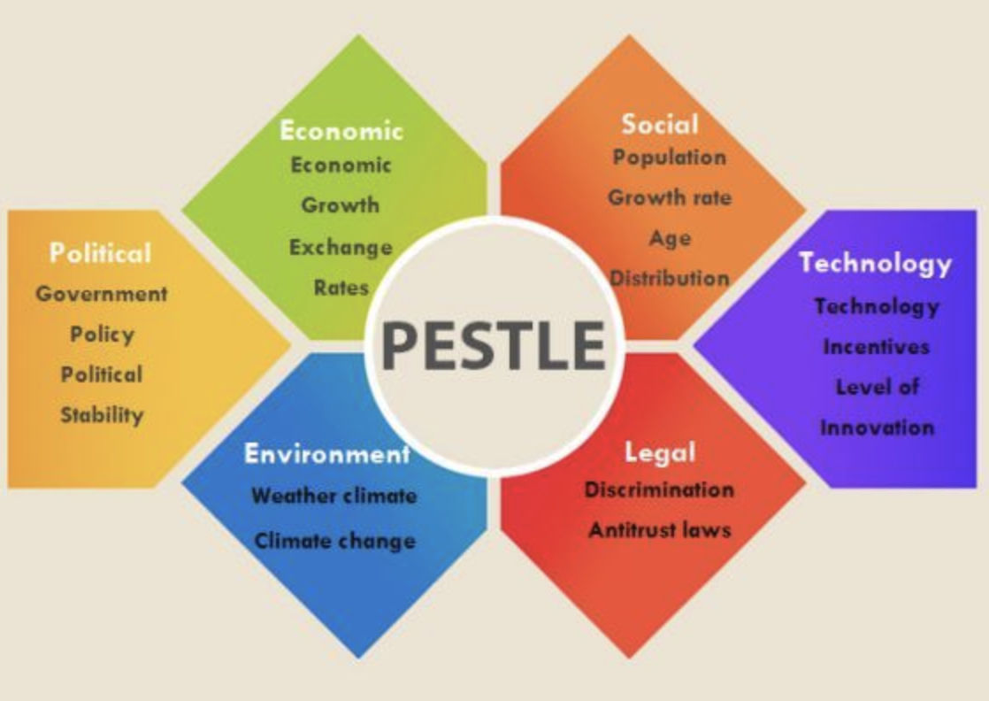
1.1.1 FIT
⇦
PEST and PESTLE Analysis

Slide 23
1.2. TAM (TECHNOLOGY APPEARANCE MODEL)
⇦
An information system theory that models how users come to accept and use a technology, suggests that when users are presented with a new technology, a number of factors influence their decision about how and when they will use it.

Slide 24
1.2. TAM (TECHNOLOGY APPEARANCE MODEL)
⇦
Originated in Theory of Reasoned Action
(TRA - socio-psychology, attitude <-> PU,PEOU)
Some improved versions and alternative models: TAM 2, TAM 3, UTAUT, MPT, HMSAM

Slide 25
1.2. TAM (TECHNOLOGY APPEARANCE MODEL)
⇦
Perceived usefulness (PU) –
This was defined by Fred Davis as
"the degree to which a person believes that using a particular system would enhance
his or her job performance ".

Slide 26
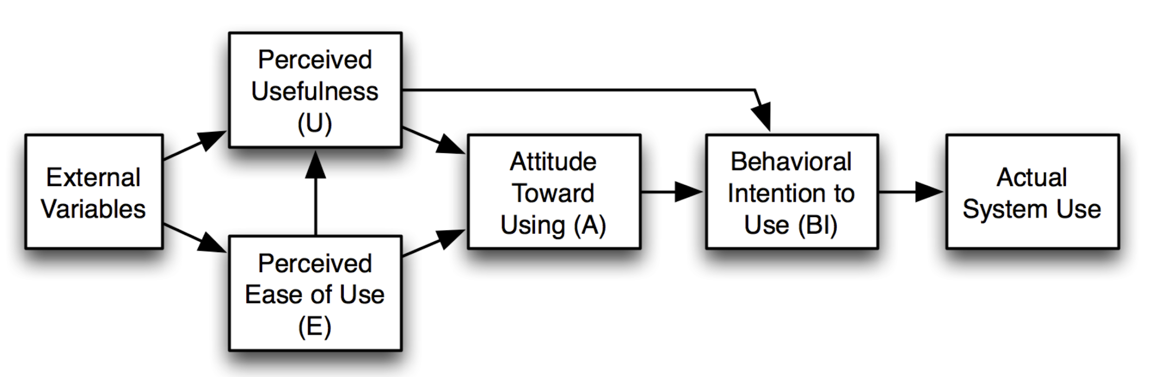
1.2. TAM (TECHNOLOGY APPEARANCE MODEL)
⇦
Perceived ease-of-use (PEOU) –
Davis defined this as "the degree to which
a person believes that using a particular system would be free from effort" (Davis 1989).
The Technology Acceptance Model, version 1. (Davis, Bagozzi & Warshaw 1989)

Slide 27
2. USABILITY
⇦
“A way for designers to evaluate the systems and interfaces they create with an eye toward addressing as many HCI concerns as thoroughly possible”
STANDARD
HEURISTICS
Notes:
The standards cover the use of the product (effectiveness, efficiency and satisfaction), user interface and interaction, the process used to develop the product…
Heuristics (rules of thumbs) include visibility of system status, match between the system and the real world, user control and freedom, consistency and standards, error prevention …

Slide 28
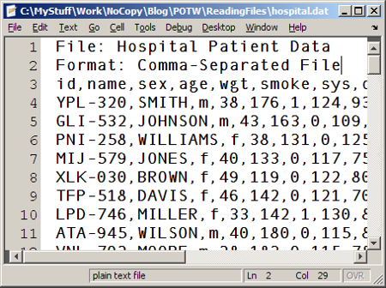
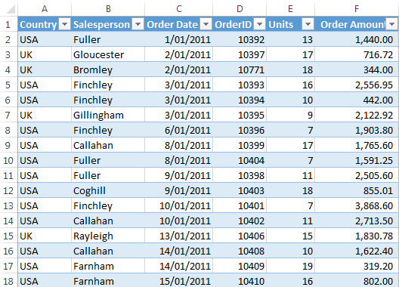
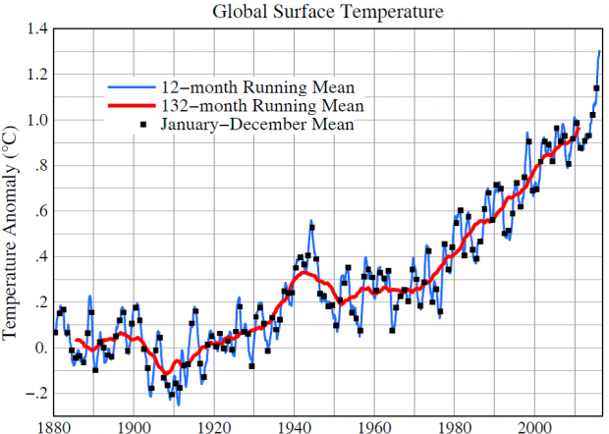
2.1. Designing for cognitive styles of individual users
⇦
TEXT
Data are made available in different forms.
TABLE
GRAPH

Slide 29
2.1. Designing for cognitive styles of individual users
⇦
PIVOT TABLE
Gives users greater control over how they look at data

Slide 30
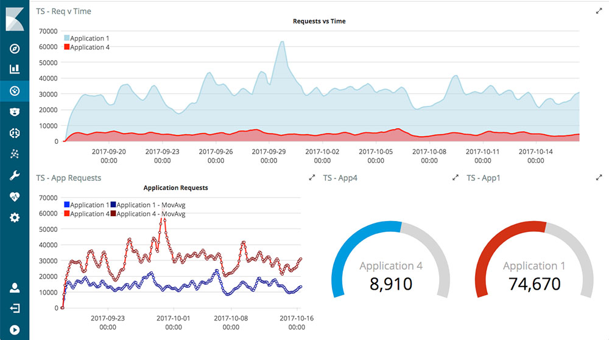
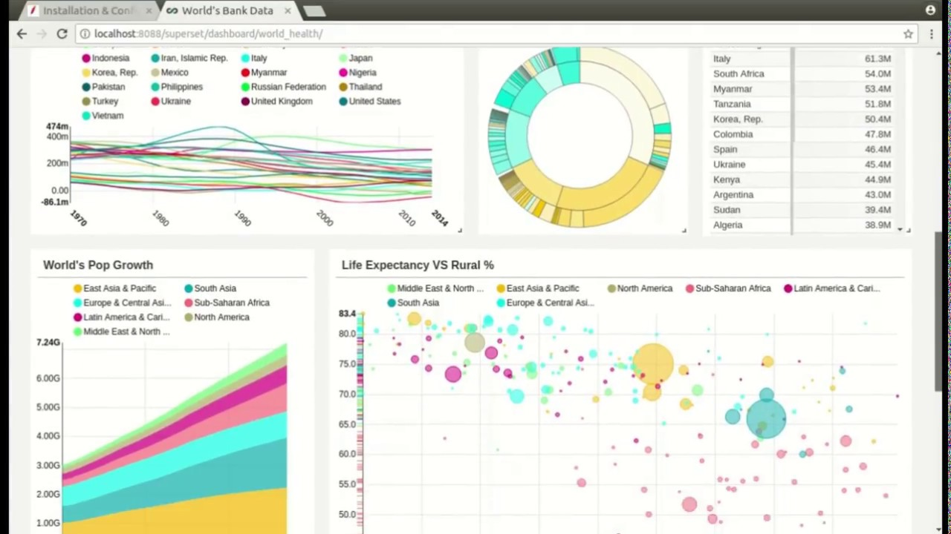
2.1. Designing for cognitive styles of individual users
⇦
VISUAL ANALYSIS OF DATABASES
Support visual thinking
Extend the user’s cognitive capabilities
Notes:
-> Increase the changes of making an appropriate decision

Slide 31
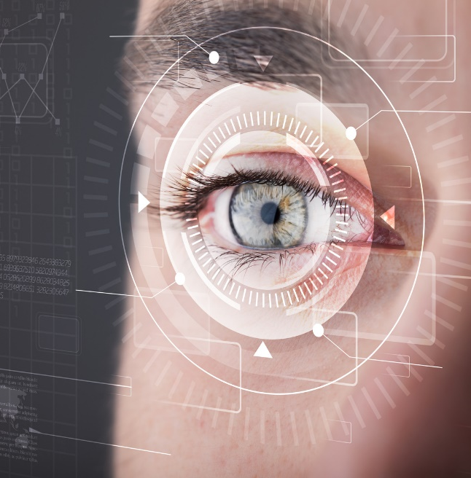
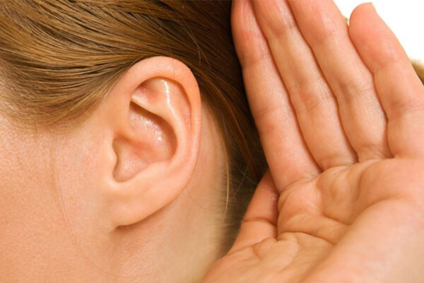

2.2. Physical considerations in HCI design
⇦
VISION
HEARING
TOUCH

Slide 32
2.3. CONSIDERING HUMAN LIMITATIONS, DISABILITIES AND DESIGN
⇦
VISION
HEARING
TOUCH
RECORDS
Physical or mental impairment
REGARDED

Slide 33
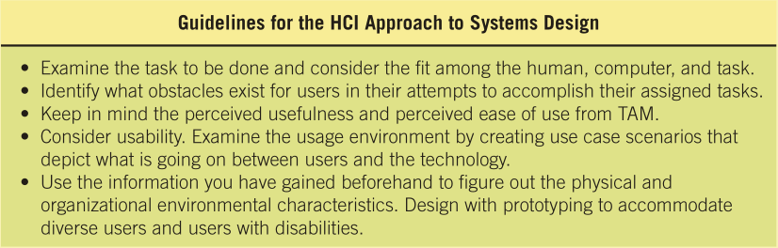
2.4. Physical considerations in HCI design
⇦

Slide 34
2.4. Physical considerations in HCI design
⇦
Match the UI to the task
Make the UI efficient
Provide appropriate feedback to users
Generate usable queries
Improve productivity of computer users

Slide 35
3. UI (USER INTERFACE)
⇦
Natural-language interfaces
Question-and-answer interfaces
Menus
Form-fill interfaces
Command-language interfaces
Graphical User Interfaces (GUIs)
Other user interfaces

Slide 36
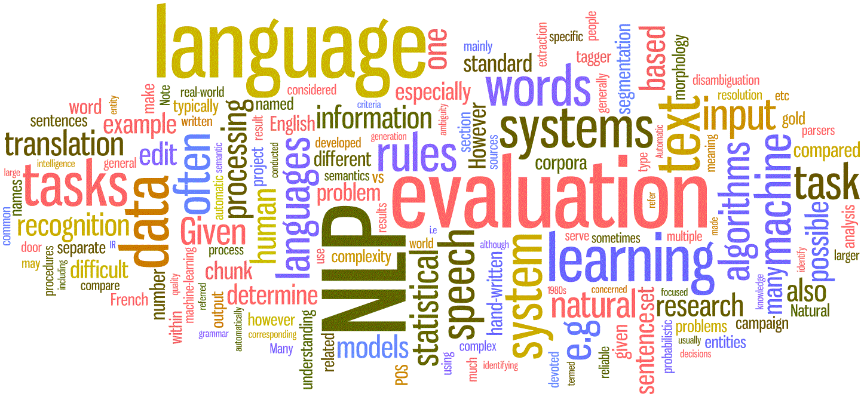
3.1. NATURAL-LANGUAGE INTERFACE
⇦
☺ Interact with the computer in “natural” language
!!! Implementation problem
!!! Extraordinary demand on computing resources

Slide 37

3.2. Q&A INTERFACE
⇦
☺ Users unfamiliar with applications may find Q&A interfaces most comfortable
!!! Computer displays questions and user answers
!!! Computer acts on each input

Slide 38
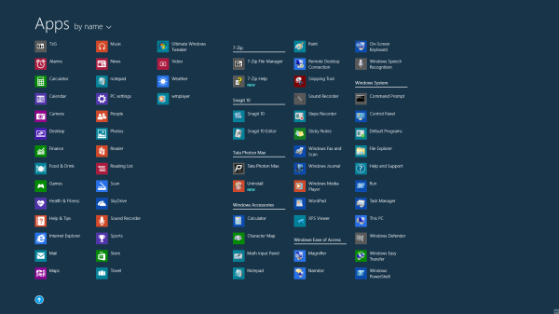
3.3.MENUS
⇦
☺ Provides an onscreen list of available selections
!!! NOT hardware dependent
!!! Can be put aside and nested

Slide 39
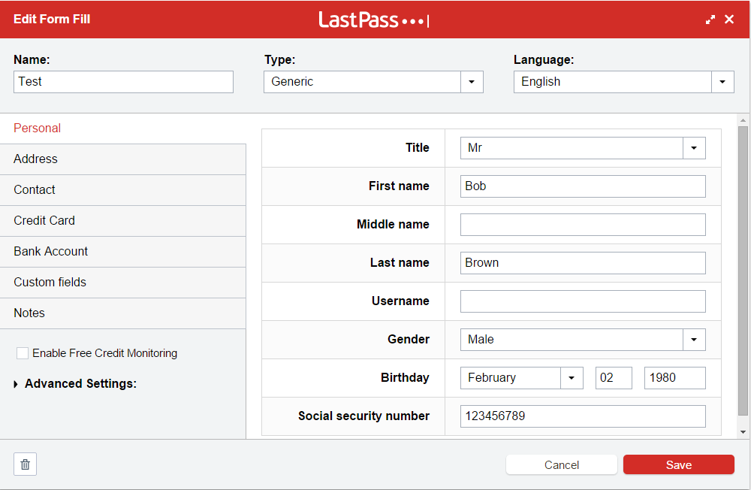
3.4. FORM-FILL INTERFACE
⇦
☺ Displaying fields containing data items or parameters
!!! Provides excellent documentation
!!! Users experienced with the system or application may become impatient

Slide 40
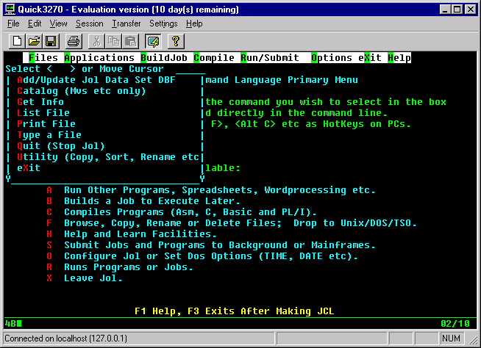
3.5. COMMAND-LANGUAGE INTERFACE
⇦
☺ Control the application with a series of keystrokes, commands, phrases, or some sequence of these
!!! More flexibility and control
!!! Obstacles for inexperienced users

Slide 41
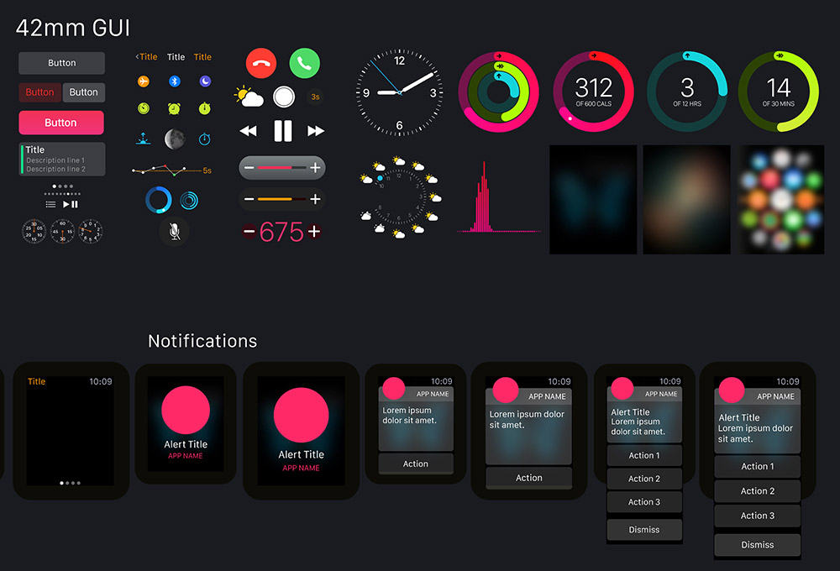
3.6. GRAPHICAL USER INTERFACE
⇦
☺ Provide users constant feedback on task accomplishment
!!! NOT hardware dependent
!!! Appropriate model of reality or an acceptable conceptual model

Slide 42
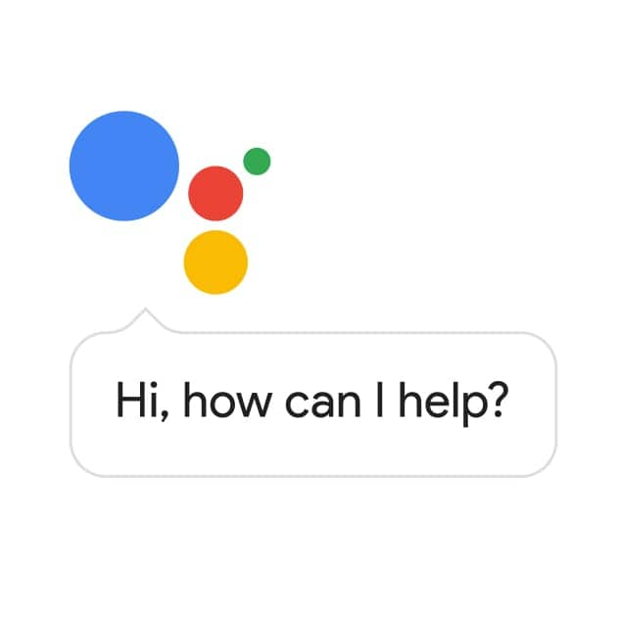
3.7. OTHER USER INTERFACE
⇦
☺ Pointing devices
☺ Touch-sensitive screens
!!! Speech recognition and synthesis ⇨ recognize an individual’s vocal signals, convert them, and store the input – SPEED DATA ENTRY
Notes:
Speech recognition and synthesis
User hands free

Slide 43
4. Guidelines for Dialog Design
⇦
1. Meaningful communication
2. Minimal user action
3. Standard operation and consistency

Slide 44
4.1 Meaningful Communication
⇦
☺ The system should present information clearly to the user
☺ Users with less skill with a computer require more communication
☺ Easy to use help screens

Slide 45
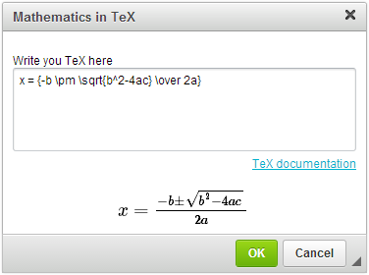
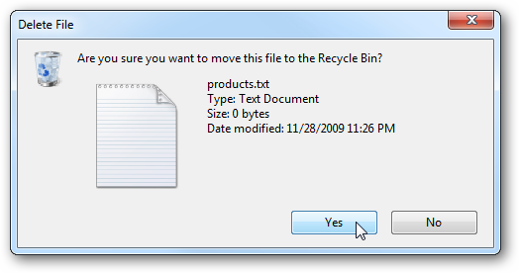
4.1 Meaningful Communication
⇦

Slide 46
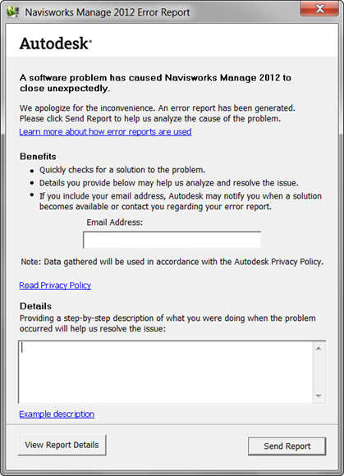
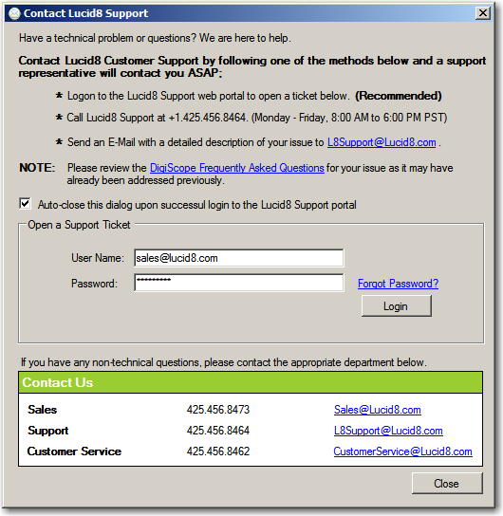
4.1 Meaningful Communication
⇦

Slide 47
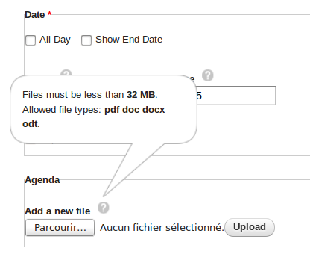
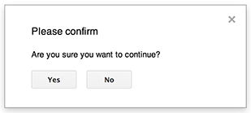
4.1 Meaningful Communication
⇦

Slide 48
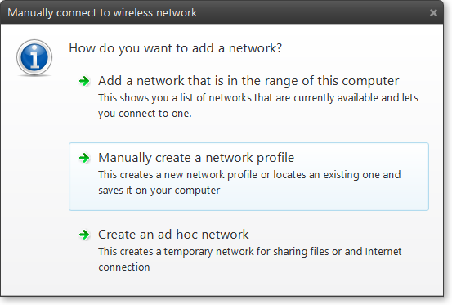
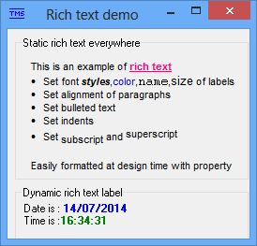
4.1 Meaningful Communication
⇦

Slide 49
4.2 Minimal User Action
⇦
☺ Keying codes instead of whole words
☺ Entering data that are not already stored on files
☺ Supplying the editing characters
☺ Using default values for fields on entry screens
☺ Designing an inquiry, change, or delete program so that the user needs to enter only the first few characters of a name or item description

Slide 50
4.2 Minimal User Action
⇦
☺ Providing keystrokes for selecting pull-down menu options
☺ Use radio buttons and drop-down lists to control displays of new Web pages or to change Web forms
☺ Provide cursor control for Web forms and other displays so the cursor moves to the next field when the right number of characters has been entered

Slide 51
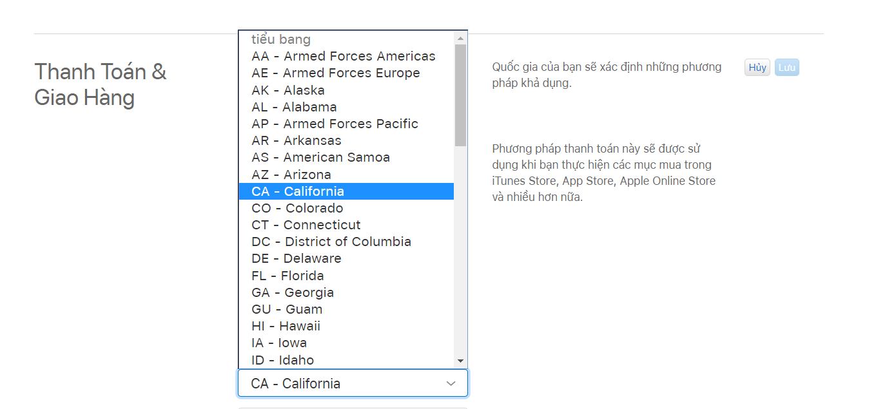
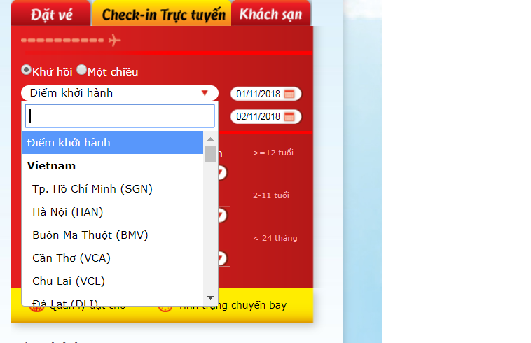
4.2 Minimal User Action
⇦
☺ Keying codes instead of whole words

Slide 52
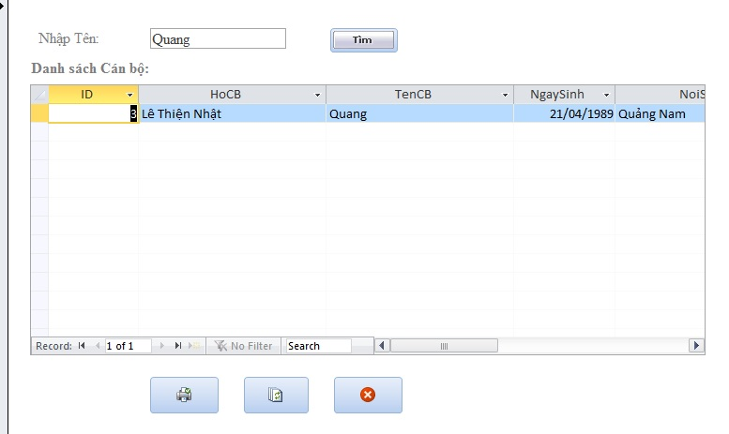
4.2 Minimal User Action
⇦
☺ Entering data that are not already stored on files

Slide 53
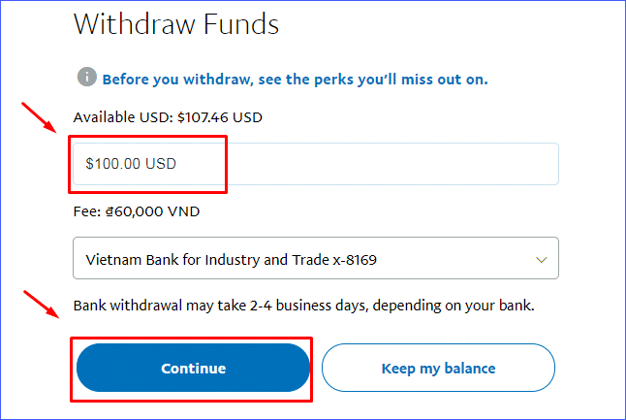
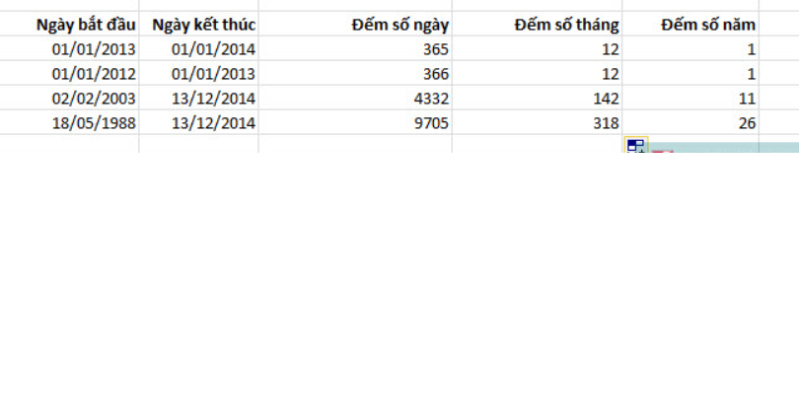
4.2 Minimal User Action
⇦
☺ Supplying the editing characters

Slide 54
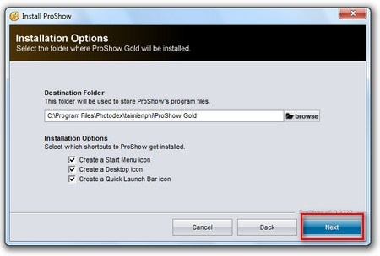
4.2 Minimal User Action
⇦
☺ Using default values for fields on entry screens

Slide 55
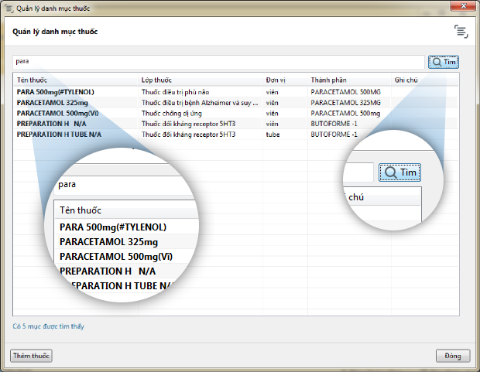
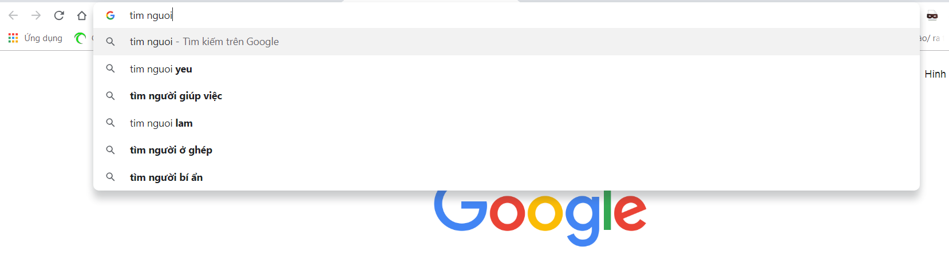
4.2 Minimal User Action
⇦
☺ Designing an inquiry, change, or delete program so that the user needs to enter only the first few characters of a name or item description

Slide 56
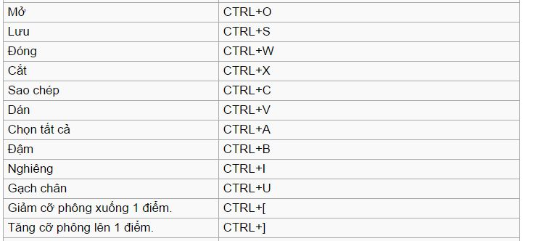
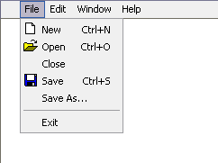
4.2 Minimal User Action
⇦
☺ Providing keystrokes for selecting pull-down menu options

Slide 57
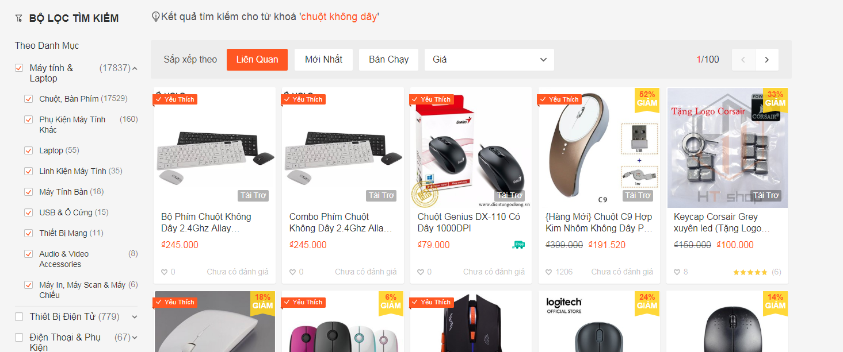
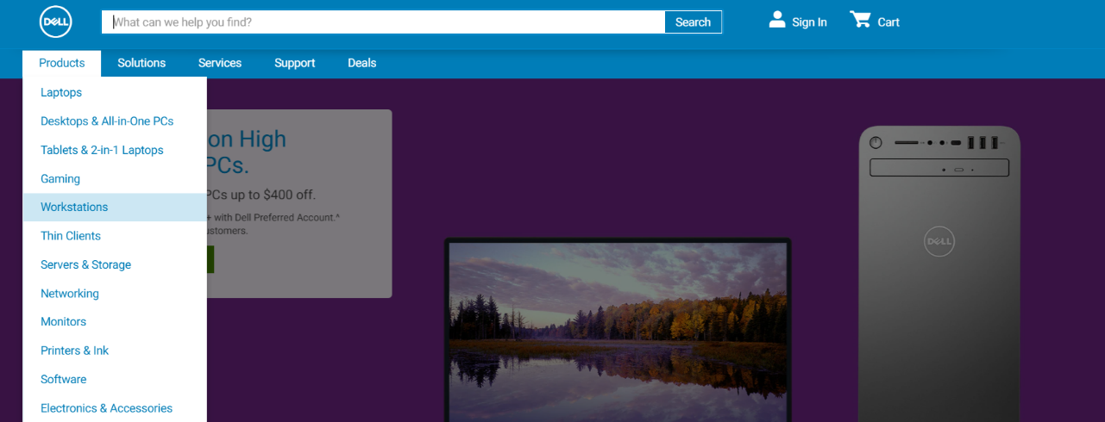
4.2 Minimal User Action
⇦
☺ Use radio buttons and drop-down lists to control displays of new Web pages or to change Web forms

Slide 58
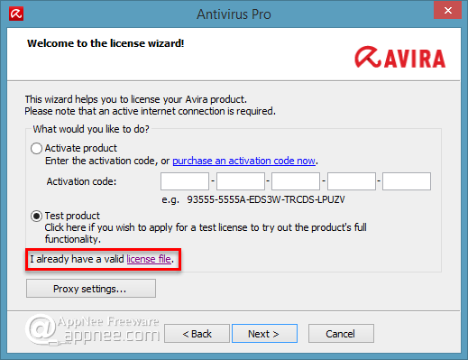
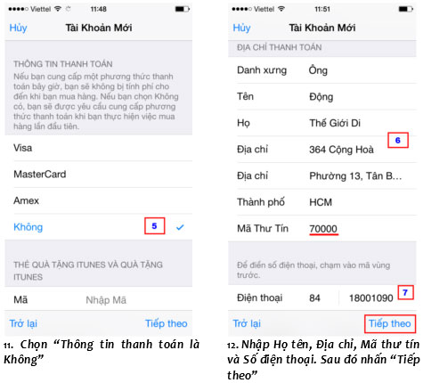
4.2 Minimal User Action
⇦
☺ Provide cursor control for Web forms and other displays so the cursor moves to the next field when the right number of characters has been entered

Slide 59
4.3 Standard Operation and Consistency
⇦
☺ Locating titles, date, time, and operator and feedback messages in the same places on all displays
☺ Exiting each program by the same key or menu option
☺ Canceling a transaction in a consistent way
☺ Obtaining help in a standardized way
☺ Standardizing the colors used for all displays or Web pages

Slide 60
4.3 Standard Operation and Consistency
⇦
☺ Standardizing the use of icons for similar operations when using graphical user interface
☺ Using consistent terminology in a display or Web site
☺ Providing a consistent way to navigate through the dialog
☺ Using consistent font alignment, size, and color on a Web page

Slide 61
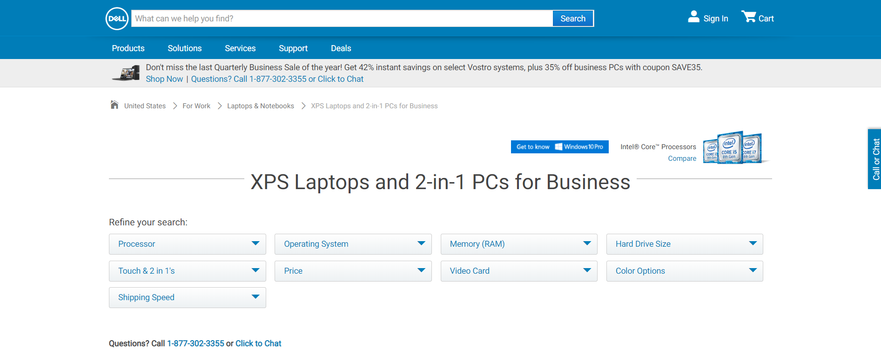
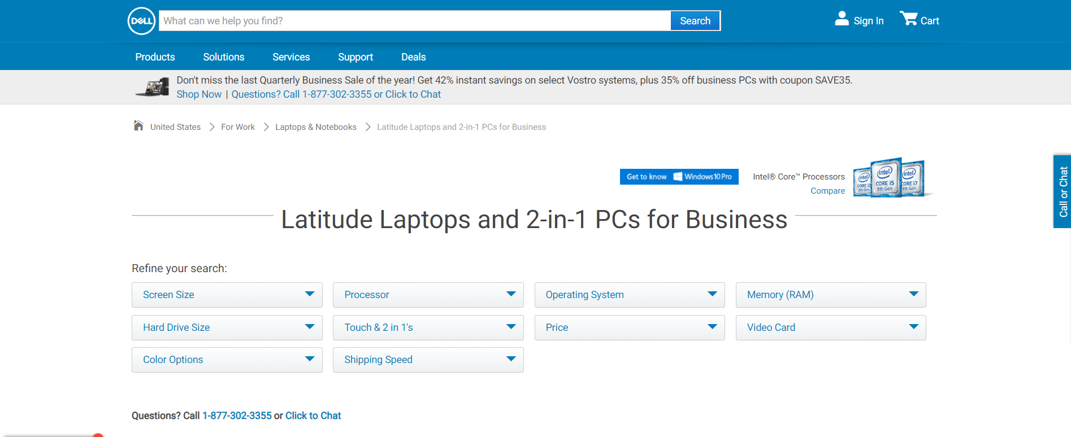
4.3 Standard Operation and Consistency
⇦

Slide 62
5. FEEDBACK
⇦
Feedback for user
Types of feedback
Including feedback in design
A variety of help options
Special Design Considerations for Ecommerce

Slide 63
5.1 FEEDBACK for users
⇦
☺ All systems require feedback to monitor and change behavior.
☺ Feedback compares current behavior with predetermined goals and gives back information describing the gap between actual and intended performance

Slide 64
5.2 Types of feedback
⇦
☺ Acknowledging acceptance of input
☺ Recognizing that input is in the correct form
☺ Notifying that input is not in the correct form
☺ Explaining a delay in processing
☺ Acknowledging that a request is completed
☺ Notifying that a request was not completed
☺ Offering the user more detailed feedback

Slide 65
5.2 Types of feedback
⇦
☺ Acknowledging acceptance of input:
The first situation in which users need feedback is to learn that the computer has accepted the input.

Slide 66
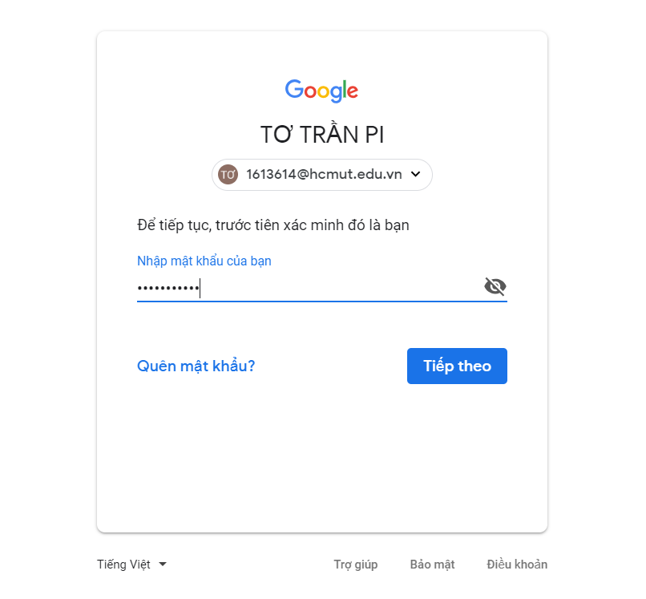

5.2 Types of feedback
⇦
☺ Acknowledging acceptance of input:

Slide 67

5.2 Types of feedback
⇦
☺ Acknowledging acceptance of input:

Slide 68

5.2 Types of feedback
⇦
☺ Recognizing that input is in the correct form
Users need feedback to tell them that the input is in the correct form.

Slide 69

5.2 Types of feedback
⇦
☺ Recognizing that input is in the correct form

Slide 70


5.2 Types of feedback
⇦
☺ Recognizing that input is in the correct form

Slide 71
5.2 Types of feedback
⇦
☺ Notifying that input is not in the correct form
Feedback is necessary to warn users that input is not in the correct form. When data are incorrect, one way to inform the user is to generate a window that briefly describes the problem with the input and explains how the user can correct it.

Slide 72


5.2 Types of feedback
⇦
☺ Notifying that input is not in the correct form

Slide 73


5.2 Types of feedback
⇦
☺ Notifying that input is not in the correct form

Slide 74

5.2 Types of feedback
⇦
☺ Notifying that input is not in the correct form

Slide 75
5.2 Types of feedback
⇦
☺ Explaining a delay in processing
One of the most important kinds of feedback informs the user that there will be a delay in processing his or her request. Delays longer than 10 seconds or so require feedback so that the user knows the system is still working.

Slide 76


5.2 Types of feedback
⇦
☺ Explaining a delay in processing

Slide 77


5.2 Types of feedback
⇦
☺ Explaining a delay in processing

Slide 78


5.2 Types of feedback
⇦
☺ Explaining a delay in processing

Slide 79
5.2 Types of feedback
⇦
☺ Acknowledging that a request is completed
Users need to know when their request has been completed and new requests may be input. Often a specific feedback message is displayed when an action has been completed by a user.

Slide 80


5.2 Types of feedback
⇦
☺ Acknowledging that a request is completed

Slide 81

5.2 Types of feedback
⇦
☺ Acknowledging that a request is completed

Slide 82
5.2 Types of feedback
⇦
☺ Acknowledging that a request is completed

Slide 83
5.2 Types of feedback
⇦
☺ Notifying that a request was not completed
Feedback is also needed to let the user know that the computer is unable to complete a request.

Slide 84


5.2 Types of feedback
⇦
☺ Notifying that a request was not completed

Slide 85

5.2 Types of feedback
⇦
☺ Notifying that a request was not completed

Slide 86
5.2 Types of feedback
⇦
☺ Offering the user more detailed feedback
Users need to be reassured that more detailed feedback is available, and they should be shown how they can get it .

Slide 87


5.2 Types of feedback
⇦
☺ Offering the user more detailed feedback

Slide 88


5.2 Types of feedback
⇦
☺ Offering the user more detailed feedback

Slide 89

5.2 Types of feedback
⇦
☺ Offering the user more detailed feedback

Slide 90
5.3 Including feedback in design
⇦
☺ Can be a powerful reinforcer of users’ learning processes.
☺ Serve to improve user performance with the system.
☺ Increase their motivation to produce.
☺ Improve the fit among the user, task and the technology.

Slide 91
5.4. a variety of help options
⇦
☺ Pressing a function key, such as F1
☺ A GUI pull-down menu
☺ Context-sensitive help
☺ Icon tips
☺ Wizards
☺ Online help or help lines
☺ Software forums

Slide 92


5.4 a variety of help options
⇦

Slide 93


5.4 a variety of help options
⇦

Slide 94
5.5 Special Design Considerations for Ecommerce
⇦
Soliciting feedback from ecommerce Web site customers
Easy navigation for ecommerce Web sites (one-click navigation)
Easy navigation for ecommerce Web sites (other considerations)

Slide 95


5.5.1 Soliciting Feedback from Ecommerce Web Site Customers
⇦
☺ Launch the user’s email program
☺ Take users to a blank message template when they click on “feedback”

Slide 96
5.5.2. Easy Navigation for Ecommerce Web Sites (One-Click Navigation)
⇦
☺ Creating a rollover menu
☺ Building a collection of hierarchical links
☺ Placing a site map on the home page and emphasizing the link to it
☺ Placing a navigational bar on every inside page that repeats the categories used on the entry screen
Notes:
ROLLOVER MENUS. A rollover menu (or rollover button) can be created with cascading styles
with JavaScript and HTML divisions. The rollover menu appears when the customer using the
Web site moves the cursor over a link
HIERARCHICAL LINKS. Creating an outline of the content of the site through the presentation of a
table of contents on the home page is another way to speed navigation of the site. This design,
however, imposes severe constraints on the designer’s creativity, and sometimes simply
presenting a list of topics does not adequately convey the strategic mission of the organization to
the user.
SITE MAP. Designing and then prominently displaying the link to a site map is a third way to
improve navigational efficiency. Remember to include the link to the site map on the home page
and on every other page as well.
NAVIGATION BAR. Finally, you can design navigation bars that are consistently displayed on the
home page as well as at the top and on the left of all other pages that comprise the site. Once you
have established (during the information requirements phase) the most useful and most used
categories (usually categories such as “Our Company,” “Our Products,” “Buy Now,” “Contact
Us,” “Site Map,” and “Search”), remember to include them on all pages.

Slide 97


5.5.2. Easy Navigation for Ecommerce Web Sites (One-Click Navigation)
⇦

Slide 98


5.5.2. Easy Navigation for Ecommerce Web Sites (One-Click Navigation)
⇦

Slide 99
5.5.3. Easy Navigation for Ecommerce Web Sites (Other Considerations)
⇦
☺ Search function
☺ Creating flexibility
☺ Creating for users with different cognitive processing , or interests
☺ Keeping the customers on the Web site

Slide 100

5.5.3 Easy Navigation for Ecommerce Web Sites (Other Considerations)
⇦

Slide 101
6. QUERIES
⇦
Help reduce users’ time spend in querying the database
Help them find the data they want
Result in a smoother user experience overall

Slide 102
6.1. QUERY TYPES
⇦
Name | Year-2015 | Year-2016 | City
John | 9900 USD | 10000 USD | Los Angeles
Peter | 25000 USD | 21000 USD | Chicago
Mary | 12000 USD | 15000 USD | Chicago
TYPE1
  What is the value of a specified attribute for a particular entity?
  V ⇦ (E,A)
  Query: City of the employee Name is John
TYPE2
  What entity has a specified value for a particular attribute?
  E ⇦ (V,A)
  Query: Employee who lives in Los Angeles.
TYPE3
  What attribute(s) has (have) a specified value for a particular entity?
  A ⇦ (V,E)
  Query: Which year does Peter get salary more than 20000 USD

Slide 103
6.1. QUERY TYPES
⇦
Name | Year-2015 | Year-2016 | City
John | 9900 USD | 10000 USD | Los Angeles
Peter | 25000 USD | 21000 USD | Chicago
Mary | 12000 USD | 15000 USD | Chicago
TYPE4
  List all the values for all the attributes for a particular entity?
  all V ⇦ (E, all A)
  Query: All attributes of the employee Name is John
TYPE5
  List all entities that have a specified value for all attributes?
  all E ⇦ (V, all A)
  Query: All employee who lives in Chicago
TYPE6
  List all the attributes that have a specified value for all entities?
  all A ⇦ (V, all E)
  Query: Which year that an employee get salary more than 20000 USD

Slide 104
6.2. BUILDING MORE COMPLEX QUERIES
⇦
ARITHMETIC
  Exponentiation
  Either multiplication or division
  Addition or subtraction
COMPARATIVE
  GT, LT , and others
BOOLEAN
  First AND and then OR

Slide 105

6.3. QUERY METHODS
⇦
QUERY BY EXAMPLE
  The database fields are selected and displayed in a grid, and requested query values are either entered in the field area or below the field

Slide 106

6.3. QUERY METHODS
⇦
STRUCTURED QUERY LANGUAGE (SQL)
Uses a series of words and commands to select the rows and columns that should be displayed in the resulting table

Slide 107
SUMMARY
⇦
Human-computer interaction (HCI)
User interfaces
  TAM
  Usability
  HCI approach

Slide 108
SUMMARY
⇦
Designing the user interface
  Natural language
  Question and answer
  Menus
  Form-fill and Web-based form-fill
  Graphical user interfaces
Designing the user interface
  The mouse
  Lightpens
  The stylus
  Touch-sensitive screens
  Voice recognition systems

Slide 109
SUMMARY
⇦
Designing user feedback
  Let users know if their input is being accepted
  If input is or is not in the correct form
  If processing is going on
  If requests can or cannot be processed
  If more detailed information is available and how to get it

Slide 110
SUMMARY
⇦
Designing ecommerce Web site feedback
  Rollover menus
  Hierarchical displays of links
  Site maps
  Navigation bars
Queries
  Six basic types

