Slide 1


Information gathering: interactive methods
System analysis and design, 8e
Kendall & kendall
Group 1:
Pham Minh Hieu 1611046
Nguyen Ho Minh Phuoc 1612736
Nguyen Thi Nhu Y 1614246
Huynh Trung Thuc 1513404

Slide 2


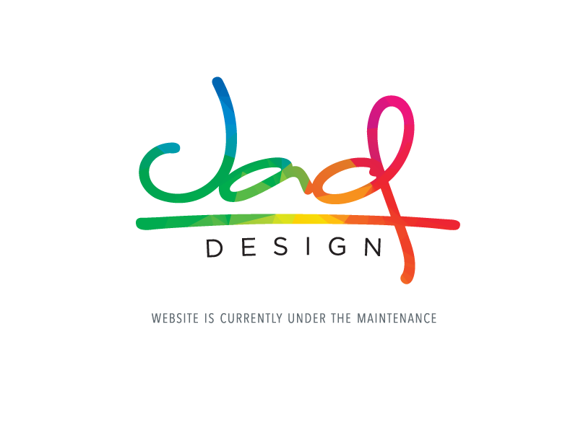

Three key interactive methods
Interviewing
Joint Application Design (JAD)
Surveying through questionnaires
Interviewing
Joint Application Design
Questionnaires

Slide 3

interviewing
Interview preparation
Question types
Arranging questions
The interview report

Slide 4
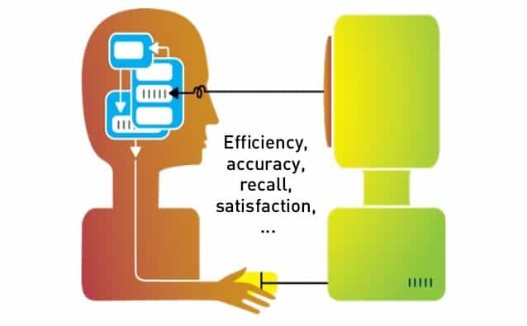
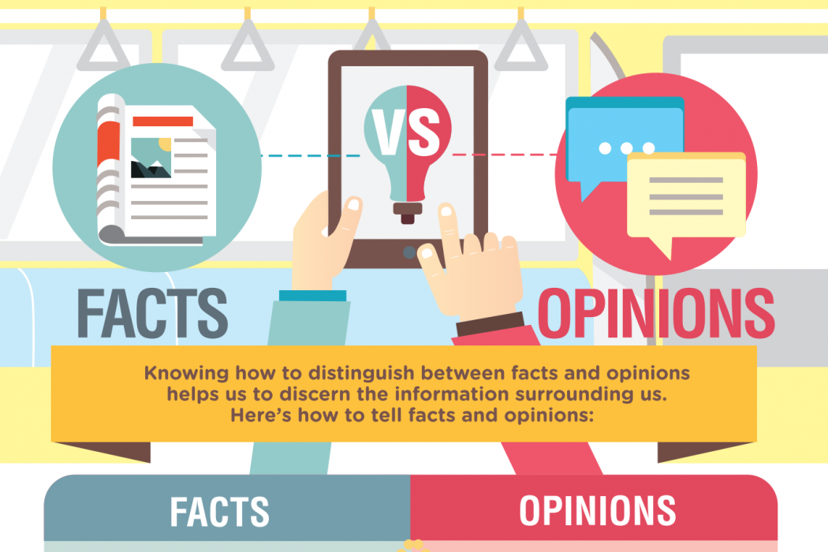


Information-gathering interviewing
A directed conversation with a specific purpose that uses a question-and-answer format.
Information:
  Interviewee opinions
  Interviewee feelings
  Personal goals
  Key HCI concerns

Slide 5





Interview preparation
Reading background material
Establishing interview objectives
Deciding whom to interview
Preparing the interviewee
Deciding on question types and structure
Notes:
Masha Gesen – Nhà văn chuyên viết về giới tri thức.

Slide 6
Question types
Open-ended questions
Closed questions
  Bipolar questions
Probes

Slide 7
Open-ended questions
Open-ended questions allow interviewees to respond how they wish, and to what length they wish.
Open-ended questions are appropriate when the analyst is interested in breadth and depth of reply.

Slide 8




Benefits of open-ended questions
Putting the interviewee at ease.
Allowing the interviewer to pick up on the vocabulary.
Providing richness of detail.
Revealing avenues of untapped questions.

Slide 9
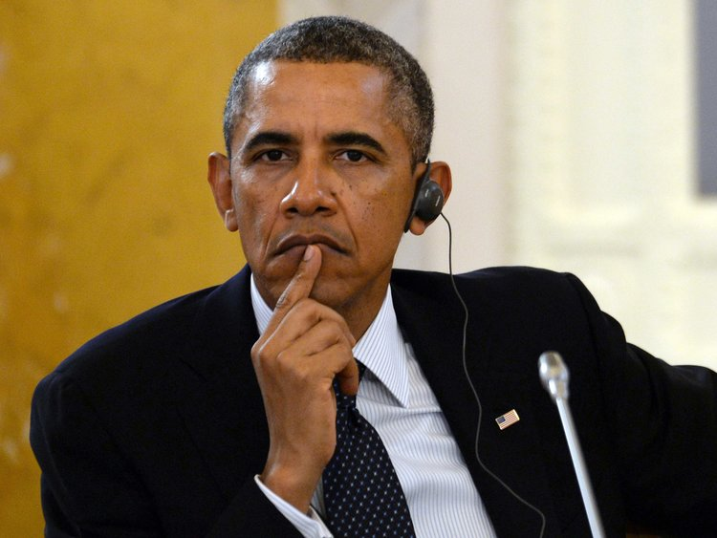

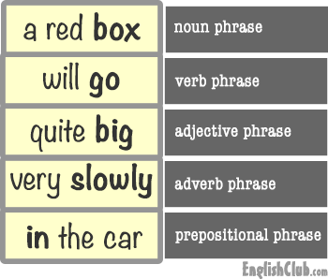

Benefits of open-ended questions
More interesting for the interviewee.
Allowing more spontaneity.
Making phrasing easier.
Useful if interviewer is unprepared.

Slide 10

Drawbacks of open-ended questions
Irrelevant detail.
Losing control of the interview.
Too much time for useful information.
The interviewer is unprepared.
“Fishing expedition”.

Slide 11
Closed questions
Closed questions limit the number of possible responses.
Closed questions are appropriate for generating precise, reliable data that is easy to analyze.
Little skill are required for interviewers to administer.

Slide 12

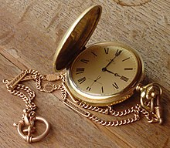
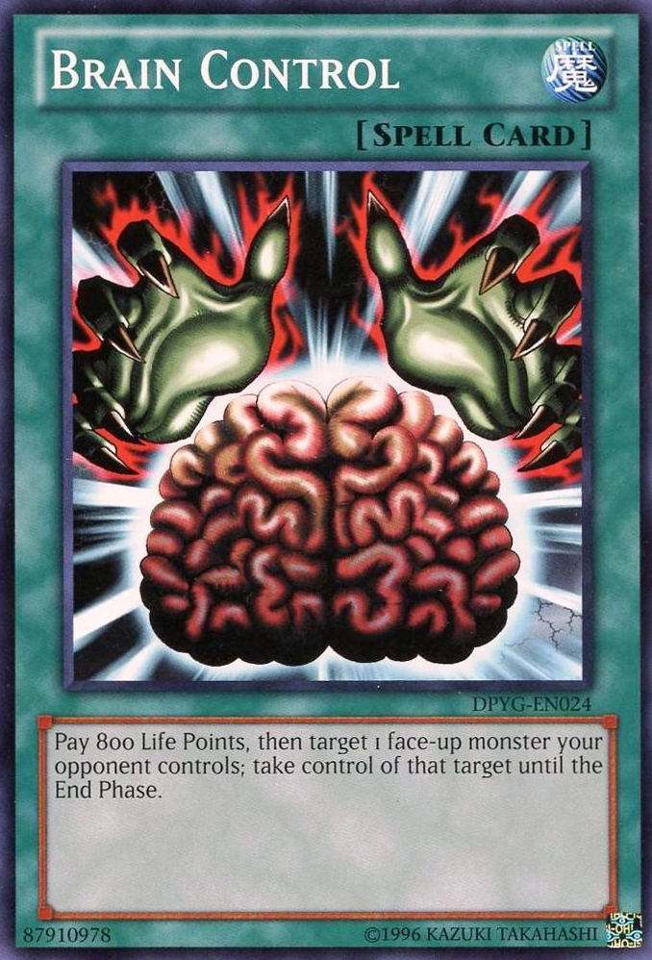
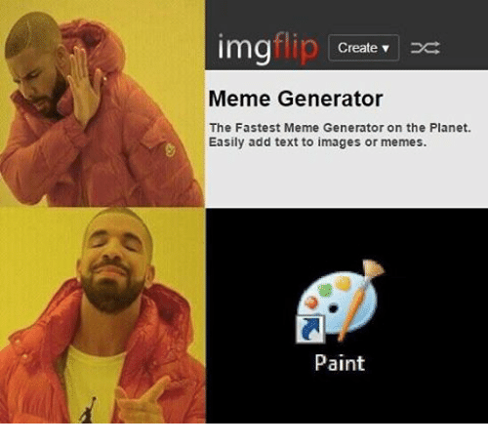
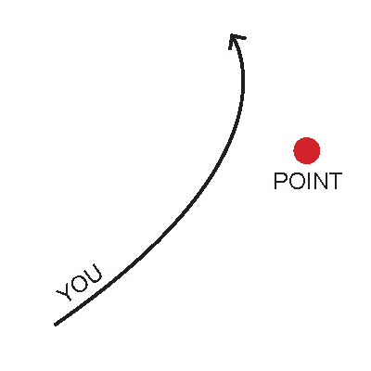

Benefits of closed questions
Saving time.
Easily comparing interviews.
Getting to the point.
Keeping control over the interview.
Covering lots of ground quickly.
Getting to relevant data.

Slide 13

Drawbacks of closed questions
Boring for the interviewee.
Failing to obtain rich detail.
Missing main ideas.
Failing to build rapport.

Slide 14
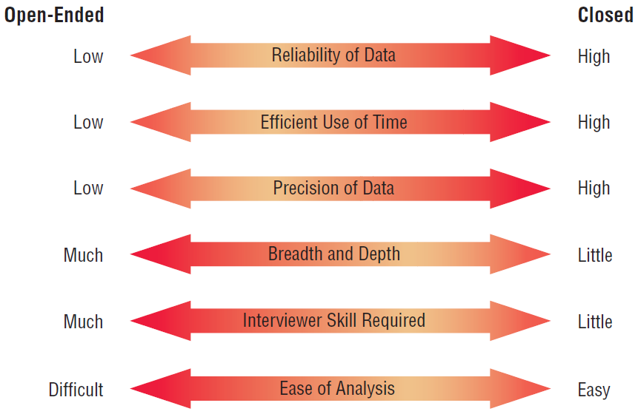
Figure 4.5: Attributes of open-ended and closed questions.

Slide 15
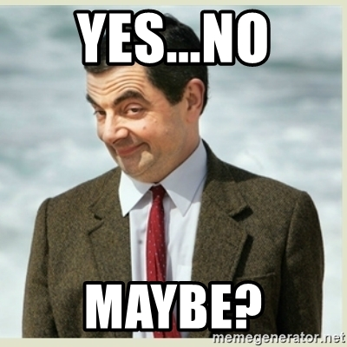
Bipolar questions
Bilolar questions are those that may be answered with a ‘yes’ or ‘no’ or ‘agree’ or ‘disagree’.
Bipolar questions should be used sparingly.

Slide 16

probes
Probing questions elicit more detail about previous questions.
The purpose:
  To get more meaning.
  To clarify.
  To draw out the interviewee’s point.

Slide 17
Arranging questions
Pyramid
  Closed questions  open-ended questions.
Funnel
  Open-ended questions  closed questions.
Diamond-shaped
  Closed questions  open-ended  closed questions.

Slide 18
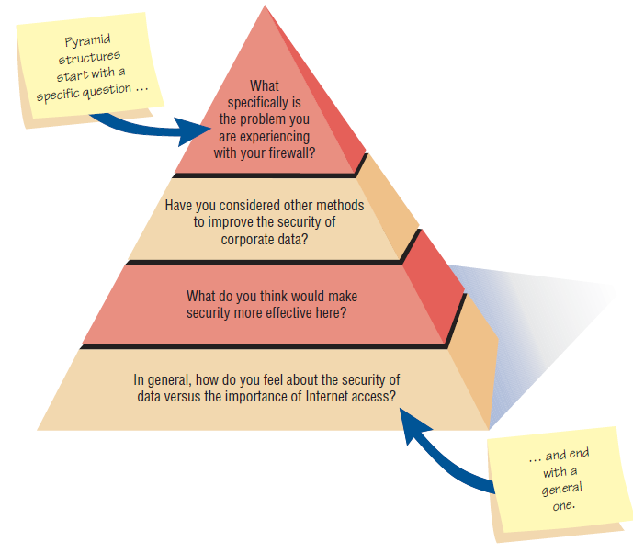
Pyramid structure
Interviewees need to be warmed up or seem reluctant to address the topic.
Interviewer want an ending determination about the topic.
What specifically is the problem you are experiencing with your firewall?
Have you considered other mechods to improve the security of corporate data?
What do you think would make security more effective here?
In general, how do you feel about the security of data versus the importance of Internet access?

Slide 19
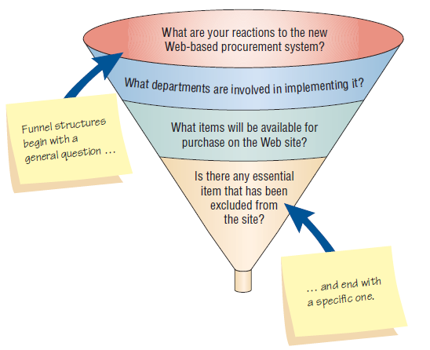
Funnel structure
Providing an easy way to begin an interview.
Interviewee feels emotionally.
What are your reactions to the new Web-based procurement system?
What departments are involved in implementing it?
What items will be available for purchase on the Web site?
Is there any essential item that has been excluded from the site?

Slide 20
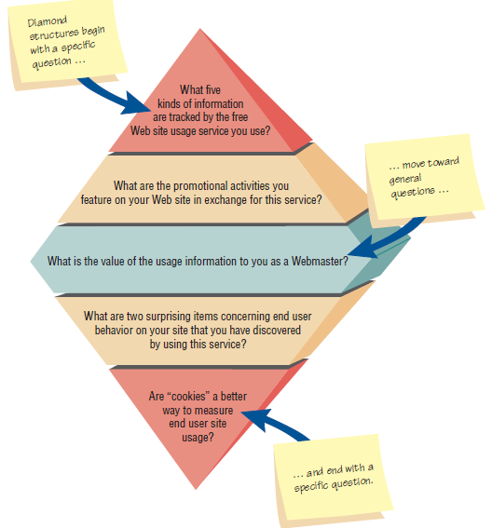
Diamond structure
Combining the strength of both the pyramid and funnel structures.
Taking longer than the other structures.
What five kinds of information are tracked by the free Web site usage service you use?
What are the promotional activities you feature on your Web site in exchange for this service?
What is the value of the usage information to you as a Webmaster?
What are two surprising items concerning end user behavior on your site that you have discovered by using this service?
Are “coockes” a better way to measure end user site usage?

Slide 21
Closing the interview
“Is there any thing else that you would like to add?”
Summarize and provide feedback.
Whom you should talk with next?
Future appointments.
Thank the interviewee, shake hands.

Slide 22
Writing report
Write as soon as possible.
Provide an initial summary, then more detail.
Review the report with the respondent.

Slide 23

Q & A
How many kinds of information should be sought?
How many steps in interview preparation?
How many types of questions?
How many ways to arrange the questions?

Slide 24
Joint Application Design (JAD)
Joint Application Design (JAD) can replace a series of interviews with the user community
JAD is a technique that allows the analyst to accomplish requirements analysis and design the user interface with the users in a group setting
Notes:
An alternative approach to interviewing users one by one.
Developed by IBM.
The motivation was to cut the time and hence the cost required by interviews. It also create more use identification with new systems as a result of the participative process.

Slide 25
Conditions that Support the Use of JAD
Users are restless and want something new
The organizational culture supports joint problem-solving behaviors
Analysts forecast an increase in the number of ideas using JAD
Personnel may be absent from their jobs for the length of time required

Slide 26
Who Is Involved
Executive sponsor
IS Analyst
Users
Session leader
Observers
Scribe
Notes:
All project team members must be committed to the JAD approach and become involved.
Executive sponsor – a senior person who will introduce and conclude the JAD session.
IS Analyst – gives an expert opinion about any disproportionate costs of solutions proposed
Users – try to select users that can articulate what information they need to perform their jobs as well as what they desire in anew or improved computer system.
Session leader – someone who has excellent communication skills to facilitate appropriate interactions.
Observers – analysts or technical experts from other functional areas to offer technical explanations and advice.
Scribe – formally write down everything that is done.

Slide 27
Where to Hold JAD Meetings
Offsite
  Comfortable surroundings
  Minimize distractions
Attendance
  Schedule when participants can attend
  Agenda
  Orientation meeting
Notes:
Hold offsite to minimize the daily distractions and responsibilities of the participants’ regular work.
Do not hold the session unless everyone can attend. An agenda should be giving out before the meeting so the participants know what to expect. If possible an orientation meeting can be given.

Slide 28
Benefits of JAD
Time is saved, compared with traditional interviewing
Rapid development of systems
Improved user ownership of the system
Creative idea production is improved
Notes:
Some organizations have estimated a 15-percent time savings over traditional.
Helps users become involved early in systems projects and treats their feedback seriously.
Much like brainstorming which allows for creative idea production.

Slide 29
Drawbacks of Using JAD
JAD requires a large block of time to be available for all session participants
If preparation or the follow-up report is incomplete, the session may not be successful
The organizational skills and culture may not be conducive to a JAD session
Notes:
It is not possible to do other activities concurrently or to time-shift any activities, as is typically done in one-to-one interviewing.
It is a judgmental decision if the organization is truly committed to, and prepared for , this approach.

Slide 30
Q&A
Watching the video summary. Link: https://www.youtube.com/watch?v=T-AhzjCTfQ0
List the situations that warrant use of JAD in place of personal organizational interviews.

Slide 31
Questionnaires
Questionnaires are useful in gathering information from key organization members about:
  Attitudes
  Beliefs
  Behaviors
  Characteristics
Notes:
Attitudes – what people in the organization say they want.
Beliefs – what people think is actually true.
Behavior – what organizational members do.
Characteristics – properties of people or things.
Answers to questions on attitudes and beliefs are sensitive to the wording chosen by the systems analyst. => have to be delicated to choose the questions and answer
It also qualificated like interview
Compare with interview: limited or confusing emotion, but can be used to survey a large sample of system users to sense problems or raise important issues before interviews are scheduled.
Many similarities between the two techniques, the ideal would be to use them in conjunction with each other
Unclear questionnaire responses => interview
Designing the questionnaire based on what is discovered in the interview.
Not always necessary to use both.

Slide 32
Planning for the Use of Questionnaires
Organization members are widely dispersed
Many members are involved with the project
Exploratory work is needed
Problem solving prior to interviews is necessary
Notes:
Large data, no need to spend too much time for face-to-face interview => still have to prepare
What are attempting to gain through using a survey?
if to know what % of students pleasure this representation, questionnaire.
If to get the in-deep analysis decision-making process, interview.
3. muốn đánh giá ý kiến tổng thể trước khi dự án hệ thống được đưa ra bất kỳ hướng cụ thể nào.

Slide 33
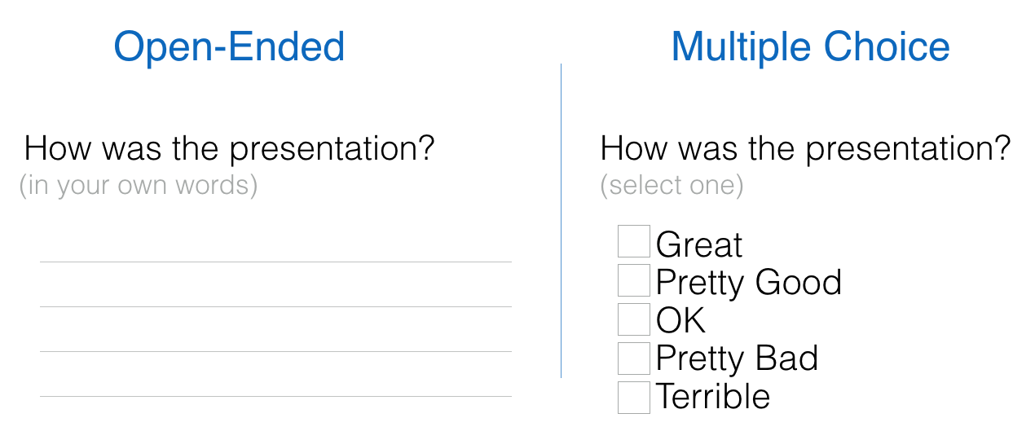
Question Types
Questions are designed as either:
  Open-ended
    Try to anticipate the response you will get
    Well suited for getting opinions
  Closed
    Use when all the options may be listed
    When the options are mutually exclusive
Notes:
Even when you write an open-ended question, it must be narrow enough to guide respondents to answer in a specific way.
Use open-ended questions when it is impossible to list effectively all possible responses to a question.
Minh bạch, rõ ràng, chi tiết
Use closed questions when you want to survey a large sample of people. The reason becomes obvious when you start imagining how the data you are collecting will look. If you use only openended questions for hundreds of people, correct analysis and interpretation of their responses becomes impossible without the aid of a computerized content analysis program.

Slide 34
Figure 4.12 Trade-offs between the use of open-ended and closed questions on questionnaires
Notes:
Tốc độ hoàn thành
Tính chất khám phá
Chiều rộng và chiều sâu
Dễ chuẩn bị
Dễ phân tích

Slide 35
Questionnaire Language
Simple
Specific
Short
Not patronizing
Free of bias
Addressed to those who are knowledgeable
Technically accurate
Appropriate for the reading level of the respondent
Notes:
Write questionnaires in the respondents own language usage.
Mỗi hệ thống có những tiêu chuẩn về từ ngữ khác nhau
Simple – Use the language of the respondents whenever possible.
Specific – work at being specific rather then vague in wording.
Short – keep questions short
Not patronizing – do not talk down to participants through low-level language choices.
Free of bias – also means avoiding objectionable questions.
Addressed to those who are knowledgeable – target questions to correct respondents.

Slide 36
Measurement Scales
The two different forms of measurement scales are:
  Nominal
  Interval
Notes:
Scaling is the process of assigning numbers or other symbols to an attribute or characteristic for the purpose of measuring that attribute or characteristic.

Slide 37
Nominal Scales
Nominal scales are used to classify things
It is the weakest form of measurement
Data may be totaled
What type of software do you use the most?
1 = Word Processor
2 = Spreadsheet
3 = Database
4 = An Email Program

Slide 38
Interval Scales
An interval scale is used when the intervals are equal
There is no absolute zero
How useful is the support given by the Technical Support Group?
NOT USEFUL EXTREMELY
AT ALL USEFUL
1 2 3 4 5
Notes:
More complete analysis can be performed on interval scales.

Slide 39
Validity And Reliability
Reliability of scales refers to consistency in response—getting the same results if the same questionnaire was administered again under the same conditions
Validity is the degree to which the question measures what the analyst intends to measure
Notes:
Questionnaires must be valid and reliable.
Hiệu lực và tin cậy

Slide 40
Problems with Scales
Leniency
Central tendency
Halo effect
Notes:
Construction of scales is a serious task which must consider the problems associated with their construction.

Slide 41
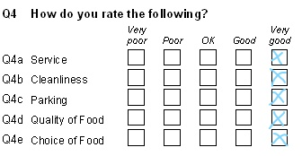
Leniency
Caused by easy raters
  Solution is to move the “average” category to the left or right of center

Slide 42
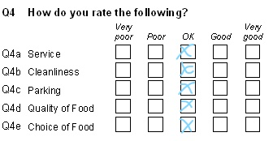
Central Tendency
Central tendency occurs when respondents rate everything as average
  Improve by making the differences smaller at the two ends
  Adjust the strength of the descriptors
  Create a scale with more points

Slide 43
Halo Effect
When the impression formed in one question carries into the next question
Solution is to place one trait and several items on each page

Slide 44
Q&A
What are the two basic question types used on questionnaires?
What are two kinds of information or scales that are most commonly used by systems analysts?
List three problems that can occur because of careless construction of scales.

Slide 45
Designing the Questionnaire
Allow ample white space
Allow ample space to write or type in responses
Make it easy for respondents to clearly mark their answers
Be consistent in style

Slide 46




Designing the Questionnaire
Allow ample white space

Slide 47

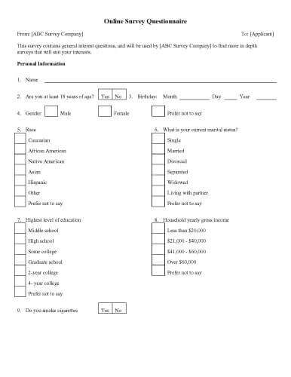
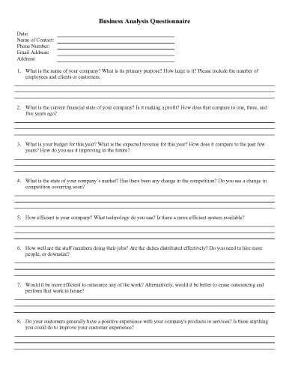
Designing the Questionnaire
Notes:
Bố trí quá ít không gian trống gây nên cảm giác choáng ngợp, dễ gây chán nản cho người làm khảo sát -> giảm chất lượng thông tin

Slide 48
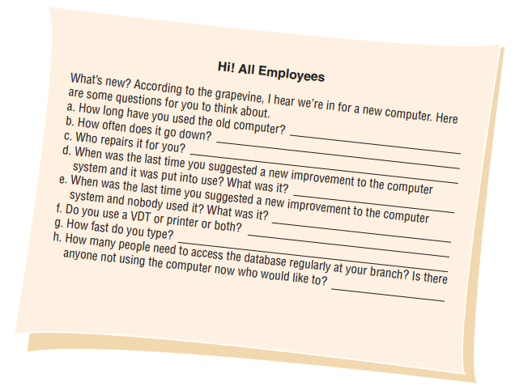
Designing the Questionnaire
Allow ample space to write or type in responses
Notes:
Không gian quá chật: khi điền vào bất tiện, chữ bị tràn ra ngoài, hoặc giới hạn suy nghĩ ý kiến của người làm khảo sát

Slide 49
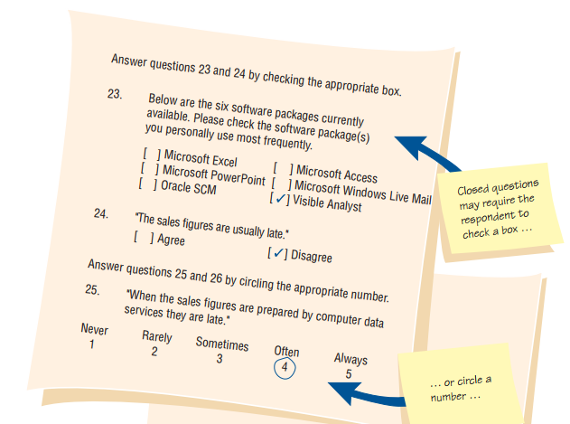
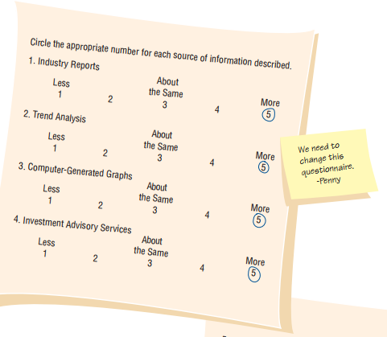
Designing the Questionnaire
Make it easy for respondents to clearly mark their answers

Slide 50
Designing the Questionnaire
Be consistent in style

Slide 51
Order of Questions
1. Place most important questions first
2. Cluster items of similar content together
3. Introduce less controversial questions first
Notes:
I. Đặc biệt với những khảo sát dài II. Để tránh gây rối, khó chịu cho người trả lời khảo sát

Slide 52

Administering Questionnaires

Slide 53
RESPONDENTS
Deciding what kind of respondents should receive the questionnaire
Rank
Length of service with the company
Job duties
Special interest in the current or proposed system

Slide 54
Methods of Administering the Questionnaire
Convening all concerned respondents together at one time
Personally administering the questionnaire
Allowing respondents to self-administer the questionnaire
Mailing questionnaires
Administering over the Web or via email

Slide 55
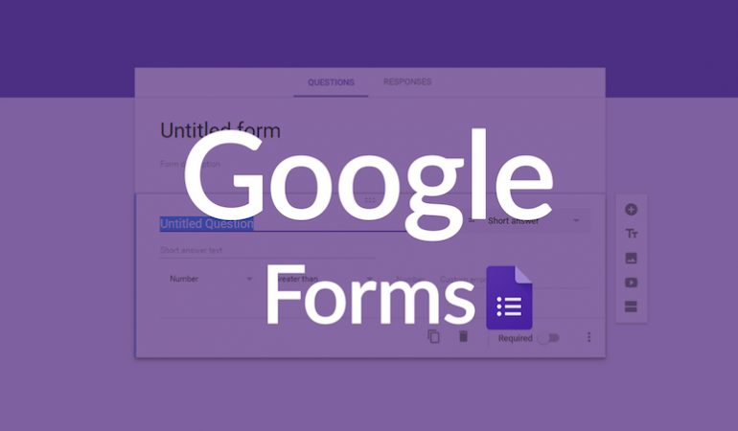
Electronically Submitting Questionnaires
Reduced costs
Collecting and
storing the results
electronically
Notes:
Hình thức được chuẩn hóa, Đỡ chi phí nhân công, tổng hợp thông tin

Slide 56
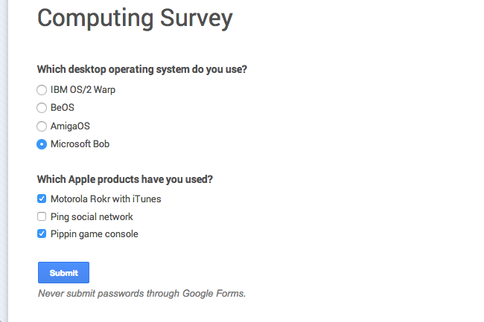
Electronically Submitting Questionnaires
Reduced costs
Collecting and
storing the results
electronically
Notes:
Hình thức được chuẩn hóa, Đỡ chi phí nhân công, tổng hợp thông tin

Slide 57
Designing with web services
Easy to do
Solves almost problems
Flexible

Slide 58
Summary

