Slide 1


PROJECT MANAGER
GROUP 3
Vũ Ngọc Duy 1510519
Nguyễn Văn Hùng 1511360
Lê Bá Anh Tuấn 1414384
Nguyễn Kỳ Cao 51300333

Slide 2

Outline
Project Initiation
Determine Feasibility và Determine Resources.
Ativity Planing and Control.
Managing Analysis and Design activities.
Agile Approach.

Slide 3

1. Project initiation
Problems in the organization
  Problems that lend themselves to systems solutions
Opportunities for improvement
  Caused through upgrading, altering, or installing new systems

Slide 4
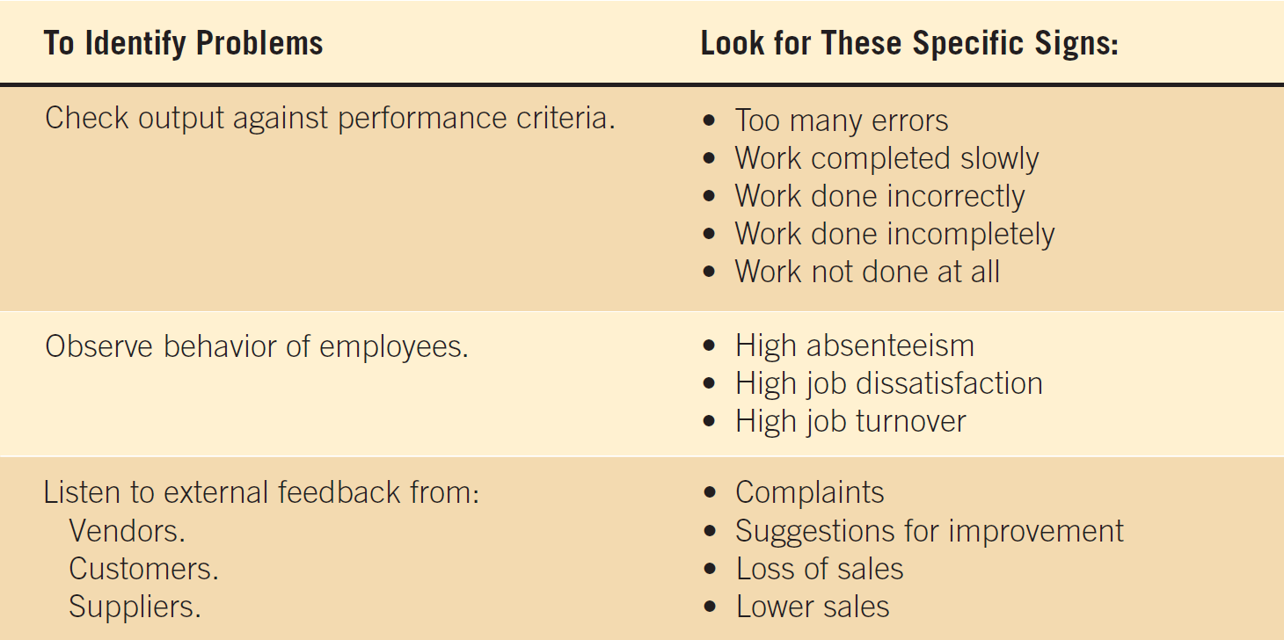
Figure 3.1 Checking output, observing employee behavior, and listening to feedback are all ways to help the analyst pinpoint systems problems and opportunities

Slide 5
Problem Definition
Problem statement
  Paragraph or two stating the problem or opportunity
Issues
  Independent pieces pertaining to the problem or opportunity
Objectives
  Goals that match the issues point-by-point
Requirements
  The things that must be accomplished along with the possible solutions, and constraints, that limit the development of the system

Slide 6
Problem Definition Steps
Find a number of points that may be included in one issue
State the objective
Determine the relative importance of the issues or objectives
Identify which objectives are most critical

Slide 7
Selection Of Projects
Backing from management
Appropriate timing of project commitment
Possibility of improving attainment of organizational goals
Practical in terms of resources for the system analyst and organization
Worthwhile project compared with other ways the organization could invest resources

Slide 8
2.Determine Feasibility & Determine resources.
Defining objectives
Determining resources
- Operationally
- Technically
- Economically

Slide 9
Project Objective Definition
A project objective describes the desired results of a project, which often includes a tangible item.
An objective is specific and measurable, and must meet time, budget, and quality constraints.
To produce the most benefit, objectives must be defined early in the project life cycle, in phase two, the planning phase.

Slide 10
Benefits of the Well-Written Objective
it can affect every step of the project life cycle.
give your team a greater chance of achieving the objective because they know precisely what they're working towards.
Clear project objectives also support the current emphasis on total quality management

Slide 11
Many possible objectives exist including:
  Speeding up a process
  Streamlining a process
  Combining processes
  Reducing errors in input
  Reducing redundant storage
  Reducing redundant output
  Improving system and subsystem integration

Slide 13
Determining resources
The three key elements of feasibility include technical, economic, and operational feasibility

Slide 14
Technical Feasibility
This assessment focuses on the technical resources available to the organization.
It helps organizations determine whether the technical resources meet capacity and whether the technical team is capable of converting the ideas into working systems.
Technical feasibility also involves evaluation of the hardware, software, and other technology requirements of the proposed system.

Slide 15
Economic Feasibility
This assessment typically involves a cost/ benefits analysis of the project, helping organizations determine the viability, cost, and benefits associated with a project before financial resources are allocated.
It also serves as an independent project assessment and enhances project credibility—helping decision makers determine the positive economic benefits to the organization that the proposed project will provide.
Includes:
  Analyst and analyst team time
  Business employee time
  Hardware
  Software
  Software development

Slide 16
Operational Feasibility
This assessment involves undertaking a study to analyze and determine whether—and how well—the organization's needs can be met by completing the project.
Operational feasibility studies also analyze how a project plan satisfies the requirements identified in the requirements analysis phase of system development

Slide 17
Legal Feasibility
This assessment investigates whether any aspect of the proposed project conflicts with legal requirements like zoning laws, data protection acts, or social media laws.

Slide 18
Scheduling Feasibility
This assessment is the most important for project success
After all, a project will fail if not completed on time.
In scheduling feasibility, an organization estimates how much time the project will take to complete.

Slide 19
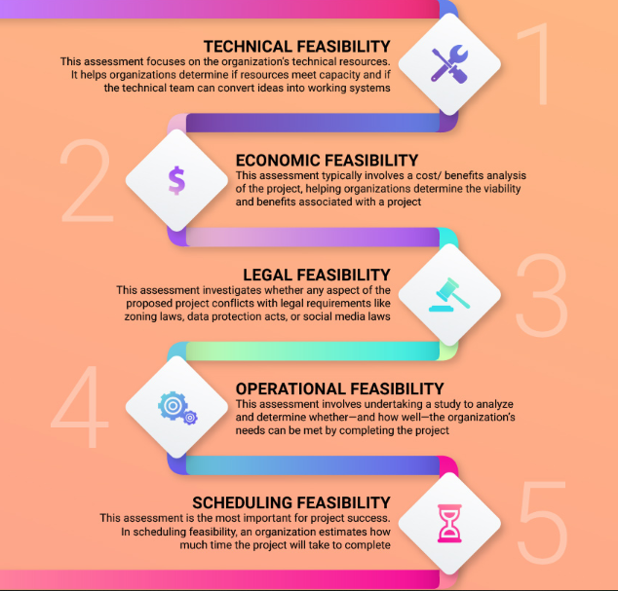

Slide 20
3. Activity Planning And Control
Planning includes:
  Selecting a systems analysis team
  Estimating time required to complete each task
  Scheduling the project
Control includes:
  Comparing the plan for the project with its actual evolution
  Taking appropriate action to expedite or reschedule activities

Slide 21
Estimating Time
Project is broken down into phases
Further project is broken down into tasks or activities
Finally project is broken down into steps or even smaller units
Time is estimated for each task or activity
Most likely, pessimistic, and optimistic estimates for time may be used

Slide 22
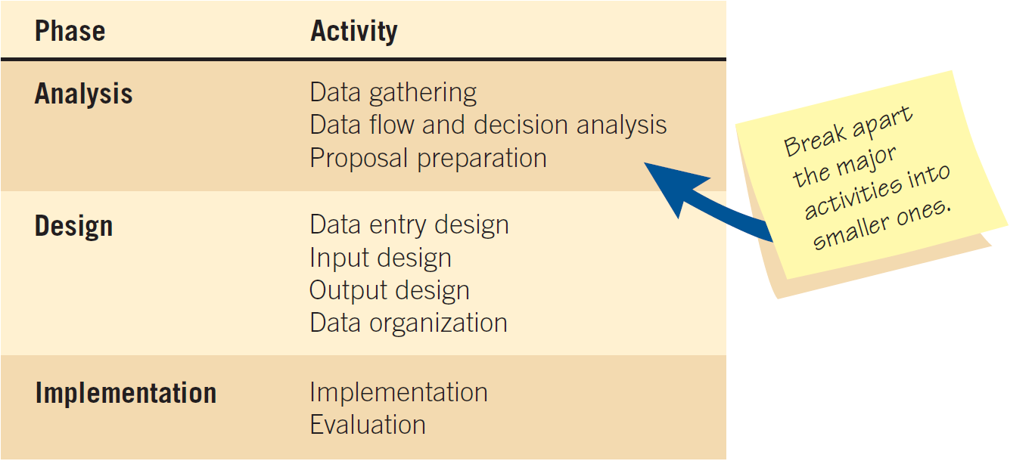
Beginning to plan a project

Slide 23
Refining the planning and scheduling of analysis activities

Slide 24
Project Scheduling
Gantt Charts
  Simple
  Lends itself to end user communication
  Drawn to scale
PERT diagrams
  Useful when activities can be done in parallel

Slide 25
a two-dimensional Gantt chart

Slide 26
A completed PERT diagram

Slide 27
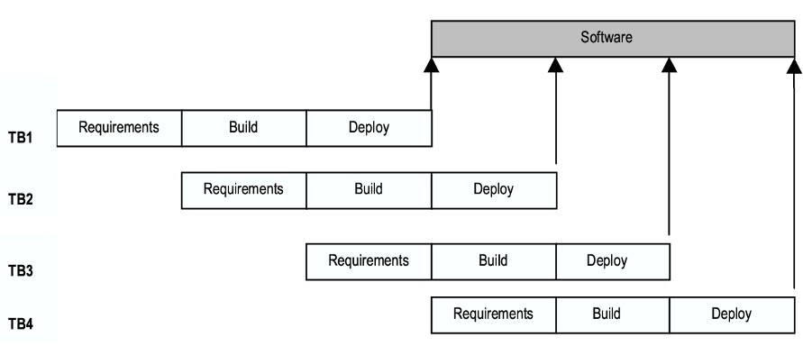
Timeboxing

Slide 28
Project Due Dates
Estimating models
  Costar
  Construx
Function point analysis
  Helps the analyst quantitatively estimate the overall length of software development efforts

Slide 29
Function Point Analysis
Count components
Rate each component’s complexity
Assign complexity numbers
Arrive at a subtotal
Multiply by adjustment factor

Slide 30
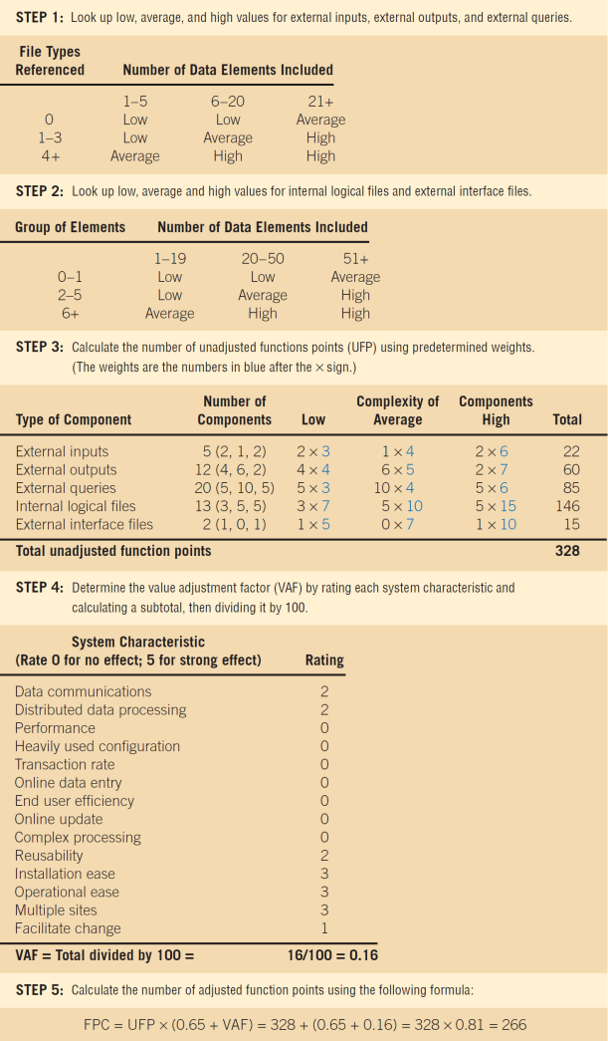

Slide 31
Staffing Requirements
Choice of software can influence the amount of effort that goes into system development
It is not true that the more people assigned to a task, the faster it will get done

Slide 32
Managing Risk
30 percent of all projects succeed
20 percent fail
50 percent finish, but are either late, over budget, or offer fewer features than originally promised

Slide 33
4. Managing Analysis & Design Activities
Team management
Ecommerce Project Management
Project Failures

Slide 34
4.1 Team management
  Assembling a team
  Team communication strategies
  Project productivity goals
  Team member motivation

Slide 35
4.1.1 Assembling a team
Shared value of team work
Good work ethic
Honesty
Competency
Readiness to take on leadership based on expertise
Motivation
Enthusiasm for the project
Trust of teammates

Slide 36
  4.1.2 TEAM COMMUNICATION STRATEGIES
Teams often have two leaders:
  One who leads members to accomplish tasks
  One concerned with social relationships
The systems analyst must manage:
  Team members
  Their activities
  Their time and resources

Slide 37
  4.1.3 PROJECT PRODUCTIVITY GOALS
Successful projects require that reasonable productivity goals for tangible outputs and process activities be set
Goal-setting helps to motivate team members

Slide 38
  4.2 ECOMMERCE PROJECT MANAGEMENT
Ecommerce and traditional software project management differences:
  The data used by ecommerce systems is scattered across the organization
  Ecommerce systems need a staff with a wide variety of skills
  Partnerships must be built externally and internally well ahead of implementation
  Security is of utmost importance

Slide 39
  4.3 PROJECT FAILURES
Project failures may be prevented by:
  Training
  Experience
  Learning why other projects have failed
Project charter
  Describes in a written document what the expected results of the systems project are and the time frame for delivery

Slide 40
5. Agile Development
An innovative philosophy and methodology comprised of systems development practices, techniques, values, and principles intended for use in developing systems in a dynamic way

Slide 41
Figure 3.17 The analyst can control the time, cost, quality, and scope of the project to balance the activities

Slide 42
Agile Core Practices and Roles of the Agile Approach
There are four Agile practices:
  A short release time
  Working a 40-hour week
  Having an onsite customer
  Pair programming

Slide 43
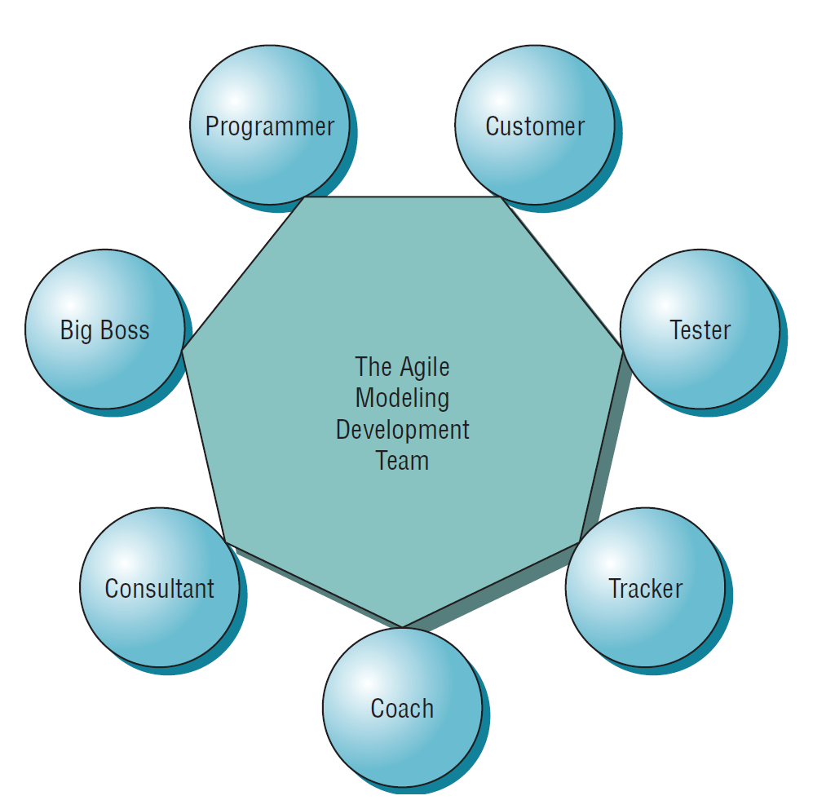
Figure 3.19 Roles in the Agile Development process include members from inside of the development team as well as at least one onsite customer

Slide 44
The Planning Game
The planning game defines rules to help formulate the development team and customer relationship
Limits uncertainty
Two players: the development team and the business customer
Customers decide what to tackle first

Slide 45
Development Process for an Agile Project
Agile projects are interactive and incremental
The five Stages of Agile development are:
  Exploration
  Planning
  Iterations to the first release
  Productionizing
  Maintenance

Slide 46
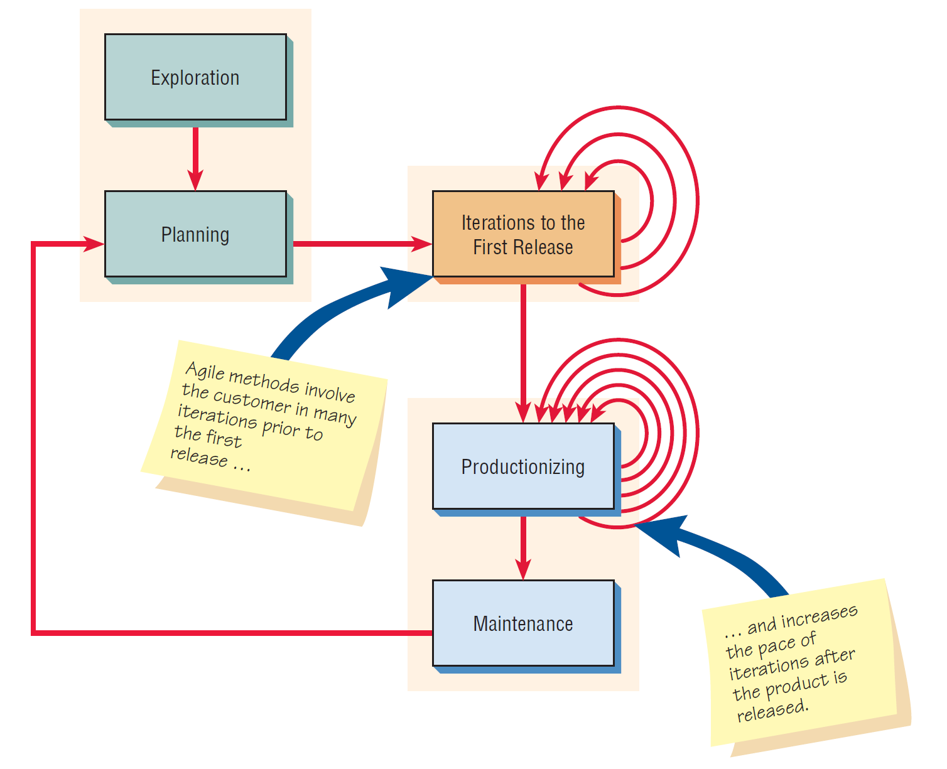
Figure 3.21 The five stages of the agile modeling development process show that frequent iterations are essential to successful system development

Slide 47


