Slide 1
USING DATAFLOW DIAGRAMS & DATA DICTIONARIES
[SYSTEM Analysis & Design]
GVHD: NGUYEN THANH TUNG
SV: DO LE DUY
NGUYEN DO DUC ANH
LE DUY HIEN
NGUYEN THI HOAI THUONG
1

Slide 2
OUTLINE
OUTLINE
Data flow diagrams
Data flow diagram symbols
Data flow diagram levels
Creating data flow diagrams
Physical and logical data flow diagrams
Partitioning
Communicating Using Data Flow Diagrams
2

Slide 3
OUTLINE
OUTLINE
Data dictionaries
The data dictionaries
The data repository
Defining data flow
Defining data structures
Defining data elements
Using the data dictionary
XML
3

Slide 4
DATA FLOW DIAGRAM
DATA FLOW DIAGRAM
4

Slide 5
I
1. Problems
User ‘s requirements prepared in prose
long descriptions of the processes
reviewing can not recollect all the issues
2. Solutions
-> Make an easily understood view of the system
The graphical representation
Data Flow Diagrams
“people remember 100% of what they see, but only 50% of what they read”
5

Slide 6
I
3. What is Data Flow Diagrams?
The graphical representation
Avantages:
Freedom from committing to the technical implementation too early
Understanding of the interrelatedness of systems and subsystems
Communicating current system knowledge to users
Analysis of the proposed system
Disadvantages:
Takes a long time to create
6

Slide 7
DATA FLOW DIAGRAM SYMBOLS
DATA FLOW DIAGRAM SYMBOLS
7

Slide 8
I
I. DATA FLOW DIAGRAM SYMBOLS
A double square for an external entity
An arrow for movement of data from one point to another
A rectangle with rounded corners for the occurrence of a transforming process
An open-ended rectangle for a data store
8

Slide 9
I
I. DATA FLOW DIAGRAM SYMBOLS
9

Slide 10
I
I. DATA FLOW DIAGRAM SYMBOLS
1. External Entities
Represent another department, a business, a person, or a machine
A source or destination of data, outside the boundaries of the system
Should be named with a noun
10

Slide 11
I
I. DATA FLOW DIAGRAM SYMBOLS
2. Data Flow
Shows movement of data from one point to another
Described with a noun
Arrowhead indicates the flow direction
Represents data about a person, place, or thing
11

Slide 12
I
I. DATA FLOW DIAGRAM SYMBOLS
3. Process
Denotes a change in or transformation of data
Represents work being performed in the system
Naming convention
  Assign the name of the whole system when naming a high-level process
  To name a major subsystem attach the word subsystem to the name
  Use the form verb-adjective-noun for detailed processes
12

Slide 13
I
I. DATA FLOW DIAGRAM SYMBOLS
4. Data Store
A depository for data that allows examination, addition, and retrieval of data
Named with a noun, describing the data
Data stores are usually given a unique reference number, such as D1, D2, D3
Represents a:
  Filing cabinet
  Database
  Computerized file
13

Slide 14
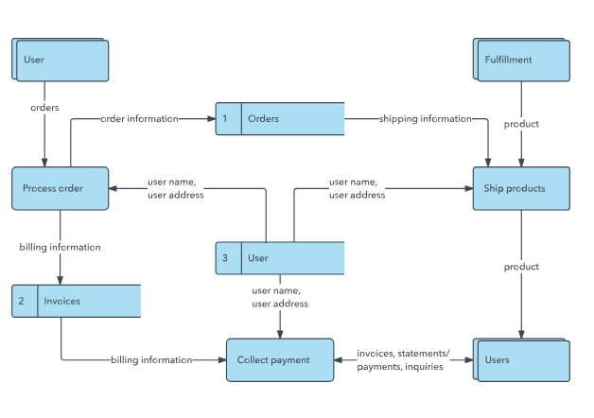
I
I. DATA FLOW DIAGRAM SYMBOLS
14

Slide 15
DATA FLOW DIAGRAM LEVEL
DATA FLOW DIAGRAM LEVEL
15

Slide 16
II
II. DATA FLOW DIAGRAM LEVEL
1. Context Diagram
only one process, is given the number 0
Context Diagram
highest level
All external entities are shown
16

Slide 17
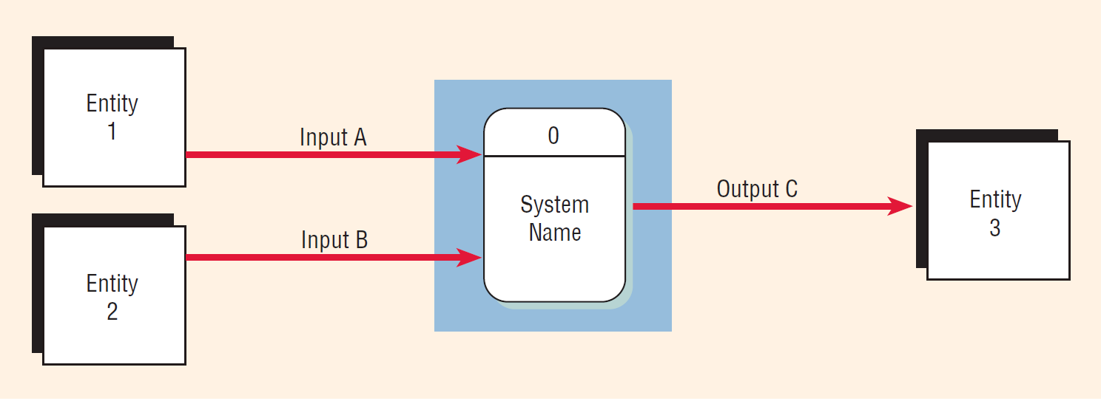
II
II. DATA FLOW DIAGRAM LEVEL
1. Context Diagram
17

Slide 18
II
II. DATA FLOW DIAGRAM LEVEL
2. Diagram 0
  The explosion of the context diagram
May include many processes
Each process is numbered
Diagram 0
Major data stores and all external entities are included
18

Slide 19
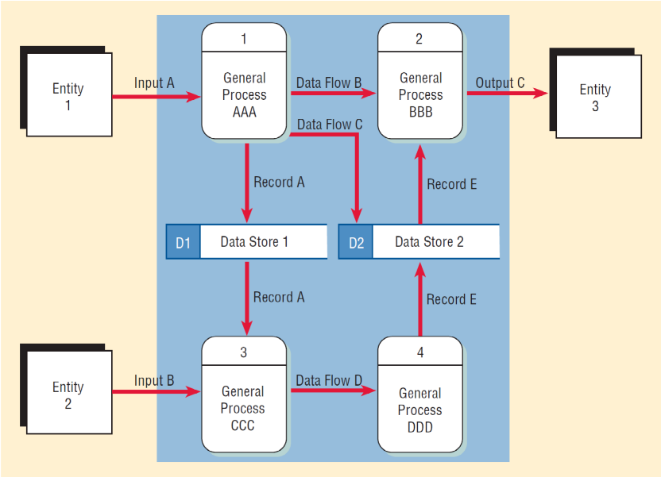
II
II. DATA FLOW DIAGRAM LEVEL
2. Diagram 0
19

Slide 20
II
II. DATA FLOW DIAGRAM LEVEL
3. Child Diagrams
  Each process on diagram 0 may be exploded to create a child diagram
cannot produce output or receive input that the parent process does not
Child DIagrams
process's number = parent process's number
Entities are usually not shown
20

Slide 21
II
II. DATA FLOW DIAGRAM LEVEL
3. Child Diagrams
  If the parent process has data flow connecting to a data store, the child diagram may include the data store as well
  When a process is not exploded, it is called a primitive process
21

Slide 22
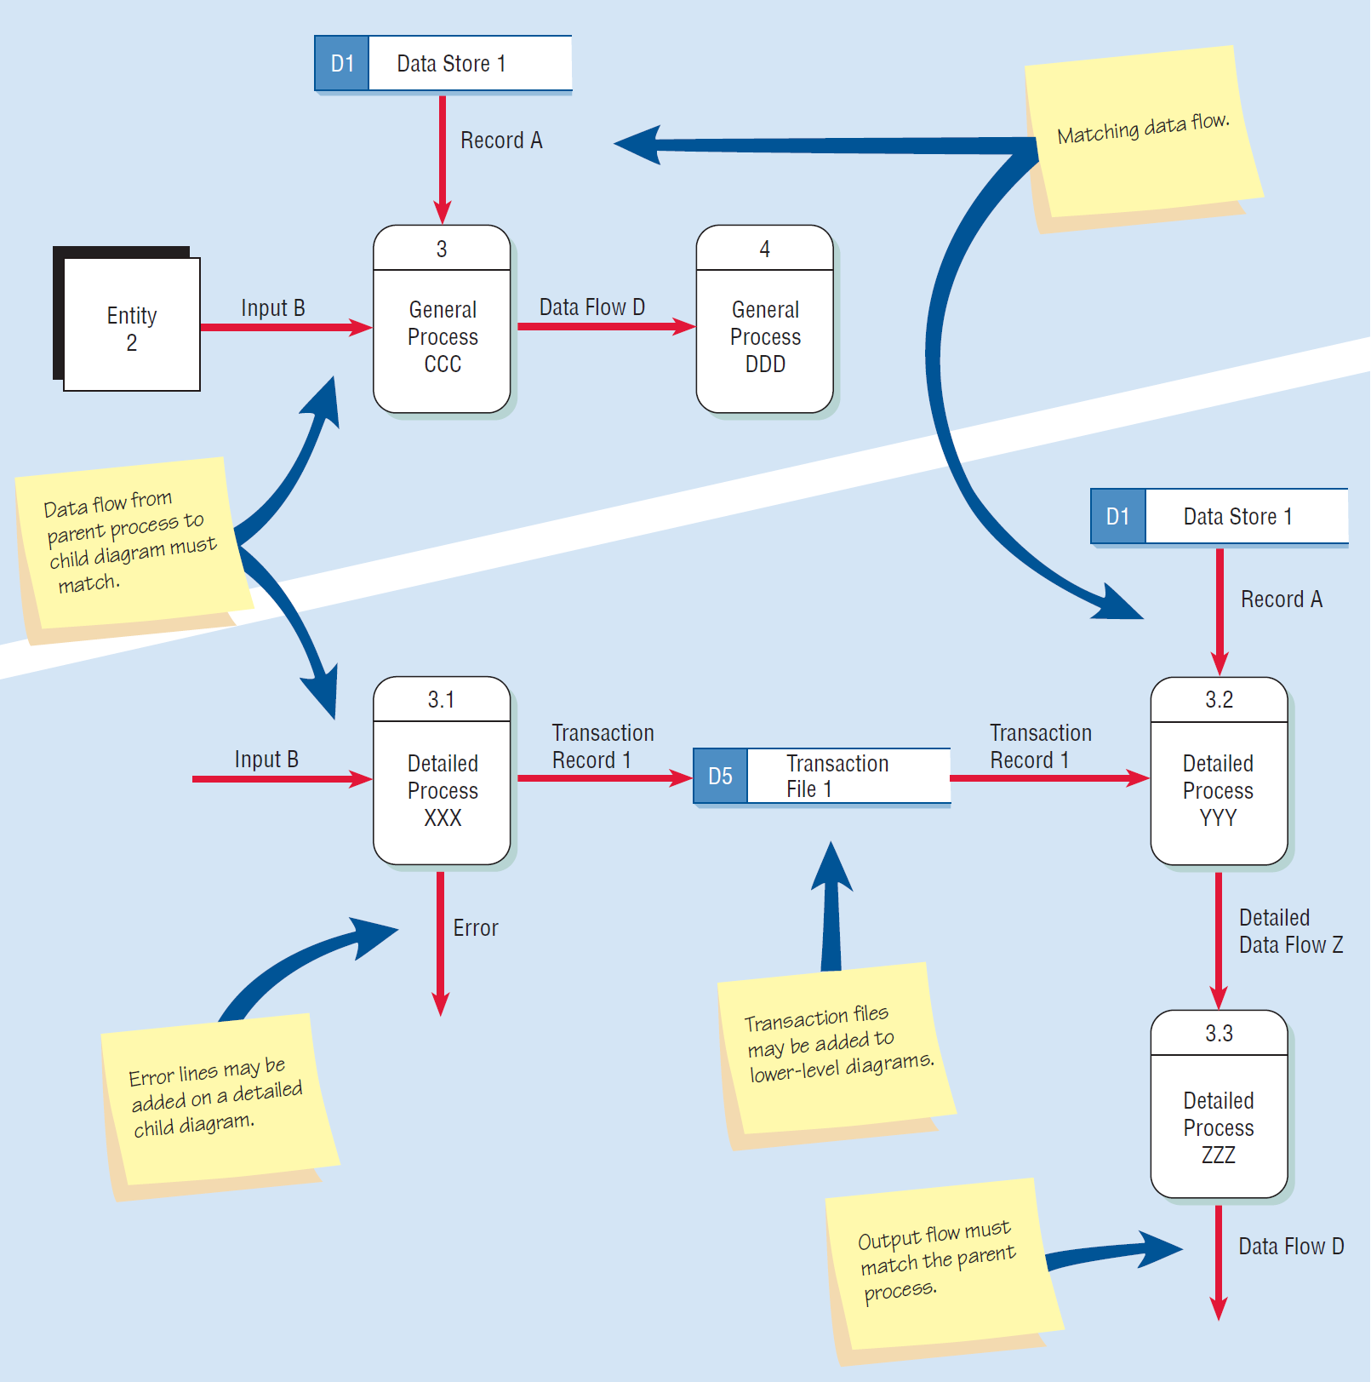
II
II. DATA FLOW DIAGRAM LEVEL
3. Child Diagrams
22

Slide 23
CREATING DATA FLOW DIAGRAMS
CREATING DATA FLOW DIAGRAMS
23

Slide 24
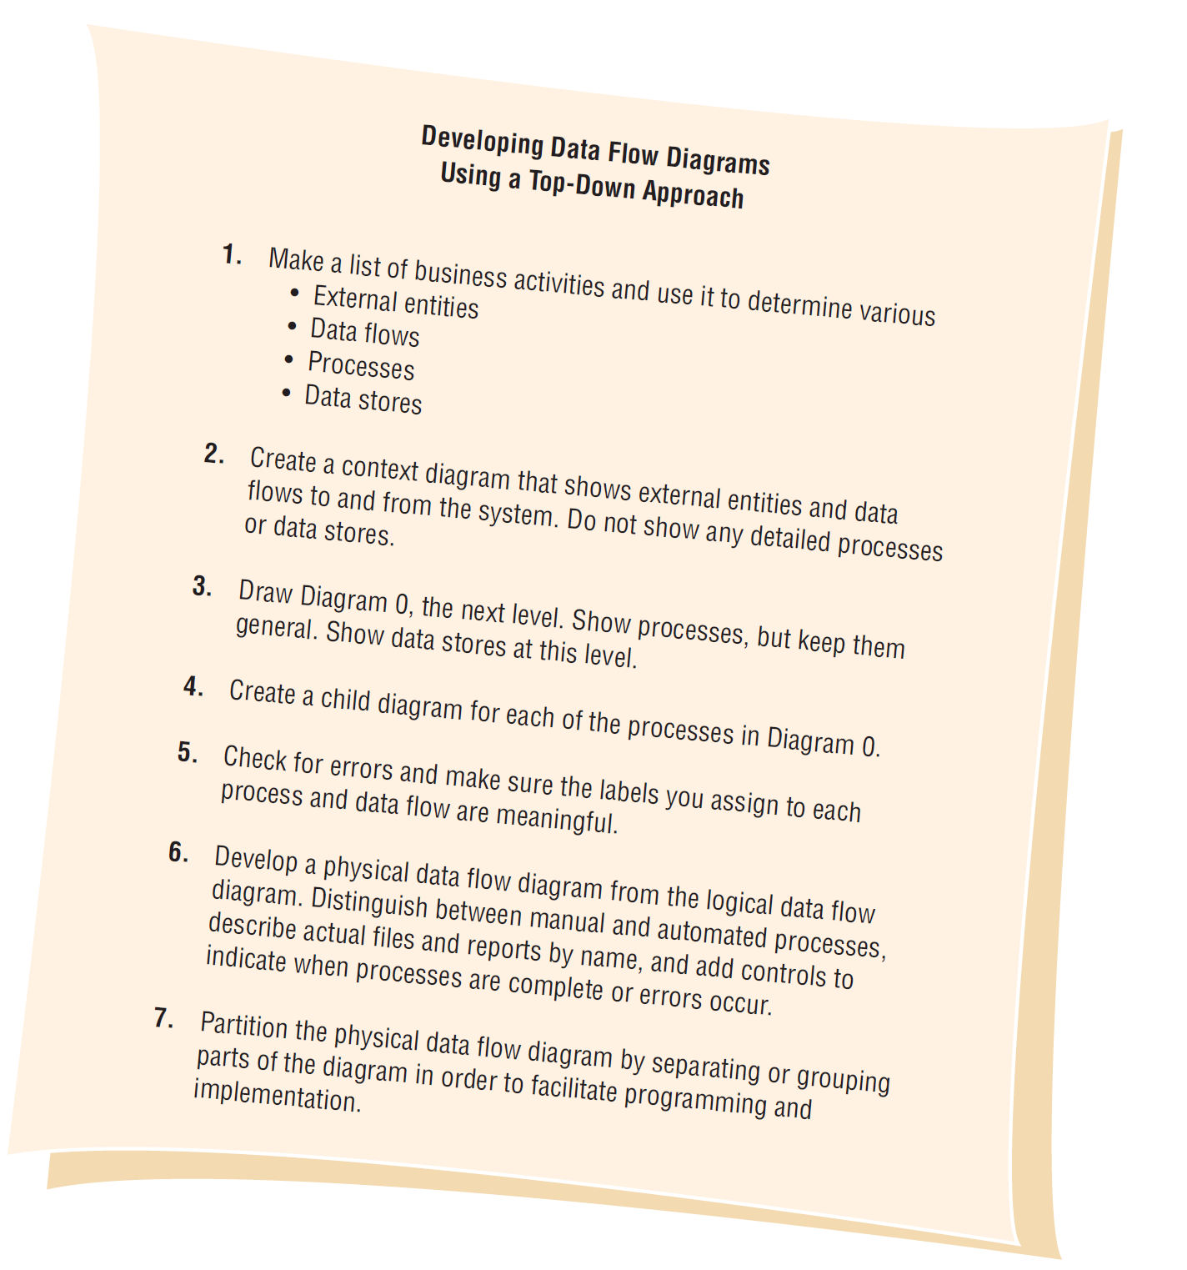
III
III. CREATING DATA FLOW DIAGRAMS
24

Slide 25
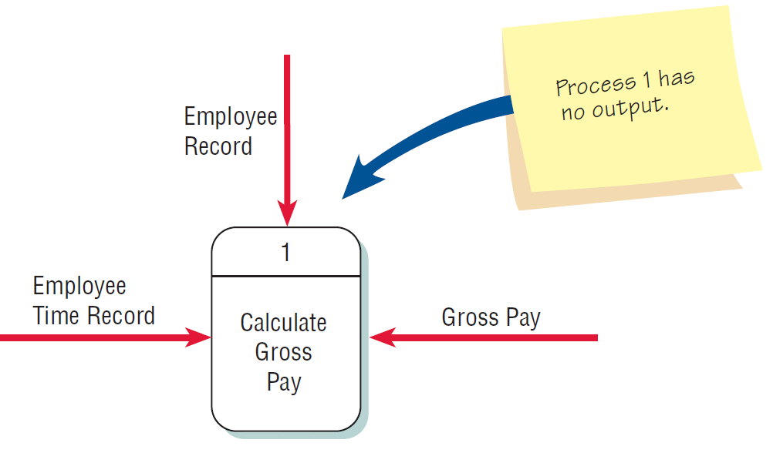
III
CHECKING THE DIAGRAMS FOR ERRORS
Forgetting to include a data flow or pointing an arrow in the wrong direction
25

Slide 26
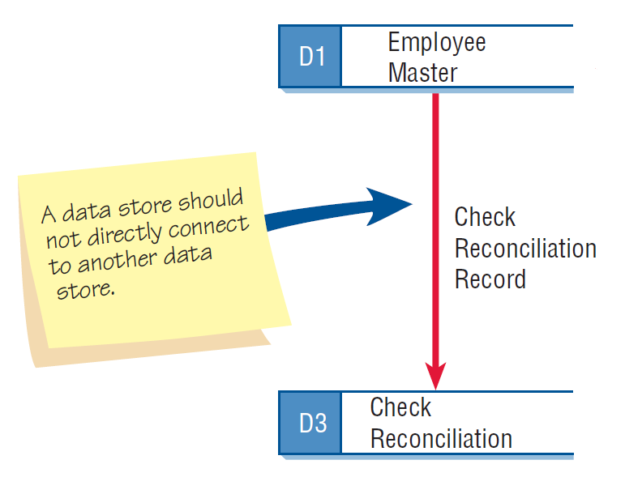
III
CHECKING THE DIAGRAMS FOR ERRORS
Connecting data stores and external entities directly to each other
26

Slide 27
III
CHECKING THE DIAGRAMS FOR ERRORS
Incorrectly labeling processes or data flow
Too many processes
Omitting data flow
Creating unbalanced decomposition (or explosion) in child diagrams
27

Slide 28
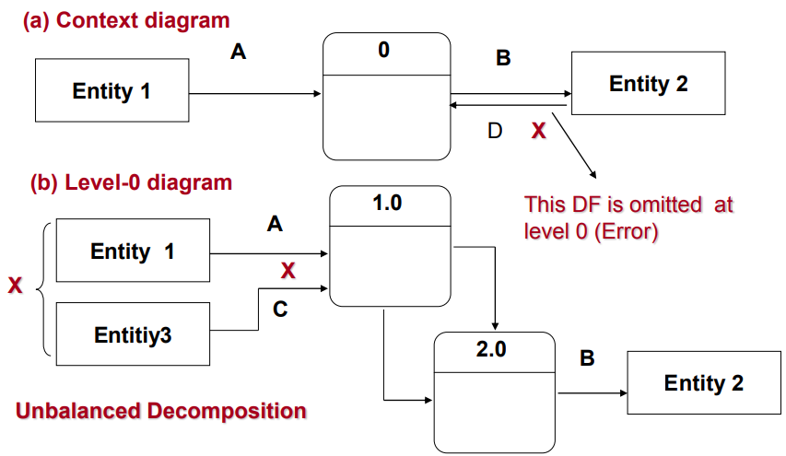
III
CHECKING THE DIAGRAMS FOR ERRORS
28

Slide 29
PHYSICAL AND LOGICAL DATA FLOW DIAGRAMS
PHYSICAL AND LOGICAL DATA FLOW DIAGRAMS
29

Slide 30
IV
Logical and Physical Data Flow Diagrams (DFD)
Logical DFD
  Focuses on the business and how the business operates
  Not concerned with how the system will be constructed
  Describes the business events that take place and the data required and produced by each event
Physical DFD
  Shows how the system will be implemented.
  Depicts the system.
30

Slide 31
IV
Features common of logical and physical DFDs
Design Feature | Logical | Physical
Model depicts? | How the business operates. | How the system will be implemented (or how the current system operates).
Processes present? | Business activities. | Programs, program modules, and manual procedures.
Data stores represent? | Collections of data regardless of how the data are stored. | Physical files and databases, manual files.
Type of data stores? | Show data stores representing permanent data collections. | Master files, transition files. Any processes that operate at two different times must be connected by a data store.
System controls? | Show business controls. | Show controls for validating input data, for obtaining a record (record found status), for ensuring successful completion of a process, and for system security (example: journal records).
31

Slide 32
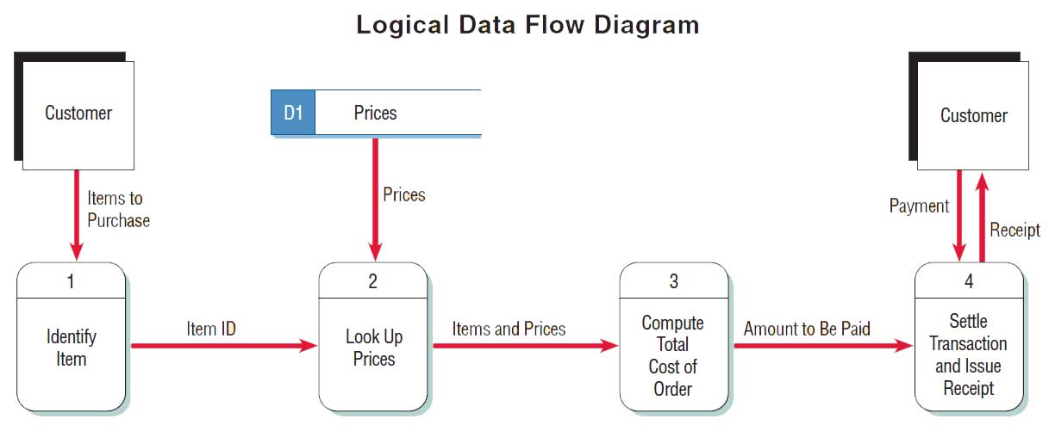
IV
Example: Logical DFD.
32

Slide 33
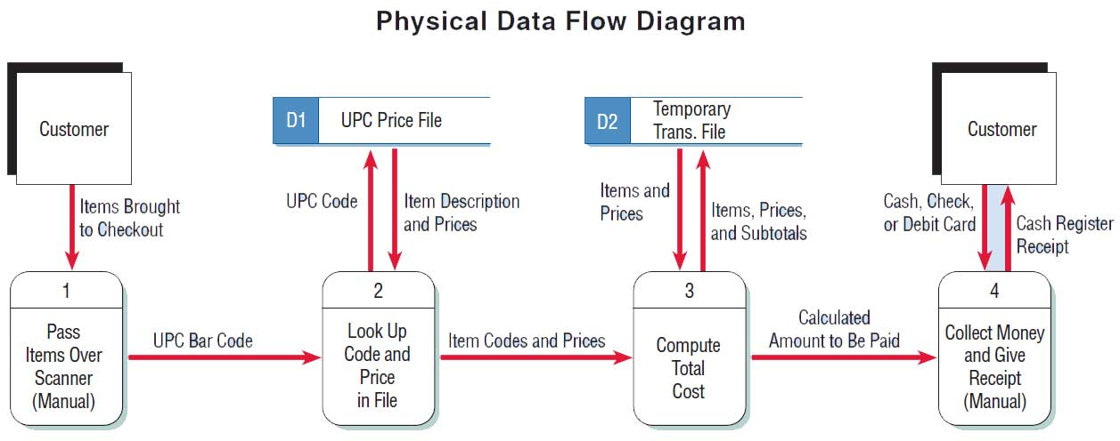
IV
Example: Physical DFD.
33

Slide 34
IV
Developing Logical Data Flow Diagrams
Advantages to using a LOGICAL model:
Better communication with users
More stable systems
Better understanding of the business by analysts
Flexibility and maintenance
Elimination of redundancy and easier creation of the physical model
34

Slide 35
IV
Developing Physical Data Flow Diagrams
Advantages to using a PHYSICAL model:
Clarifying which processes are performed by humans and which are automated
Describing processes in more detail
Sequencing processes that have to be done in a particular order
Identifying temporary data stores
Specifying actual names of files and printouts
Adding controls to ensure the processes are done properly
35

Slide 36
PARTITIONING
PARTIONING
36

Slide 37
V
Partitioning Data Flow Diagrams
Partitioning is the process of examining a data flow diagram and determining how it should be divided into collections of manual procedures and computer programs.
A dashed line is drawn around a process or group of processes that should be placed in a single computer program.
37

Slide 38
V
Reasons for Partitioning
Different user groups
Timing
Processes may be separated into different programs for security
Similar tasks
Efficiency
Consistency
Security
38

Slide 39
V
Partitioning Web Sites
Improves the way humans use the site.
Improves speed of processing.
Ease of maintaining the site.
Keep the transaction secure.
39

Slide 40
COMMUNICATING USING DATA FLOW DIAGRAMSS
COMMUNICATING USING DATA FLOW DIAGRAMS
40

Slide 41
VI
Communicating Using Data Flow Diagrams
Use unexploded data flow diagrams early when ascertaining information requirements.
Meaningful labels for all data components.
41

Slide 42
VI
SUMMARY
Data flow diagrams
    Structured analysis and design tools that allow the analyst to comprehend the system and subsystems visually as a set of interrelated data flows
DFD symbols
    Rounded rectangle
    Double square
    An arrow
    Open-ended rectangle
42

Slide 43
VI
SUMMARY
Creating the logical DFD
    Context-level data flow diagram
    Level 0 logical data flow diagram
    Child diagrams
Creating the physical DFD
    Create from the logical data flow diagram
    Partitioned to facilitate programming
43

Slide 44
VI
SUMMARY
Partitioning data flow diagrams
  Whether processes are performed by different user groups
  Processes execute at the same time
  Processes perform similar tasks
  Batch processes can be combined for efficiency of data
  Processes may be partitioned into different programs for security reasons
44

Slide 45
OUTLINE
OUTLINE
Data dictionaries
The data dictionaries
The data repository
Defining data flow
Defining data structures
Defining data elements
Using the data dictionary
XML
45

Slide 46
Learning Objectives
Learning Objectives
Understand analysts use of data dictionaries for analyzing data-oriented systems
Create data dictionary entries
Understand the concept of a repository and the role of CASE
Recognize the functions of data dictionaries
46

Slide 47
Learning Objectives
Cataloging
Data flow diagrams can be used to catalog
  Data processes
  Flows
  Stores
  Structures
  Elements
Cataloging takes place with the data dictionary
47

Slide 48
THE DATA DICTIONARY
THE DATA DICTIONARY
48

Slide 49
I
1. Definition
The data dictionary (DD) is quite simply a dictionary that defines data
A reference work of data about data (metadata)
Collects and coordinates data terms, and confirms what each term means to different people in the organization
49

Slide 50
I
2. Need for Understanding the Data Dictionary
Provide documentation
Eliminate redundancy
Validate the data flow diagram
Provide a starting point for developing screens and reports
Determine the contents of data stored in files
To develop the logic for DFD processes
Create XML
50

Slide 51
I
3. Components of the DD
=
+
[ ]
/
( )
{ }
* *
Equivalence
Concatenation
Either/Or Boundary
Optional
Iterations of
Comment
51

Slide 52
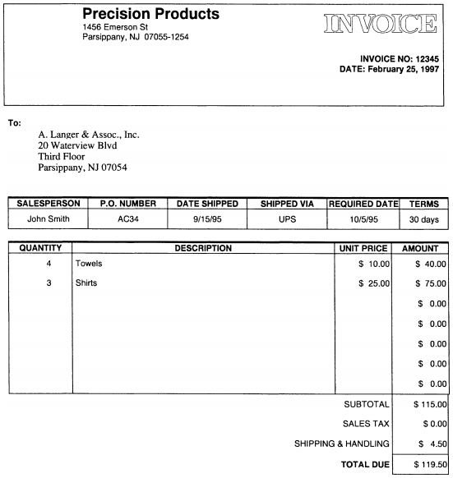
I
4. Example
52

Slide 53
I
4. Example (cont)
Vendor_Invoice = Vendor_Invoice+Invoice_Number+Vendor_Invoice_Date+
Vendor_Invoice_Name + Vendor_Invoice_Address_Line_1 +
Vendor_Invoice_Address_Line_2 +
Vendor_Invoice_Address_Line_3 + Vendor_State + Vendor_City +
Vendor_Zip_Code + Vendor_Salesperson + PO_Number +
Vendor_Date_Shipped + Vendor_Shipped_Via +
Vendor_Required_Date + Vendor_Terms + 1 {Item-Quantity +
Item_Description + Item_Unit_Price + Item_Amount} + Subtotal
Sales_Tax + Shipping/Handling + Invoice_Total_Due
53

Slide 54
THE DATA REPOSITORY
THE DATA REPOSITORY
54

Slide 55
II
1. Definition
A data dictionary contains information about data and procedures and a large collection of project information
The data dictionaries stores information relating to the data element’s behavior
55

Slide 56
II
2. The repository concept
Information about the data maintained by the system
Procedural logic and use cases
Screen and report design
Data relationships
Project requirements and final system deliverables
Project management information
56

Slide 57
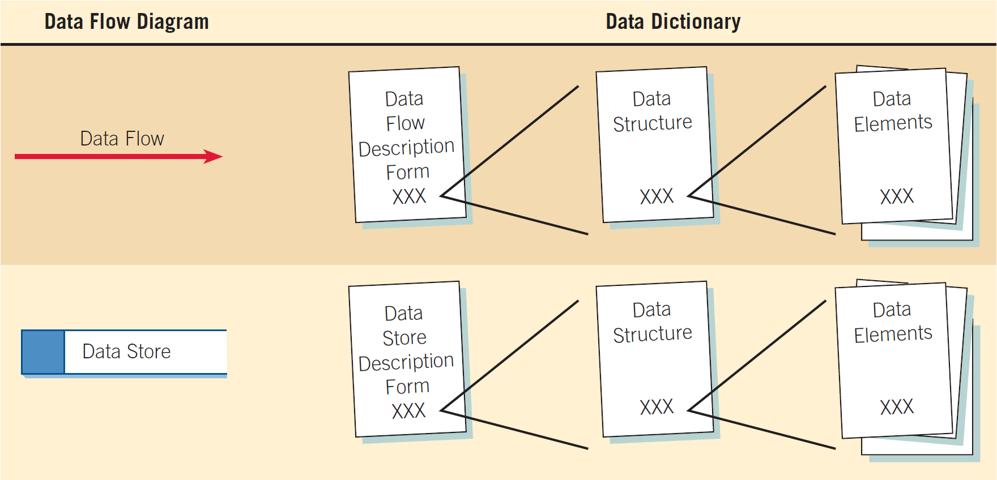
II
How DD relate to DFD
57

Slide 58
II
3. Data Dictionary Categories
Data flows
Data structures
Elements
Data stores
58

Slide 59
DEFINING DATA FLOW
DEFINING DATA FLOW
59

Slide 60
III
1. The source of the data flow
An external entity
A process
A data flow coming to or from a data store
2. Type of data flow
A record entering or leaving a file.
Containing a report, form, or screen.
Internal - used between processes
60

Slide 61
III
3. Defining the Data Flow
ID - identification number
Unique descriptive name
A general description of the data flow
The source of the data flow
The destination of the data flow
Type of data flow
The name of the data structure describing the elements
The volume per unit time
An area for further comments and notations
61

Slide 62
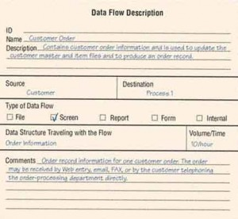
III
An example of a data flow description from World’s Trend Catalog Division
62

Slide 63
DEFINING DATA STRUCTURES
DEFINING DATA STRUCTURES
63

Slide 64
IV
1. Describing Data Structures
Data structures are made up of smaller structures and elements.
An algebraic notation is used to describe data structures.
64
Notes:
A record structure would be an example of a data structure.

Slide 65
IV
2. Algebraic Notation
Equal sign, meaning “is composed of”.
Plus sign, meaning "and”.
Braces {} meaning repetitive elements.
Brackets [] for an either/or situation.
Parentheses () for an optional element.
65
Notes:
Repetitive elements are also called repeating groups or tables.
Brackets – the elements listed between the brackets are mutually exclusive.
Parentheses – optional elements may be left blank on entry screens and may contain spaces or zeros for numeric fields in file structures.

Slide 66
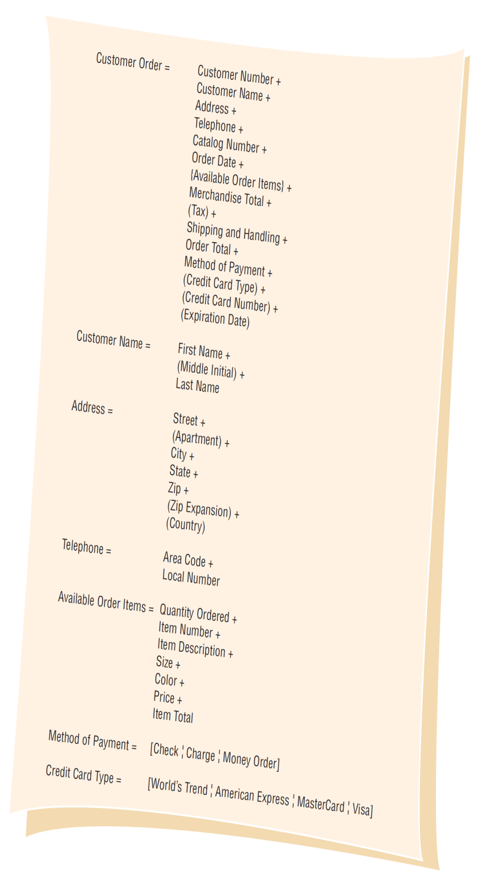
Data structure example
for adding a customer order
at World’s Trend Catalog Division
66

Slide 67
IV
3. Structural Records
A structure may consist of elements or structural records.
These are a group of elements, such as:
  Customer Name
  Address
  Telephone
Each of these must be further defined until they are broken down into their component elements.
67
Notes:
A structural record is made up of a group of element. Customer Name is made up of First Name, Middle Name, Last Name.

Slide 68
IV
3. Structural Records
Structural records and elements that are used within many different systems are given a non-system-specific name, such as street, city, and zip.
The names do not reflect a functional area.
This allows the analyst to define them once and use in many different applications.
68
Notes:
For example, City may be a customer city, supplier city, or employee city.

Slide 69
Structural Record
Example
69

Slide 70
IV
4. Logical and Physical Data Structures
Logical
  Show what data the business needs for its day-to-day operations.
Physical
  Include additional elements necessary for implementing the system.
70
Notes:
It is important that the logical design accurately reflect the mental model of how the user views the system.
The physical data structures are designed using the logical data structures as a basis.

Slide 71
IV
4. Logical and Physical Data Structures
Physical Data Structures:
  Key fields used to locate records
  Codes to identify record status
  Transaction codes to identify different record types
  Repeating group entries
  Limits on items in a repeating group
  Password
71
Notes:
Key fields used to locate records – An example is an item number, its not required for a business to function but is necessary for identifying and locating computer records.
Codes to identify record status – such as whether an employee is active or inactive.
Transaction codes to identify different record types – a credit file containing records for returned items as well as records of payments.
Repeating group entries – contain a count of how many items are in the group
Password – might be used by a customer accessing a secure Web site.

Slide 72
DEFINING DATA ELEMENTS
DEFINING DATA ELEMENTS
72

Slide 73
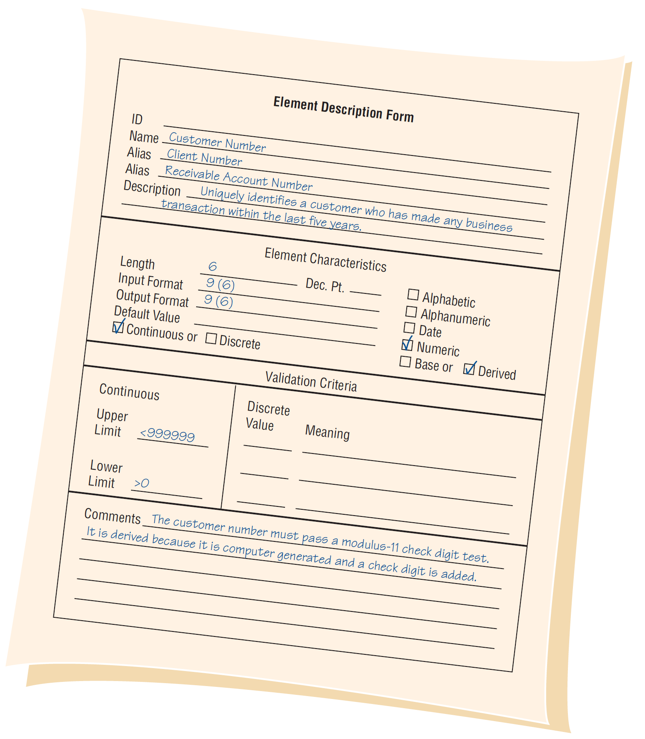
An element description
form example from
World’s Trend Catalog Division
73

Slide 74
V
1. Describing Data Structures
Element ID
The name of the element
Aliases
A short description of the element
Element is base or derived
Element length
Type of data
Input and output formats
Validation criteria
Default value
An additional comment or remark area
74
Notes:
Element ID - This optional entry allows the analyst to build automated data dictionary entries.
The name of the element - descriptive and unique; It should be what the element is commonly called in most programs or by the major user of the element.
Aliases - which are synonyms or other names for the element; These are names used by different users within different systems.
Whether the element is base or derived –
A base element is one that has been initially keyed into the system.
A derived element is one that is created by a process, usually as the result of a calculation or some logic.
Type of data – alphanumeric or text data.

Slide 75
V
2. Element ID
Optional entry.
Allows the analyst to build automated data dictionary entries.
75
Notes:
Element ID - This optional entry allows the analyst to build automated data dictionary entries.

Slide 76
V
3. The Nam of the Element
Should be:
  Descriptive
  Unique
Based on what the element is commonly called in most programs or by the major user of the element.
76
Notes:
The name of the element - descriptive and unique; It should be what the element is commonly called in most programs or by the major user of the element.

Slide 77
V
4. Aliases
Synonyms or other names for the element.
Names used by different users in different systems.
A CUSTOMER NUMBER may also be called a RECEIVABLE ACCOUNT NUMBER or a CLIENT NUMBER.
77
Notes:
Aliases - which are synonyms or other names for the element; These are names used by different users within different systems.

Slide 78
V
5. Short Description of the Element
An example might be:
  Uniquely identifies a customer who has made any business transactions within the last five years
78

Slide 79
V
6. Element Is Base or Derived
A base element is one that has been initially keyed into the system.
A derived element is one that is created by a process, usually as the result of a calculation or a series of decision making statements.
79
Notes:
Whether the element is base or derived –
A base element is one that has been initially keyed into the system.
A derived element is one that is created by a process, usually as the result of a calculation or some logic.

Slide 80
V
7. Element Length
What should the element length be
  Some elements have standard lengths, state abbreviations, zip codes, or telephone numbers
  For other elements, the length may vary and the analyst and user community must decide the final length
  Numeric amount lengths
  Name and address fields
  Other fields
80
Notes:
Numeric amount lengths - should be determined by figuring the largest number the amount will contain and then allowing room for expansion.
Totals should be large enough to accommodate the numbers accumulated into them.
Name and address fields – can be determined from a table.
Other fields – look at historical data found in the organization.

Slide 81
V
7. Element Length
An example of Name and Address Length:
Element | Length | Percent of data that will fit (U.S.)
Last Name | 11 | 98
First Name | 18 | 95
Company Name | 20 | 95
Street | 18 | 90
City | 17 | 99
81
Notes:
A name field of 11 characters will accommodate 98 percent of the last names in the United States.

Slide 82
V
8. Data Truncation
If the element is too small, the data will be truncated.
The analyst must decide how this will affect the system outputs.
If a last name is truncated, mail would usually still be delivered.
A truncated email address or Web address is not usable.
82

Slide 83
V
9. Type of Data
Alphanumeric or text data.
Formats:
  Mainframe: packed, binary, display
  Microcomputer (PC) formats
  PC formats, such as Currency, Number, or Scientific, depend on how the data will be used
83
Notes:
Type of data – alphanumeric or text data.
Mainframe: packed, binary, display –
Zoned decimal – used for printing and displaying data
Packed decimal – commonly used to save space on file layouts and for elements that require a high level of arithmetic to be performed on them.
Binary – suitable for the same purposes as the packed decimal format but is less commonly used.

Slide 84
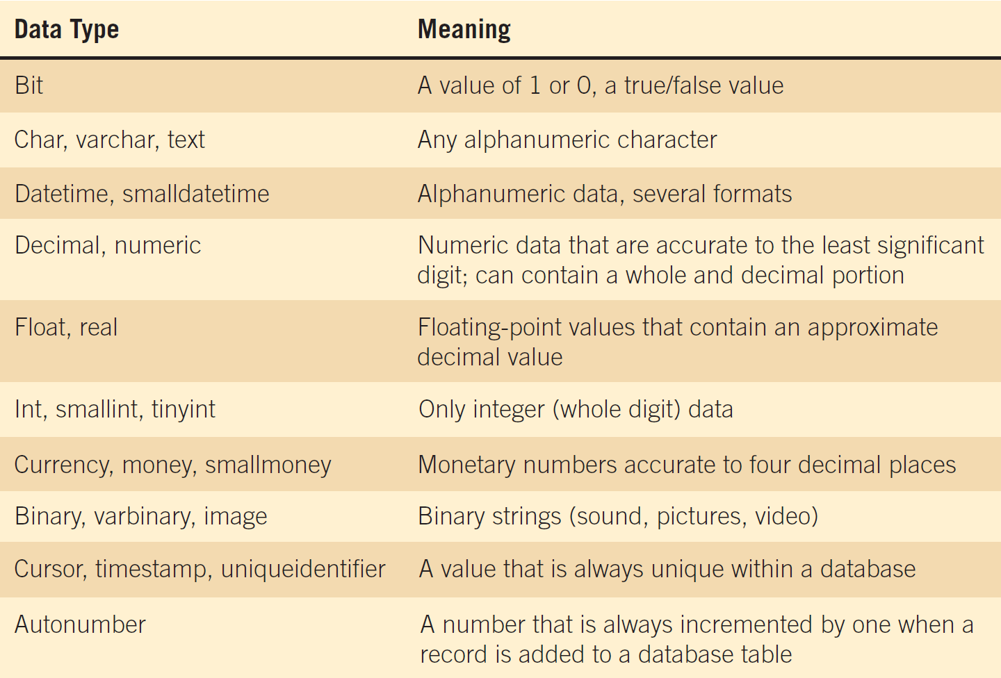
Some examples of data formats used in PC systems
84

Slide 85
Format character codes
85
Notes:
Input and output formats should be included, using coding symbols:
Z - Zero suppress.
9 – Number.
X – Character.
X(8) - 8 characters.
. , - Comma, decimal point, hyphen.
These may translate into masks used to define database fields.

Slide 86
V
10. Validation Criteria
Ensure that accurate data are captured by the system.
Elements are either:
  Discrete, meaning they have fixed values
  Continuous, with a smooth range of values
86
Notes:
Discrete –
Discrete elements are verified by checking the values within a program.
They may search a table of codes.
Continuous –
Continuous elements are checked that the data is within limits or ranges.

Slide 87
V
11. Default Value
Include any default value the element may have.
The default value is displayed on entry screens.
Reduces the amount of keying
  Default values on GUI screens
    Initially display in drop-down lists
    Are selected when a group of radio buttons are used
87

Slide 88
V
12. Comment or Remarks Area
This might be used to indicate the format of the date, special validation that is required, the check-digit method used, and so on.
88

Slide 89
DEFINING DATA STORES
DEFINING DATA STORES
89

Slide 90
VI
1. Data Stores
Data stores are created for each different data entity being stored.
When data flow base elements are grouped together to form a structural record, a data store is created for each unique structural record.
Because a given data flow may only show part of the collective data that a structural record contains, many different data flow structures may need to be examined to arrive at a complete data store description.
90
Notes:
Data stores are created for each different data entity being stored - All base elements must be stored in the system. Derived elements may also be stored in the system.

Slide 91
VI
2. Describing the Data Store
The Data Store ID
The Data Store Name
An Alias for the table
A short description of the data store
The file type
File format
91
Notes:
The Data Store ID – often mandatory to prevent the analyst from storing redundant information.
The Data Store Name - descriptive and unique.
An Alias for the table – such as CLIENT MASTER for the CUSTOMER MASTER.
The file type - computer or manual.
File format - Database table or flat file.

Slide 92
VI
2. Describing the Data Store
The maximum and average number of records on the file as well as the growth per year.
The file or data set name specifies the file name, if known.
The data structure should use a name found in the data dictionary.
Primary and secondary keys.
Comments.
92
Notes:
The maximum and average number of records on the file as well as the growth per year – helps the analyst to predict the amount of disk space required for the application, necessary for hardware acquisition planning.
The file or data set name specifies the file name, if known – in the initial stages this item may be left blank.
The data structure should use a name found in the data dictionary – provides a link to the elements for this data store.
Primary and secondary keys – must be elements (or a combination of elements) found in the data structure.
primary key should be unique
secondary key is used to control record sequencing on reports and to locate records directly.
Comments – used for information that does not fit into any of the above categories; update or backup timing, security and so on.

Slide 93
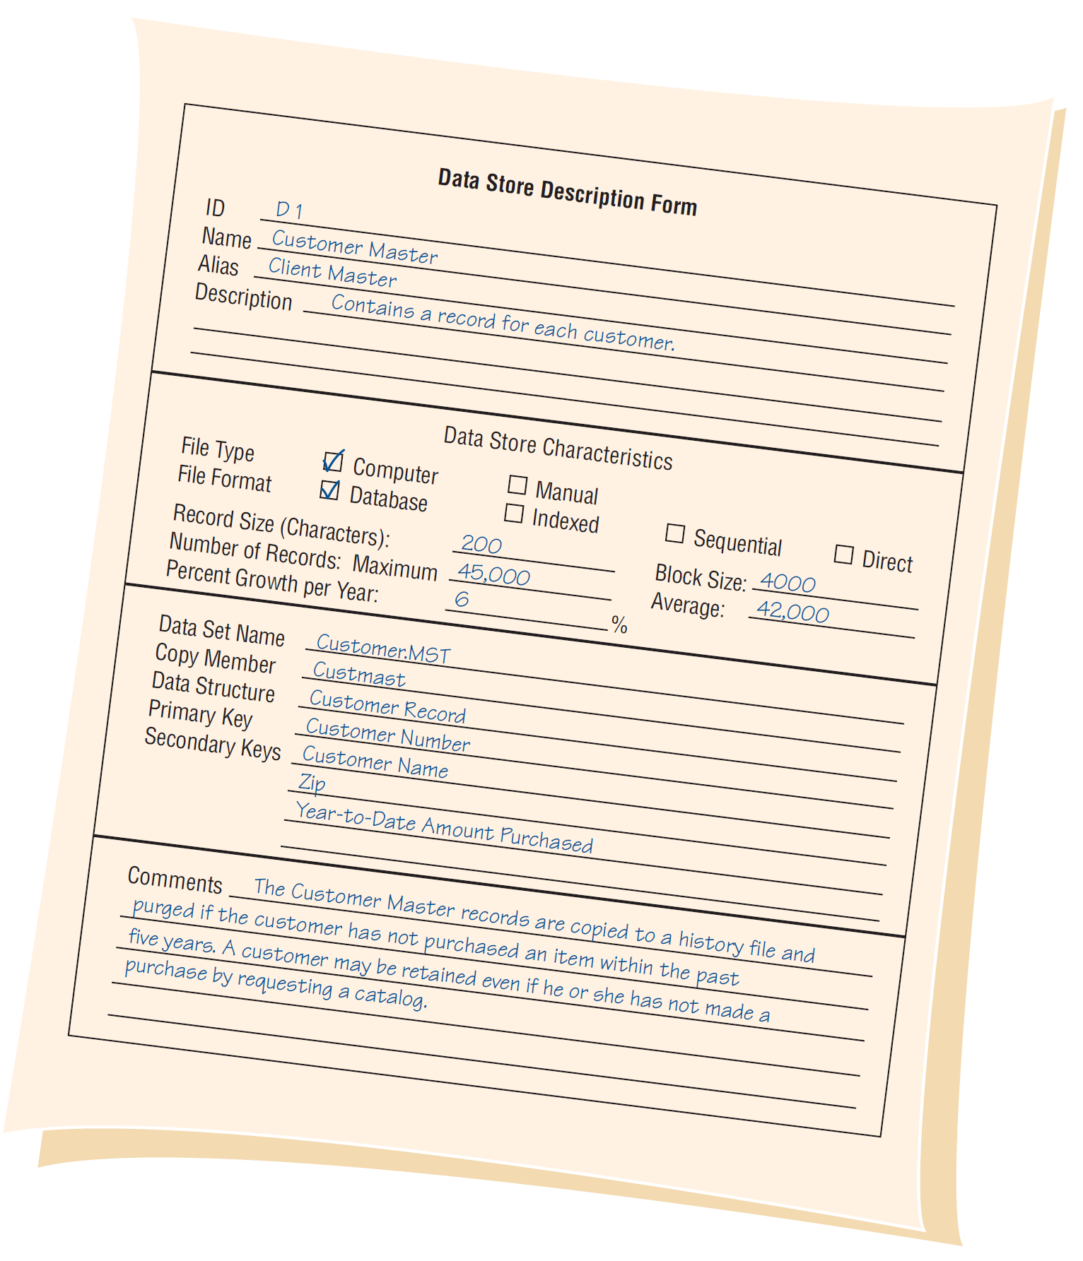
An example of
a data store form for
World’s Trend Catalog Division
93

Slide 94
VI
3. Creating the Data Dictionary
Data dictionary entries:
  Created after the data flow diagram is completed or
  Created as the data flow diagram is being developed
Created using a top-down approach.
94
Notes:
The use of algebraic notation and structural records allows the analyst to develop the data dictionary and the data flow diagrams using a top-down approach.

Slide 95
Two data flow diagrams and corresponding data dictionary entries for producing an employee paycheck
95
Notes:
It is important that he data flow names on the child data flow diagram are contained as elements or structural records in the data flow on the parent process. i.e. WAGE INFORMATION is a structural record contained in the EMPLOYEE RECORD.

Slide 96
VI
4. Analyzing Input and Output
A descriptive name for the input or output
The user contact responsible
Whether the data is input or output
The format of the data flow
Elements indicating the sequence of the data on a report or screen
A list of elements
96
Notes:
An important step in creating the data dictionary is to identify and categorize system input and output data flow.
A descriptive name for the input or output – if the data flow is on a logical diagram, the name should identify what the data are for, if on the physical design the names should include that information regarding the format.
The user contact responsible – for further details clarification, design, feedback, and final approval.
The format of the data flow – in the logical design stage the format may be undetermined.
A list of elements – including their names, lengths, and whether they are base or derived, and their editing criteria.

Slide 97
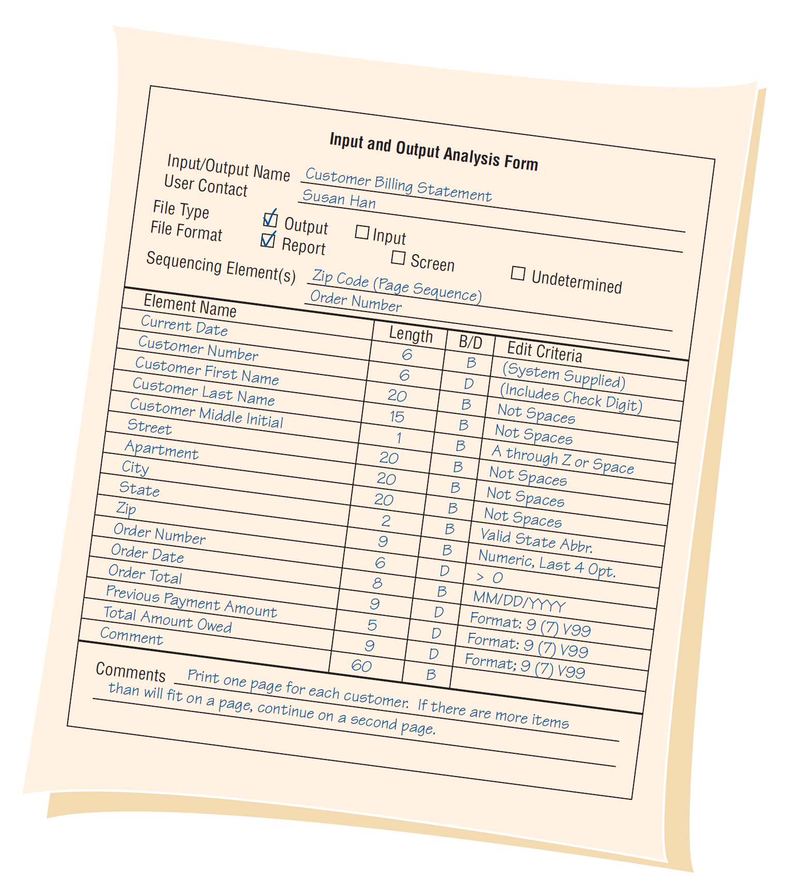
An example of an input/output analysis form for World’s Trend Catalog Division
97
Notes:
Once the forma has been completed, each element should be analyzed to determine whether the element repeats, whether it is optional, or whether it is mutually exclusive of another element.

Slide 98
VI
5. Developing Data Stores
Represent data at rest.
Contain information of a permanent or semipermanent (temporary) nature.
When data stores are created for only one report or screen, we refer to them as “user views”.
98
Notes:
Derived values do not have to be stored in a data store.
“user views” – the way the user wants to see the information.

Slide 99
USING THE DATA DICTIONARY
USING THE DATA DICTIONARY
99

Slide 100
VII
1. Using the Data Dictionary
To have maximum power, the data dictionary should be tied into a number of systems programs.
May be used to
  Create screens, reports, and forms
  Generate computer language source code
  Analyze the system design, detecting flaws and areas that need clarification
100
Notes:
The ideal data dictionary is automated, interactive, online, and evolutionary.
To have maximum power, the data dictionary should be tied into a number of systems programs – so that when an item is updated or deleted from the data dictionary, it is automatically updated or deleted from the database.

Slide 101
VII
2. Create Screens, Reports, and Forms
Use the element definition and their lengths.
Arrange the elements in a pleasing and functional way using design guidelines and common sense.
Repeating groups become columns.
Structural records are grouped together on the screen, report, or form.
101
Notes:
The ideal data dictionary is automated, interactive, online, and evolutionary.
To have maximum power, the data dictionary should be tied into a number of systems programs – so that when an item is updated or deleted from the data dictionary, it is automatically updated or deleted from the database.

Slide 102
VII
3. Analyze the System Design, Detecting Flaws and Areas that Need Clarification
All base elements on an output data flow must be present on an input data flow to the process producing the output
A derived element should created by a process and should be output from at least one process into which it is not input
The elements that are present in a data flow coming into or going out of a data store must be contained in the data store
102
Notes:
All base elements on an output data flow must be present on an input data flow to the process producing the output – base elements are keyed and should never be created by a process.
The data dictionary is the one common source in the organization for answering questions and settling disputes about any aspect of data definition.

Slide 103
XML
XML
103

Slide 104
VIII
Using Data Dictionaries to Create XML
XML is used to exchange data between businesses
XML addresses the problem of sharing data when users have different computer systems and software or different database management systems
XML documents may be transformed into different output formats
XML is a way to define, sort, filter, and translate data into a universal data language that can be used by anyone
XML may be created from databases, a form, software programs, or keyed directly into a document, text editor, or XML entry program
104

Slide 105
VIII
Using Data Dictionaries to Create XML (Continued)
The data dictionary is an ideal starting point for developing XML content
A standard definition of the data is created using a set of tags that are included before and after each data element or structure
XML elements may also include attributes
The XML document tends to mirror the data dictionary structure
105

Slide 106
VIII
XML Document Type Definitions
Used to determine if the XML document content is valid
DTDs may be created using the data dictionary
DTD may be used to validate the XML document
106

Slide 107
VIII
XML Schemas
A more precise way to define the content of an XML document
Includes exact number of times an element may occur
Includes type of data within elements
107

Slide 108
Q
&
A
Q & A
108

Slide 109
THANKS
THANKS
109

