Slide 1
Designing Effective Output/Input (UI)
Instructor: Nguyễn Thanh Tùng M.Sc.
Group 8:
Nguyễn Trường Giang 1510846
Nguyễn Vũ 1514106
Lê Xuân Hải 1411055
Huỳnh Nguyễn Trường Thịnh 1613343

Slide 2
DESIGNING EFFECTIVE
Làm thế nào để thiết kế một giao diện người dùng
(User Interface) tuyệt vời nhất
Notes:
Are your classroom colors different than what you see in this template? That’s OK! Click on Design -> Variants (the down arrow) -> Pick the color scheme that works for you!
Feel free to change any “You will…” and “I will…” statements to ensure they align with your classroom procedures and rules!

Slide 3
INPUT DESIGN
Cách mà người dùng trao đổi dữ liệu với sever.
Đánh giá chất lượng của thông tin mà người dùng sẽ cung cấp.

Slide 4
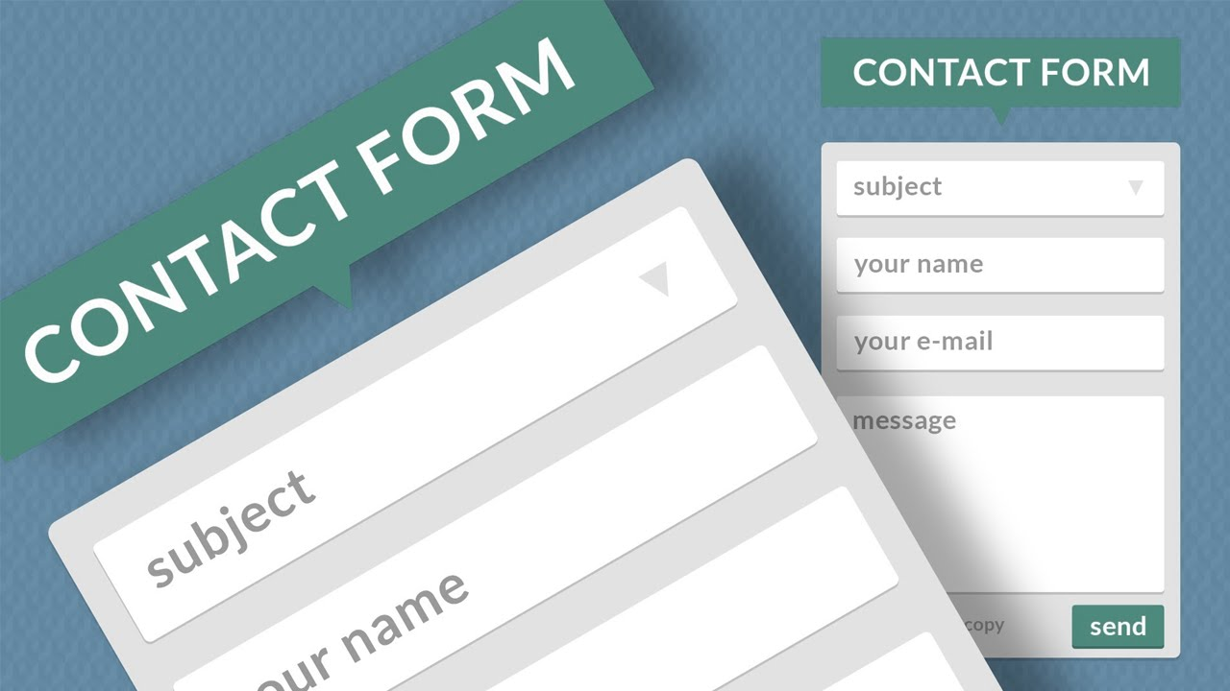
INPUT DESIGN
Các tiêu chí đánh giá
Độ hiệu quả
Tính chính xác
Tính dễ sử dụng
Độ đơn giản
Chất thu hút

Slide 5
Quy trình thiết kế form
Hình thành ý tưởng
Phát thảo ý tưởng thành một thứ gì đó cụ thể
Chia Form thành những phần nhỏ
Hoàn thiện

Slide 6
Hình thành ý tưởng
WHAT? → Đây là form gì
WHY? → Form này được tạo ra vì mục đích gì?
HOW? → Làm thế nào để thực hiện nó?
Notes:
Quá trình hình thành ý tưởng là quan trọng nhất, nó giúp bạn nhìn khái quát được những vấn đề cốt lõi cần được thực hiện trong quá trình thiết kế:
What? -> Định dạng được loại form: Khảo sát người dùng | Thu thập thông tin | Để kiểm tra
Why? -> Đi sâu hơn, mục tiêu: Lấy được thông tin người dùng về khẩu phần ăn hang ngày | Lấy thông tin địa chỉ để tặng quà
How? -> Để lấy được thông tin thì cần những trường nào, làm trắc nghiệm checkbox hay input text,...

Slide 7
Phát họa ý tưởng
Notes:
Quy tắc: giữ cho suy nghĩ đơn giản nhất có thể
-> Những trường nếu thiếu thì sẽ không hoạt động được
--> VD: Trường lấy địa chỉ để ship thì địa chỉ bắt buộc, tên và số điện thoại có hay không cũng được
--> VD: Mail chỉ cần địa chỉ người nhận, không cần địa chỉ người gởi

Slide 8
Phát họa ý tưởng
Form Flow
Hình thành khung sườn, những chi tiết chính, giảm thiểu lỗi xảy ra trong quá trình tạo dựng form.
Nên bắt đầu từ trên xuống dưới, từ trái qua phải

Slide 9
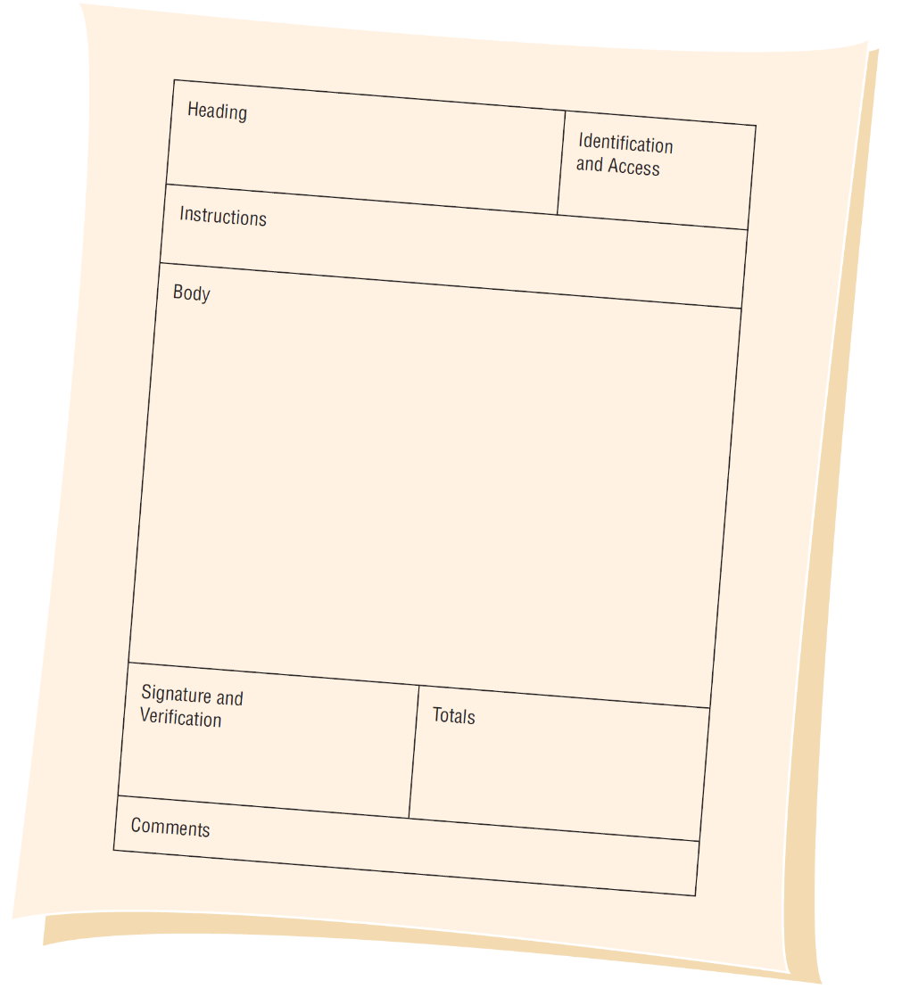
Phát họa ý tưởng
7 thành phần của một form tốt
Header
Identification and access
Instructions
Footer: Signature, verification, totals, and comments
Notes:
Heading: thường chứa tên và địa chỉ của người hoặc tổ chức tạo form
Identification and access : chứa mã code để có thể truy cập đến sau này (mã vạch, qr code,..)
Instructions: Giới thiệu, các chỉ dẫn và lưu ý về cách điền form
Body: Nơi chứa những câu hỏi
Footer: Những cách hợp lý để kết thúc một form (chữ ký, xác minh, tổng kết, và nhận xét)

Slide 10
CÁC QUY TẮC GIÚP BẠN THIẾT KẾ ĐẸP HƠN

Slide 11
Ánh sáng đổ từ trên xuống
Notes:
Ở phía trên màu sang, ở phía dưới màu tối
Các cạnh bên sẽ có xu hướng ngã đen
Hiệu ứng đổ bóng theo hướng sáng

Slide 12
Sử dụng Flat template
Notes:
Giữ cho mọi thứ đơn giản nhưng không kém thu hút

Slide 13
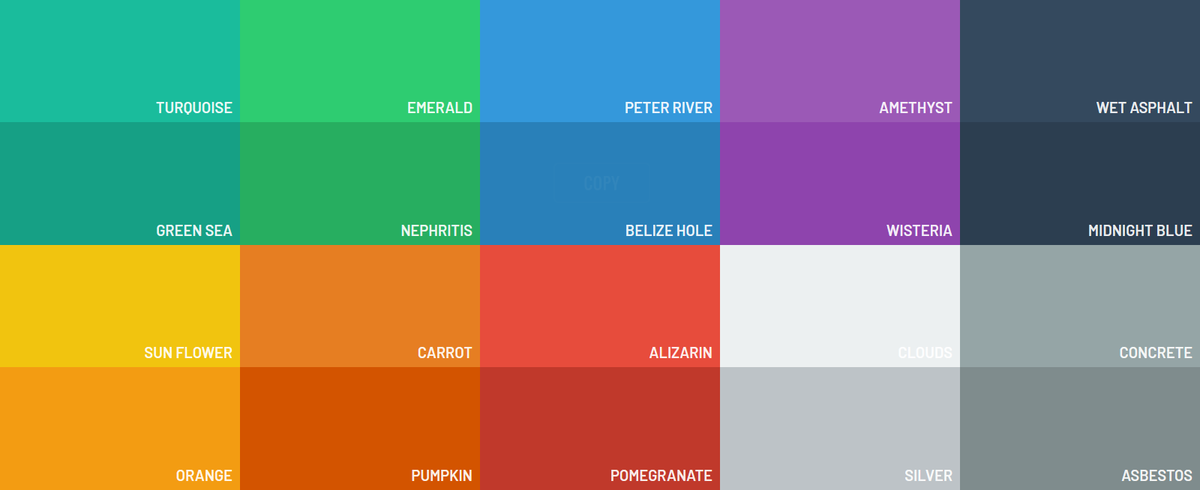
Sử dụng Flat Template

Slide 14
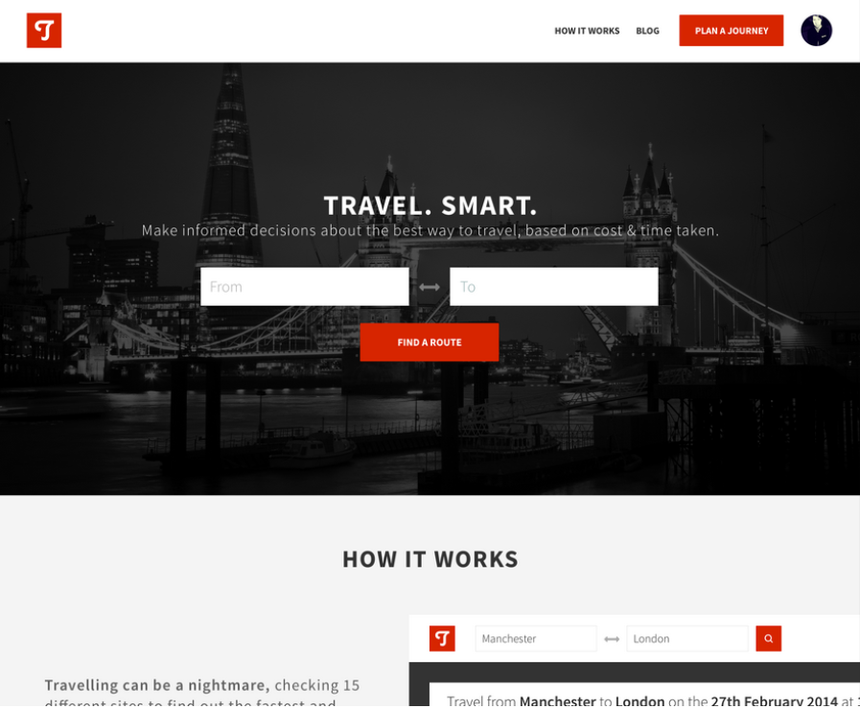
Notes:
Đây là cách chắc chắn và đơn giản nhất để design trở nên "clean" và "simple". Dùng quá nhiều màu sắc ở quá nhiều chỗ là cách dễ nhất để phá hỏng luật clean và simple. Tập trung vào chế độ đen trắng sẽ bắt buộc bạn phải tập trung đầu tiên vào những thứ như khoảng trắng, độ dài và bố cục. Và đó chính là những yếu tố quan trọng nhất cho một design được coi là "clean" và "simple".

Slide 15
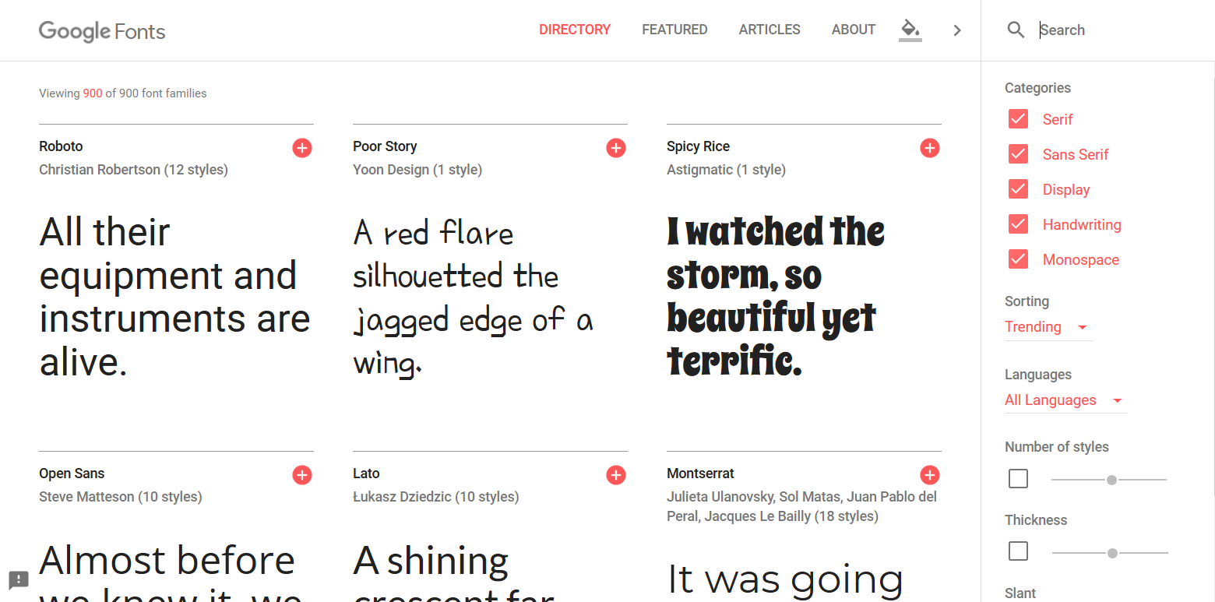
Sử dụng Font tốt
Notes:
Sử dụng từ 2-3 font để giúp nổi bật những điểm cần thiết
Bắt buộc sử dụng những font tốt

Slide 16
Open Sans

Slide 17
Montserrat

Slide 18
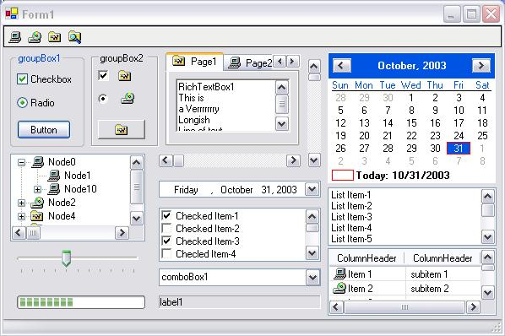

Slide 19
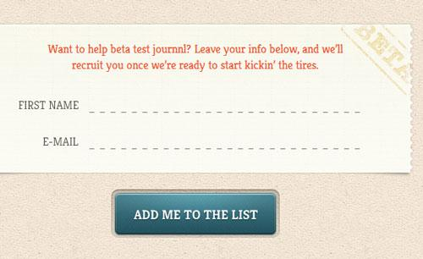
Tăng gấp đôi khoảng trắng

Slide 20
User Interface Elements

Slide 21
Checkboxes
Check boxes are used for nonexclusive choices
Captions are placed to the right of the check box
If there are more than 10 check boxes, group with a border or white space

Slide 22
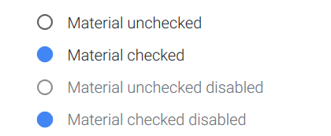
Radio buttons
Radio buttons are used to allow users to select one item at a time.

Slide 23
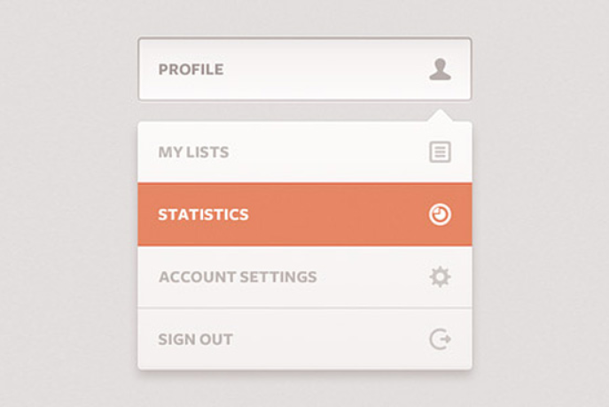
Dropdown lists
Dropdown lists allow users to select one item at a time, similarly to radio buttons, but are more compact allowing you to save space. Consider adding text to the field, such as ‘Select one’ to help the user recognize the necessary action.

Slide 24
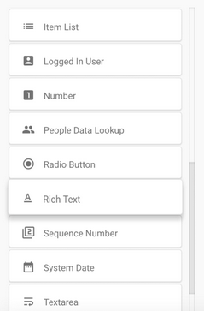
List boxes
List boxes, like checkboxes, allow users to select a multiple items at a time,but are more compact and can support a longer list of options if needed.

Slide 25
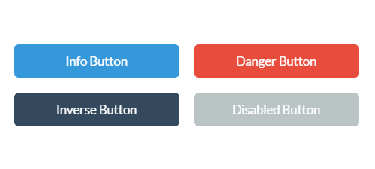
Buttons
A button indicates an action upon touch and is typically labeled using text, an icon, or both.

Slide 26
Dropdown Button
The dropdown button consists of a button that when clicked displays a drop-down list of mutually exclusive items.

Slide 27
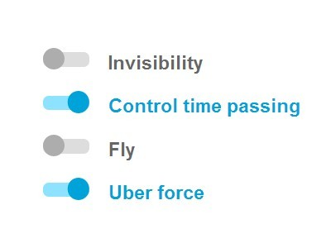
Toggles
A toggle button allows the user to change a setting between two states. They are most effective when the on/off states are visually distinct.

Slide 28
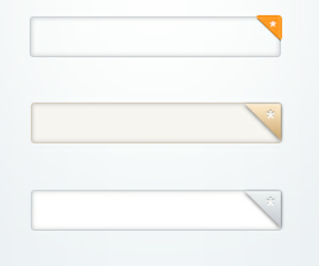
Text fields
Text fields allow users to enter text. It can allow either a single line or multiple lines of text.

Slide 29
Avoid
Avoid dropdown menus with less than 4 options. Use radio buttons instead;
Visually group related details, such as first name and last name (even better combine them into one field ‘Full name’);
Date of birth can be a single datepicker, not three separate dropdown menus;
Try to avoid optional fields in forms. If you cannot, a simple '(optional)' in the label is enough to differentiate it from the other fields.

Slide 31
Tab Control Dialogue Boxes
Tab control dialog boxes help organize GUI features (controls) for users
Each tab dialog box should have three basic buttons:
OK
Cancel
Help

Slide 32
DESIGNING EFFECTIVE OUTPUT

Slide 33
DESIGNING EFFECTIVE OUTPUT
Learning Objectives
Understand the objectives for effective output design
Relate output content to output methods inside and outside the organizational context
Realize how output bias affects users
Design display output
Design tabular and graphic output for users interacting with decision support systems
Design a Web site for ecommerce

Slide 34
OUTPUT
Information delivered to users
Output forms
Hard-copy - printed reports
Soft-copy - computer screens, video, audio
To create output, the analyst works interactively with the user until the output is satisfactory
Notes:
Output is information delivered to users through an information system by way of intranets, extranets, or the Web.
Some data require extensive processing before they become suitable output; other data are stored, and when they are retrieved, they are considered output, with little or no processing.
Output can take many forms, including soft copy such as display screens, smartphones, tablets, microforms, and video and audio output, as well as the traditional hard copy of printed reports.
Users rely on output to accomplish their tasks, and they often judge the merit of a system solely by its output. To create the most useful output possible, a systems analyst must work closely with users through an interactive process until the result is considered to be satisfactory.

Slide 35
DESIGNING EFFECTIVE OUTPUT
Major Topics
Output Design Objectives
Output technologies
Factors in choosing an output technology
Report design
Screen design
Web site design

Slide 36
Output Design Objectives

Slide 37
Output Design Objectives
1. Serve a specific user or organizational purpose
2. Meaningful to the user
3. Deliver the appropriate quantity of output
4. Make sure the output is where it is needed
5. Provide output on time
6. Choosing the right output method
Notes:
1. Designing Output to Serve the Intended Purpose :
All output should have a purpose.
Analyst should find out what purposes are
Output is then designed based on those purposes.
If the output is not functional, it should not be created because there are costs of time and materials associated with all output from a system.
=====================================================================
2. Designing Output to Fit the User:
With a large information system serving many users for many different purposes, it is often difficult to personalize output.
On the basis of interviews, observations, cost considerations, and perhaps prototypes, it will be possible to design output that addresses what many, if not all, users need and prefer.
((Generally speaking, it is most practical to create user-specific or user-customizable output when designing for a decision support system or other highly interactive applications such as those using the Web as a platform. It is still possible, however, to design output to fit a user’s tasks and function in the organization, which leads us to the next objective.))
=====================================================================
3. Delivering the Appropriate Quantity of Output :
Part of the task of designing output is deciding what quantity of output is correct for users
For example, ... subset => detail later
=====================================================================
4. Making Sure the Output Is Where It Is Needed :
Output is often produced at one location and then distributed to the user.
To be used and useful, output must be presented to the right user.
No matter how well designed reports are, if the pertinent decision makers do not see them, they have no value.
=====================================================================
5. Providing Output on Time
One of the most common complaints of users is that they do not receive information in time to make necessary decisions. It plays a large part in how useful output will be.
Many reports are required on a daily basis, some only monthly, others annually, and others only by exception.
Using Web
Accurate timing of output can be critical to business operations.
=====================================================================
6. Choosing the Right Output Method Choosing the right output method for each user is another objective in designing output. Much output now appears on display screens, and users have the option of printing it out with their own printer. An analyst needs to recognize the trade-offs involved in choosing an output method. Costs differ; for the user, there are also differences in the accessibility, flexibility, durability, distribution, storage and retrieval possibilities, transportability, and overall impact of the data. The choice of output methods is not trivial, nor is it usually a foregone conclusion.

Slide 38
Relating Output Content to Output Method

Slide 39
Relating Output Content to
Output Method
Content of output must be considered as interrelated to the output method
External – going outside the business
Internal – staying within the business
Notes:
“The content of output from information systems must be considered as interrelated to the output method.”
Whenever you design output, you need to think of how function influences form and how the intended purpose will influence the output method that you choose.
Output is useful to people in some way can be considered output.
external (going outside the business), such as information that appears to the public on the Web,
internal (staying within the business), such as material available on an intranet.

Slide 40
Relating Output Content
to Output Method
External Output:
Utility bills
Advertisements
Paychecks
Annual Reports
Communications
Notes:
External output is familiar through:
- utility bills,
- advertisements,
- paychecks,
- annual reports,
- other communications that organizations have with their customers, vendors, suppliers, industry, and competitors.
Systems analysts sometimes design external output, such as utility bills, to serve double duty as turnaround documents. Figure 11.1 is a gas bill that is a turnaround document for a gas company’s data processing. The output for one stage of processing becomes the input for the next. When the customer returns the designated portion of the document, it is optically scanned and used as computer input.

Slide 41
Relating Output Content to
Output Method
External Output:
Differs from internal output in:
Distribution
Design
Appearance
Notes:
Distribution :
- External: towards their customers, vendors, suppliers, industry, and competitors.
- Internal : towards staffs
Design & Appearance :
- External : More colorful
- Internal : Simple

Slide 42
Relating Output Content to
Output Method
Internal Output:
Examples:
Summary reports
Detailed reports
Historical reports
Exception reports
Might consist of material available on an intranet
Notes:
Internal outputs include various reports to decision makers.
- A summary report : summarizing monthly sales totals.
- A detailed report might give weekly sales by salesperson
- Other kinds of internal reports include historical reports and exception reports that are output only at the time an exception occurs
- Examples of exception reports are a listing of all employees with no absences for the year, a listing of all salespeople who did not meet their monthly sales quota, or a report on consumer complaints made in the past six months.

Slide 43
Output Technologies
Printers
Display screen
Audio output and Podcasts
DVD, CD-ROM and CD-RW
Electronic output
Notes:
Producing different types of output requires different technologies

Slide 44
Output Technologies
Printers
The trend in printers is toward increased flexibility
Key factors of printers:
Reliability
Compatibility with software and hardware
Manufacturing support
Notes:
For printed output, the options include a variety of printers, including standard document printers, specialized label printers, and 3-D printers
Văn bản hành chính -

Slide 45
Output Technologies
Display Screen
Advantages:
Result in cost savings
May be desirable from the user’s standpoint
Easier to keep up to date
Disadvantages:
Different screen resolutions
Fonts
Notes:
For screen output, the options include attached or stand-alone displays as well as touch-sensitive screens found on smartphones and tablets

Slide 46
Output Technologies
Video, Audio and Animation
Video
Combines the impact of audio with a visual channel
Audio
Transient, usually output for the benefit of one user
Animation
The presentation of different images in a series, one at a time

Slide 47
Output Technologies
Electronic Output
Electronic mail (email)
Faxes
Bulletin board messages

Slide 48
Output Technologies
RSS (Really Simple Syndication)
A way of gathering and distributing news and other content from multiple sources
RSS news readers can either stand alone or be integrated with your browser as plug-ins
Has the advantage of efficiently organizing news and other information from a variety of sources chosen by the user

Slide 49
Output Technologies
Push and Pull Technologies
Pull technology allows the user to take formatted data from the Web
Push technology sends solicited or unsolicited information to a customer or client

Slide 50
Output Technologies
A comparison of output methods

Slide 51
Factors to consider when
choosing Output Technology
Who will use the output
How many people need the output
Where is the output needed
What is the purpose
What is the speed with which output is needed
How frequently will the output be accessed
How long will the output be stored
Regulations depicting output produced, stored, and distributed
Initial and ongoing costs of maintenance and supplies
Human and environmental requirements
Notes:
There are several factors to consider when choosing output technology. Although the technology changes rapidly, certain usage factors remain fairly constant in relation to technological breakthroughs. These factors, some of which present trade-offs, must be considered. They include the following:
Increasingly, organizations are taking up green IT initiatives as part of sustainability efforts. These initiatives may limit the quantity of paper reports that are printed or may discourage employees from printing out copies of email messages by adding a green IT notification to the bottom of each corporate email message. Examining each output factor separately will allow you to see the interrelationships and how they may be traded off for one another in a particular system.
============================================================================
Who will use the output :
For example, when district managers must be away from their desks for extended periods, they need printed output that can travel with them or technology that can access appropriate websites and databases as they visit the managers in their region. Screen output or interactive Web documents are excellent for people such as truck dispatchers who are deskbound for long periods.
============================================================================
How many people need the output ?
- If many people need output, Web-based documents with a print option or printed copies are probably justified.
- Some external customers may want a printed copy of specific documents, such as a stockholder report or a monthly billing statement, but others may prefer Web-based documents with an email notification.
- If only one user needs the output, a screen or audio may be more suitable.
============================================================================
Where is the output need ?
The choice of output technology is influenced by the physical destination of the output.
Information that will remain close to its point of origin, that will be used by only a few users in the business, and that may be stored or referred to frequently can safely be printed or mounted on an intranet.
An abundance of information that must be transmitted to users at “ great distances in branch “ operations may be better distributed electronically, via the Web or extranets, with the recipient customizing it.
Sometimes federal or state regulations dictate that a printed form remain on file at a particular location for a specified period of time. In those instances, it is the responsibility of the systems analyst to see that the regulation is observed for any output that is designed.
============================================================================
What is the purpose ?
If it is intended to be a report created to “ attract shareholders “ to the business by allowing them to peruse corporate finances at their leisure, well-designed, printed output such as an annual report is desirable. A variety of media may also be used so that the annual report is available on the Web as well as in printed form.
If the purpose of output may be to provide instant updates on stock market quotes, and if the material is highly encoded and changeable, screen crawls, web pages, or audio presentations are preferable. Output must support user tasks, such as performing analysis, or determining ratios, so software tools, including calculators and embedded formulas, could be part of output. Output must also support organizational tasks such as tracking, scheduling, and monitoring.
============================================================================
WhaT is The speed WiTh Which oUTpUT is needed?
at the lowest level of operations management need output rapidly so that they can quickly adjust to events such as a stopped assembly line, raw materials not arriving on time, or a worker being absent unexpectedly. Online screen output may be useful here.
at the lowest level of operations management need output rapidly so that they can quickly adjust to events such as a stopped assembly line, raw materials not arriving on time, or a worker being absent unexpectedly. Online screen output may be useful here.
============================================================================
How frequently will the output be accessed ?
The more frequently output is accessed, the more important is the capability to view it on a display connected to local area networks or the Web
Infrequently accessed output that is needed by only a few users is well suited to a CD-ROM archive
============================================================================
hoW long Will (or MUsT) The oUTpUT be sTored?
- Output printed on paper deteriorates rapidly with age
- As long as the corporation is willing to maintain it and it is nonproprietary, archival information, it can be maintained in Web documents as part of the organization’s website. Organizations can enact their own internal policies about how long output must be retained.
============================================================================
Under WhaT special regUlaTions is The oUTpUT prodUced, sTored, and disTribUTed
- The appropriate format for some output is actually regulated by the government
============================================================================
hUMan environMenTal reqUireMenTs
- Printers require a dry, cool environment to operate properly. Displays require space for setup and viewing. Audio and video output require a quiet environment if they are to be heard, and they should be audible only to employees (or customers) who are using them
- Set up environment

Slide 52
Realizing How Ouput Bias affects Users
Notes:
Output is not just a neutral product that is subsequently analyzed and acted on by decision makers. Output affects users in many different ways. Systems analysts must put great thought and care into designing output so as to avoid biasing it.

Slide 53
Recognizing Bias in the way Ouput is used
Analysts must avoid unnecessarily biasing output and make users aware of the possible biases in output
Bias is introduced in three main ways:
How information is sorted
Setting of acceptable limits
Choice of graphics
Notes:
It is a common error to assume that once a systems analyst has signed off on a system project, his or her impact is ended. Actually, the analyst’s influence is long-lasting. Much of the information on which organizational members base their decisions is determined by what analysts perceive is important to the business. Bias is present in everything that humans create. This statement is not to judge bias as bad but to make the point that it is inseparable from what we (and consequently our systems) produce. The concerns of systems analysts are to avoid unnecessarily biasing output and to make users aware of the possible biases in the output they receive. Presentations of output are unintentionally biased in three main ways:
“

Slide 54
Avoiding Bias in the Design Output
Be aware of the sources of bias
Design of output that includes users
Working with users so that they are informed of the output's biases
Creating output that is flexible and allows users to modify limits and ranges
Train users to rely on multiple output for conducting "reality tests" on system output
Notes:
Systems analysts can use specific strategies to avoid biasing the output they and others design: :
:
All these strategies except the first focus on the relationship between a systems analyst and users as it involves output. Systems analysts need to recognize the potential impact of output and be aware of the possible ways in which output is unintentionally biased. They then need to be proactive in helping users design output with minimal, but identifiable, biases.

Slide 55
Designing Printed Output
Detailed Reports
Print a report line for every record on the master file
Exception reports
Print a line for all records that match a certain condition
Summary reports
Print one line for a group of records and are used to make decisions
Notes:
The source of information to be included in reports is the data dictionary, the compilation of which was covered in Chapter 8. Recall that the data dictionary includes names of data elements as well as the required field length of each entry. Reports fall into three categories: detailed, exception, and summary. Detailed reports print a report line for every record on the master file. They are used for mailings to customers, sending student grade reports, printing catalogs, and so on. Inquiry screens have replaced many detailed reports. Exception reports print a line for all records that match a set of conditions, such as which holiday decorations will be discounted the day after the holiday or which students are on the dean’s list. They are usually used to help operations managers and clerical staff run a business. Summary reports print one line for a group of records and are used to make decisions, such as which items are not selling and which are hot selling. A systems designer must understand that some website visitors might prefer to print out content. Consider inserting PDF files that can be downloaded and try printing each page in different browsers to ensure they will have a professional look if a user prints them.

